Slide 1
2025 Polarimetry updates
Co-Nab-oration meeting
Rebecca Godri

Slide 2
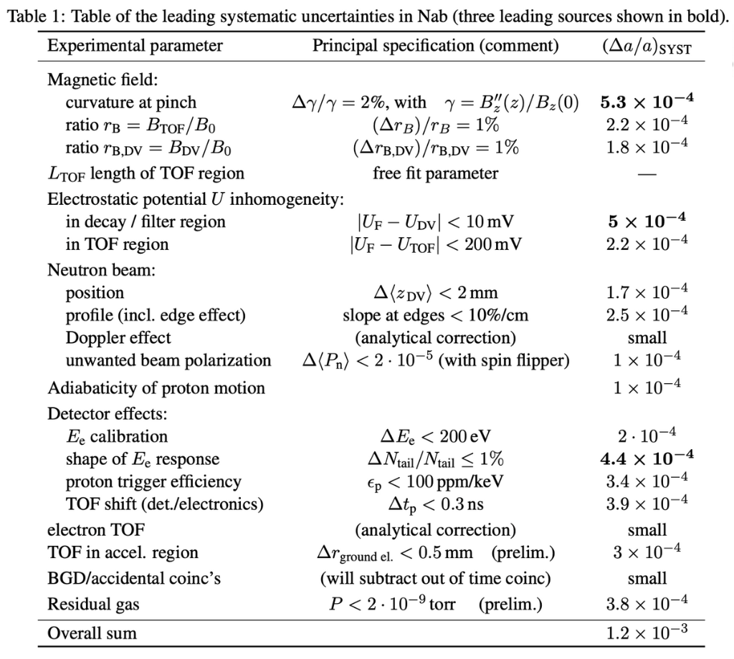
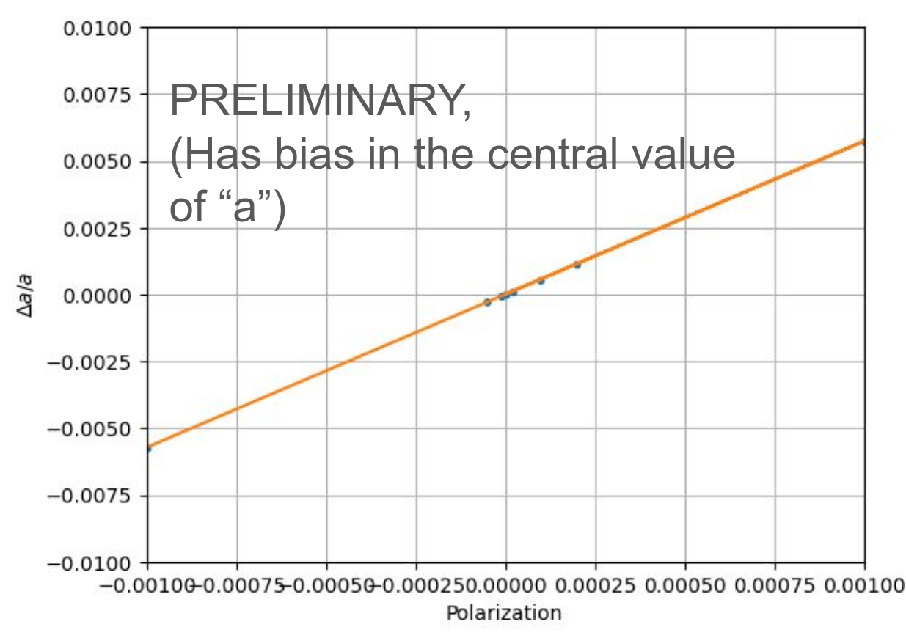
A reminder why this is important
Residual polarization in the beam will contribute to the systematic error in a
Frank and Chelsea simulated various beam polarizations and confirmed that we need P_{n} ≤ 2E-5 to achieve Δa/a < 1E-4

Slide 3
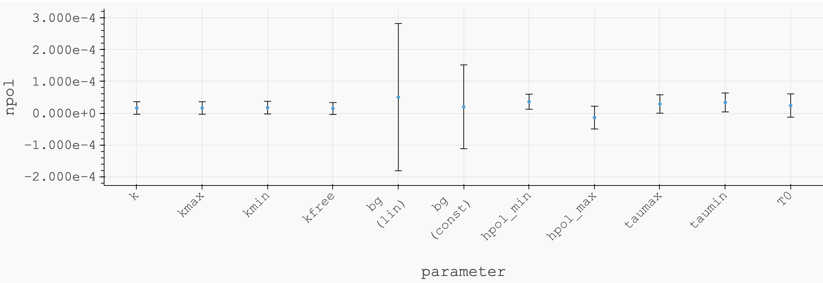
Previous polarimetry measurement (stolen from Hunter, stolen from Hitesh)
Most recent measurement was done in 2022 on 13B
We believe that the beam polarization is << 2E-4, but cannot say with full confidence
The neutron monitor that was used had unstable efficiency
H. Rahangdale

Slide 4
How to: evaluate systematics
We need a workshop on this
Open for discussion :)

Slide 5
A year in review

Slide 6
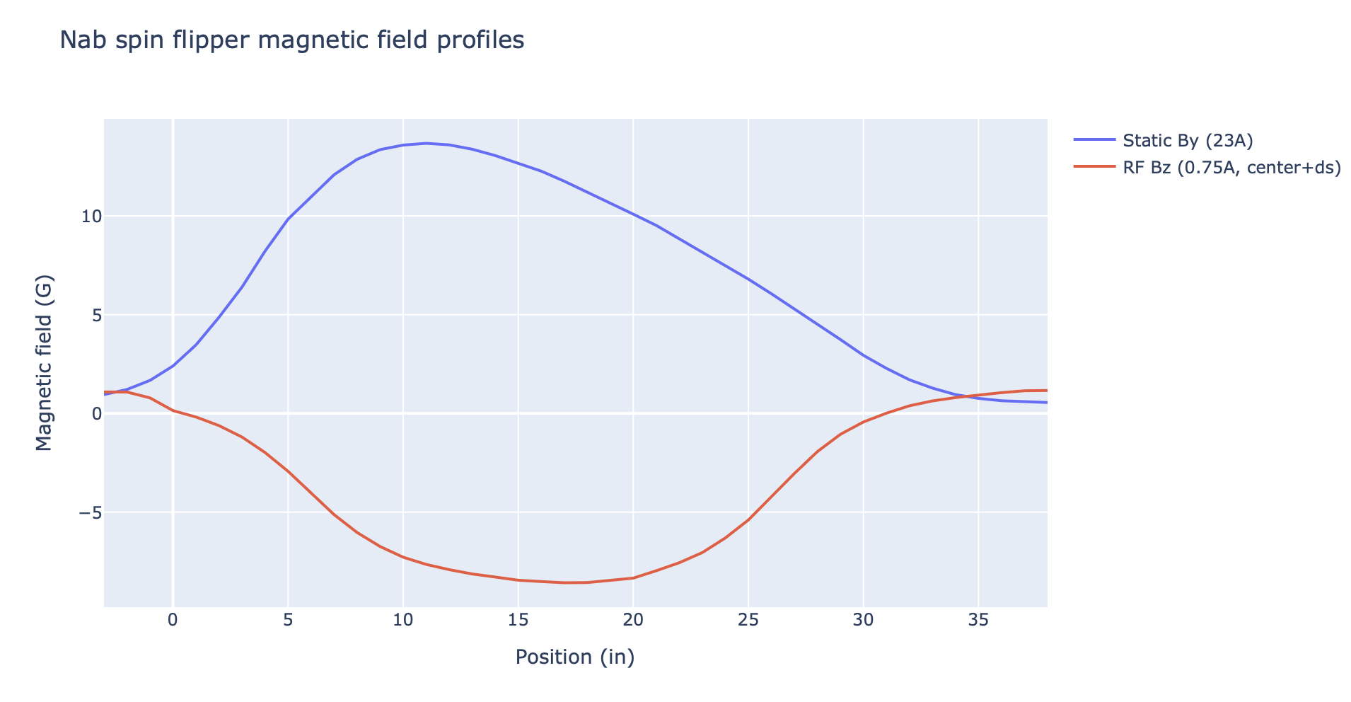
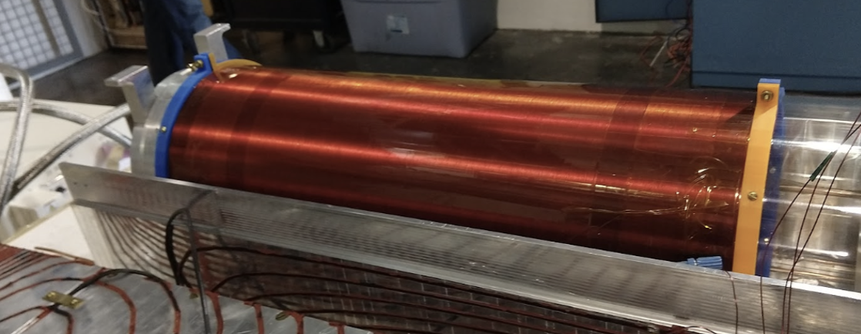
Where we were last year
Found that the RF field for Chelsea’s spin flipper was too long, so we planned to shorten it and take it to HFIR for one last test

Slide 7
2025 Accomplishments (overview)
Finished characterizing Chelsea’s spin flipper at HFIR
Tested a new-to-us spin flipper at HFIR, the MFSF
Designed the RGSF
Started building and testing the RGSF

Slide 8
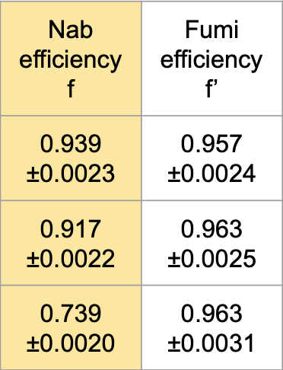
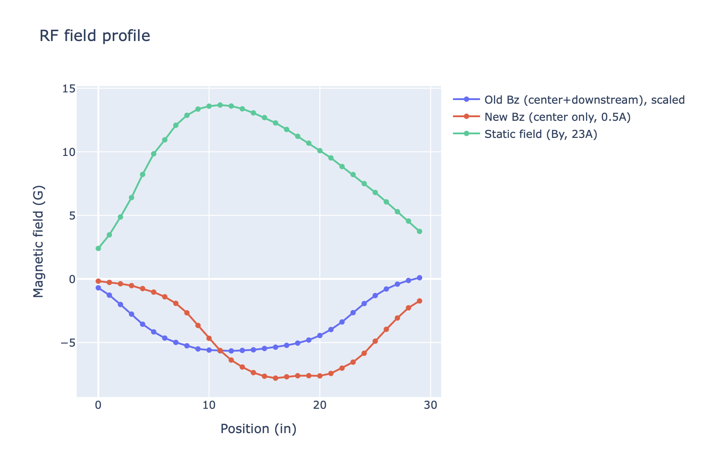
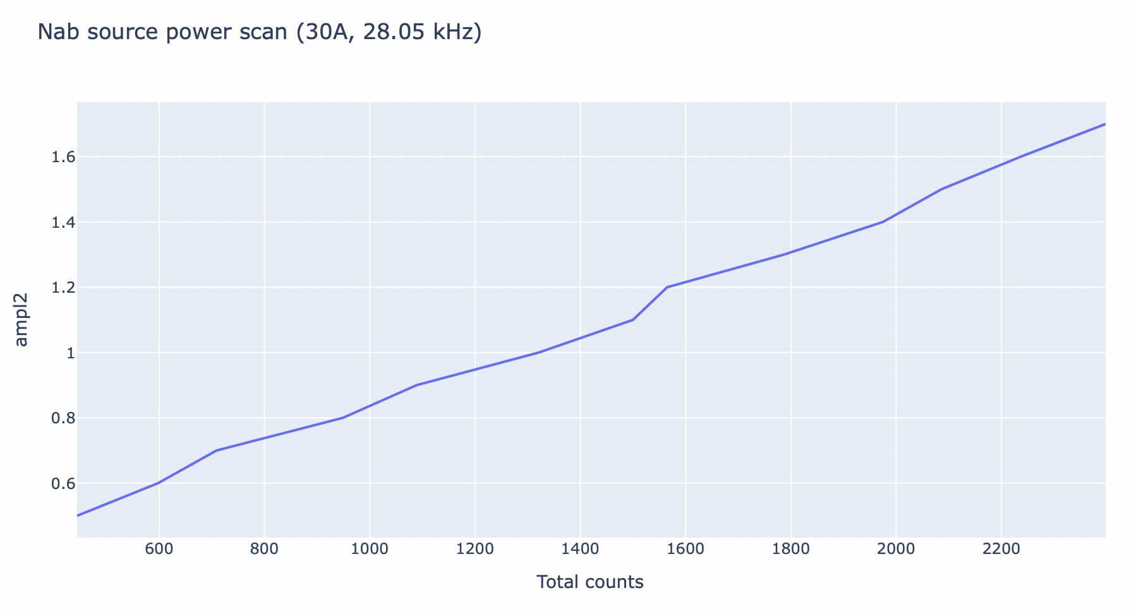
Final CG4B tests with Chelsea’s spin flipper
Where we want to flip

Slide 9
A fun addition to our CG4B measurements: The MFSF
AFP spin flipper
Uses permanent magnets as a static field
Excellent matching circuit for RF coil
Resonance frequency fixed at 290 kHz with a bandwidth of about 10 kHz
Conclusions from previous characterization tests (2023/2024)
Stable with a 2 cm diameter beam at 4.25 Å
Pickup coil response at center of beam was 1.05 G/V
Improvements could be made by adjusting the permanent magnets and increasing power (not sure what maximum power is; they ran at 60 W)

Slide 10
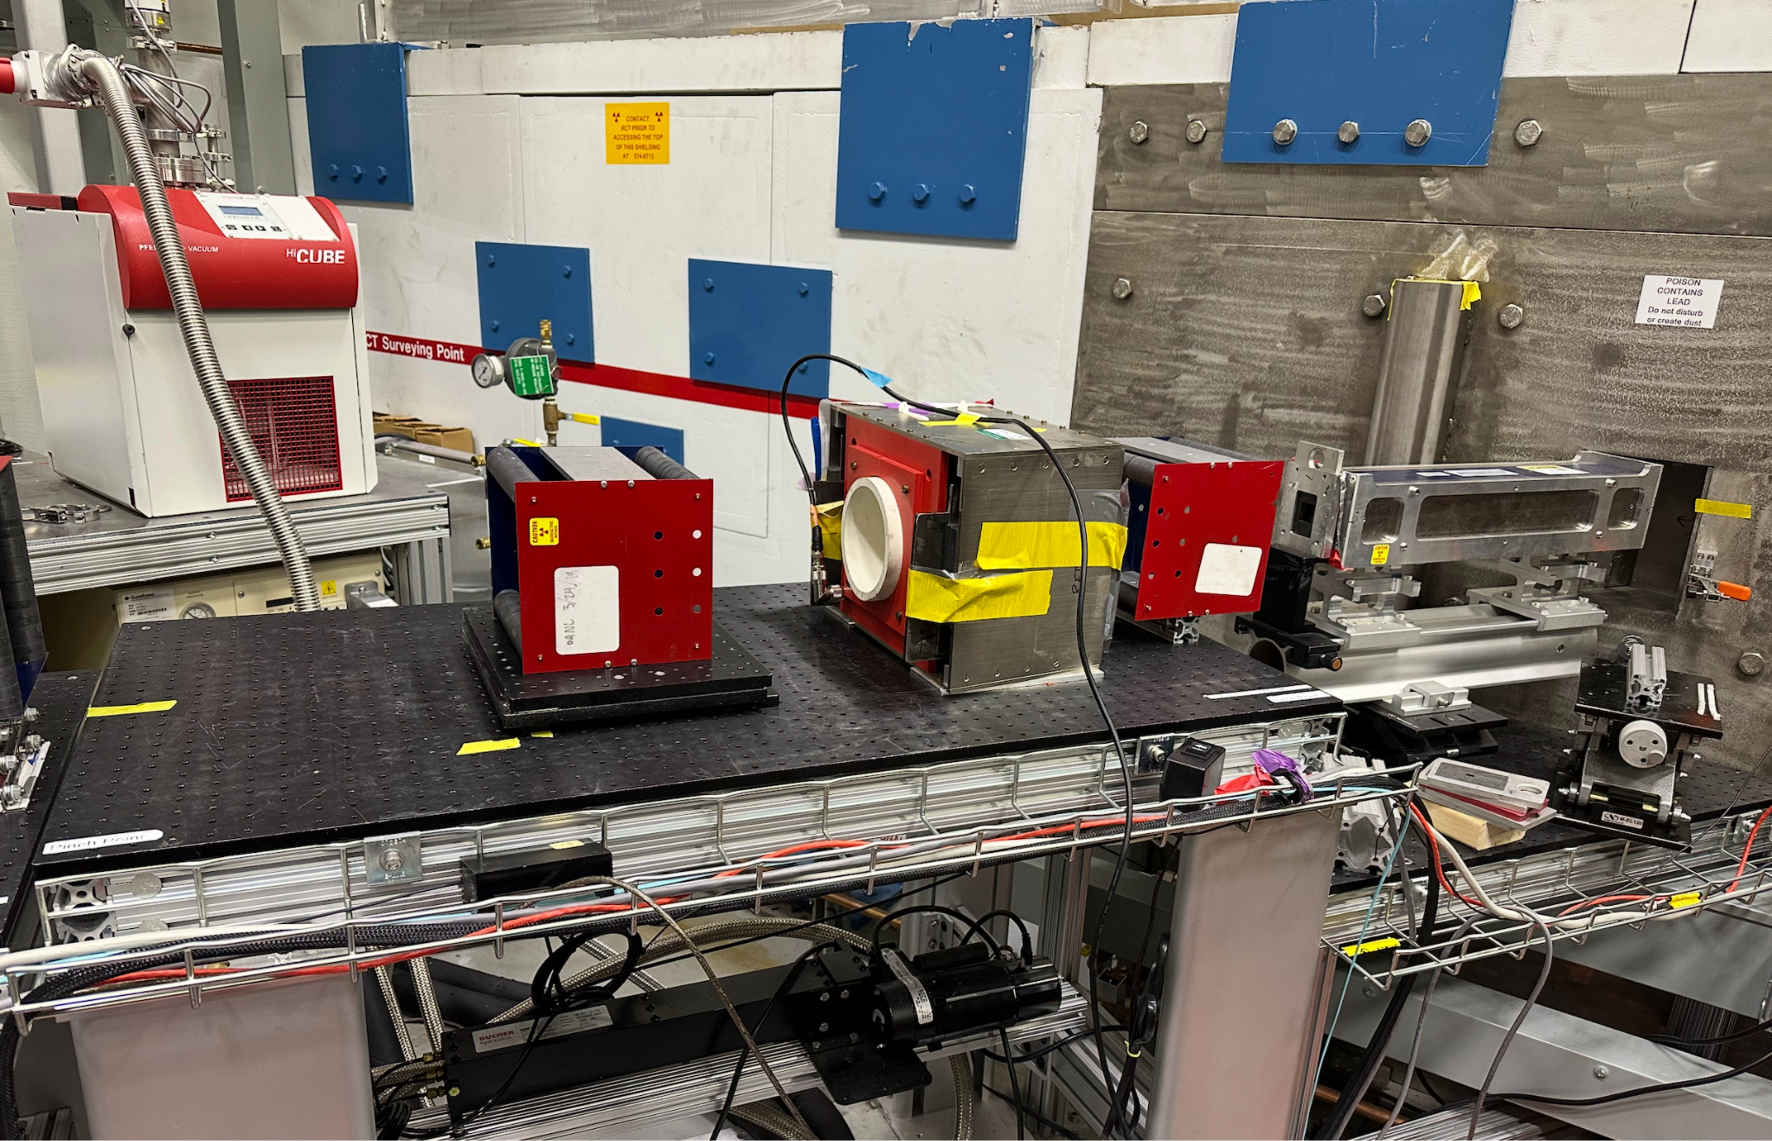
MFSF on CG-4B
Used 1”x1” collimated beam
Took about an hour start to finish to reach an efficiency of 98%
Position measurements did not show drastic decrease in efficiency
We ran with 296 kHz with 84 W
120 G at entrance of flipper
90 G in center
~ 50 G at exit
98.7% efficiency

Slide 11
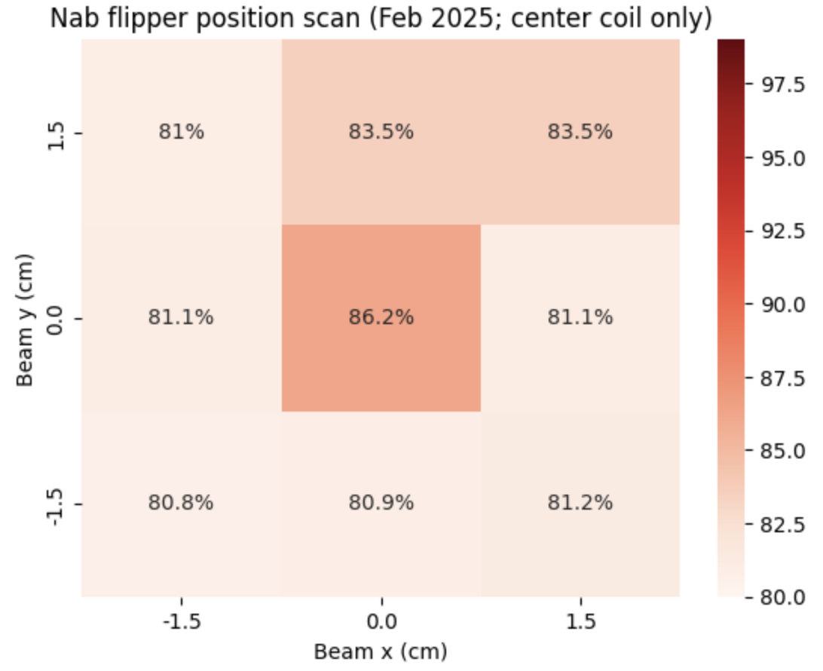
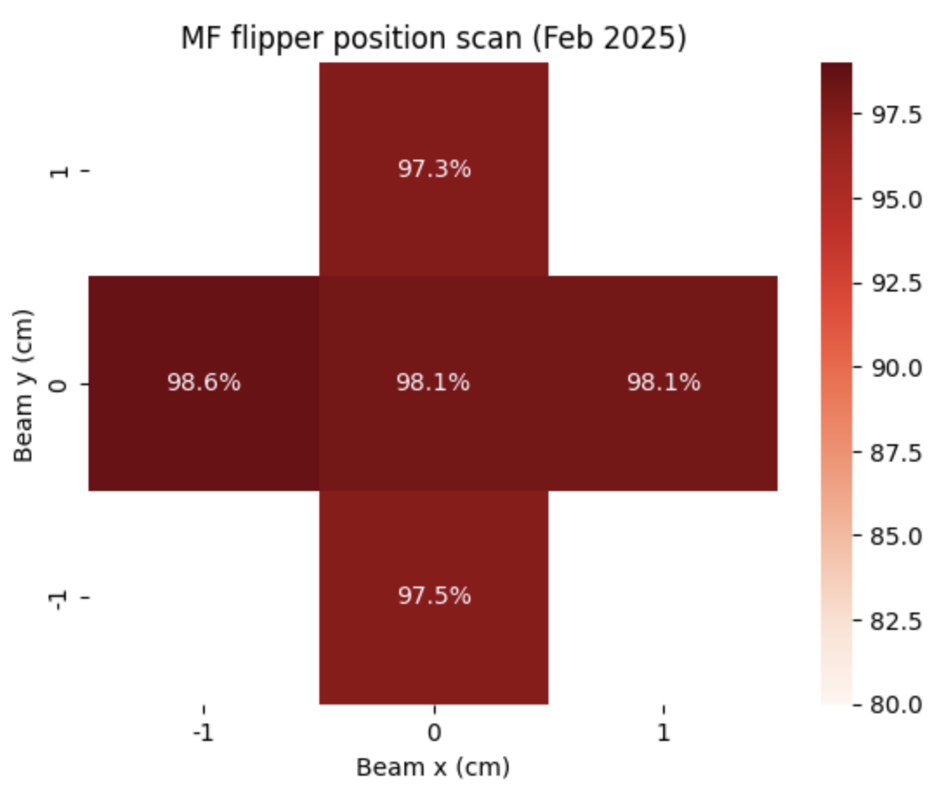
Comparison between Nab and MF flippers
(Reduced power)

Slide 12
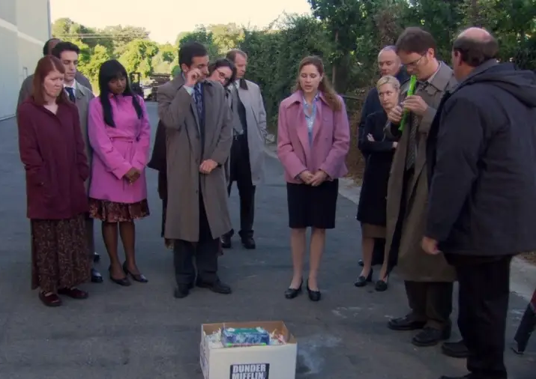
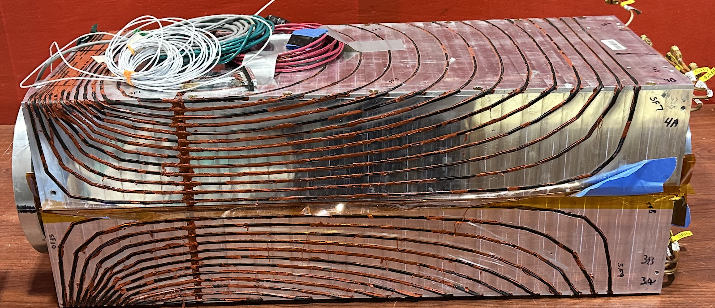
2025 CG4B conclusions
Chelsea’s spin flipper was not efficient enough for Nab’s uncertainty requirement and was not capable of reaching the power it required
A new spin flipper would need to be built

Slide 13
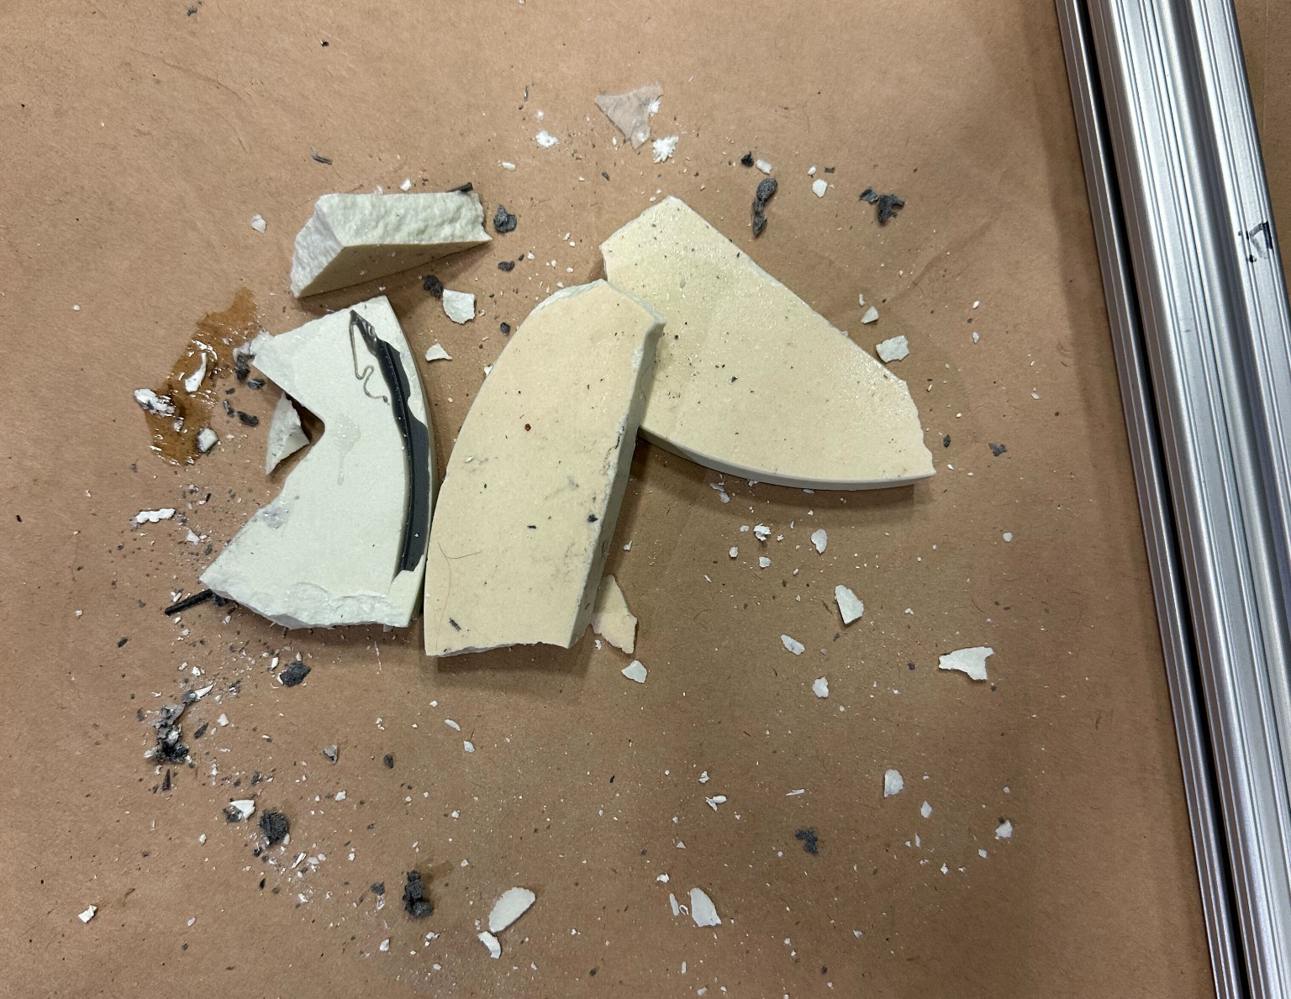
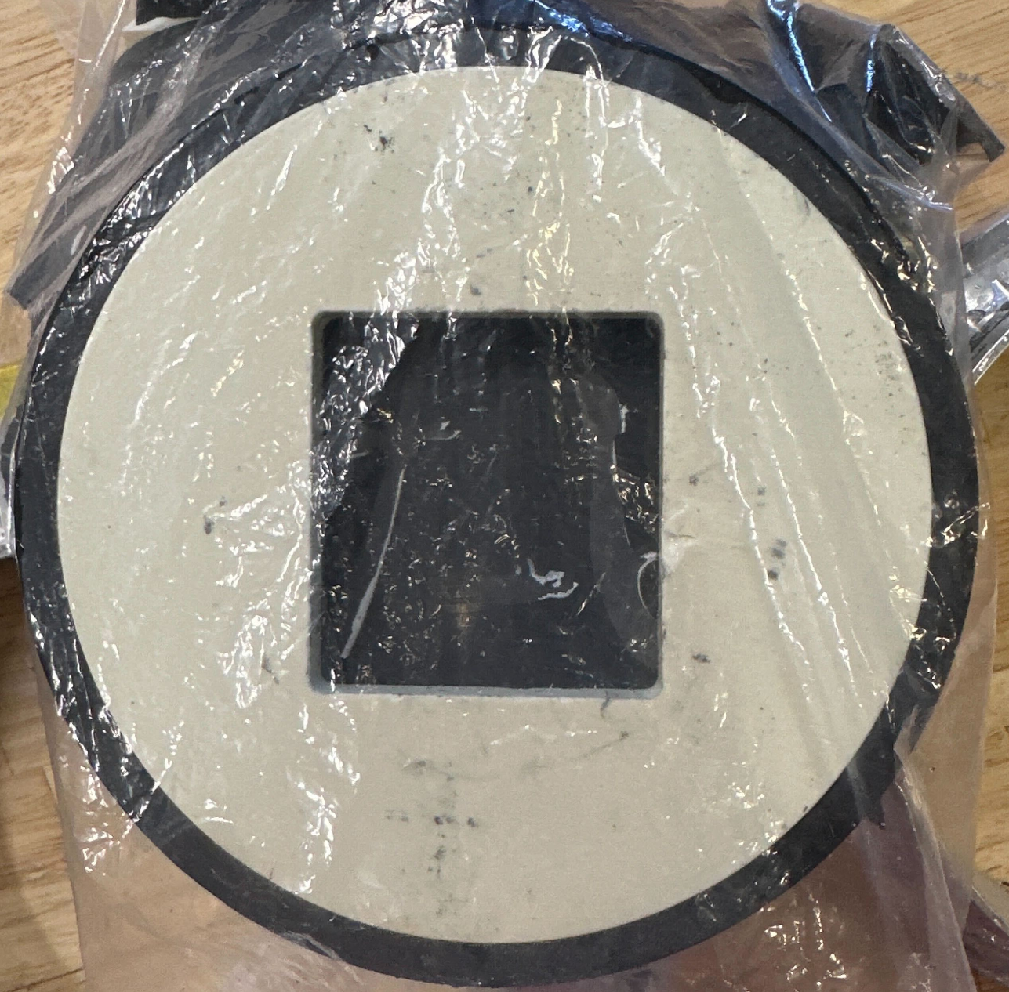
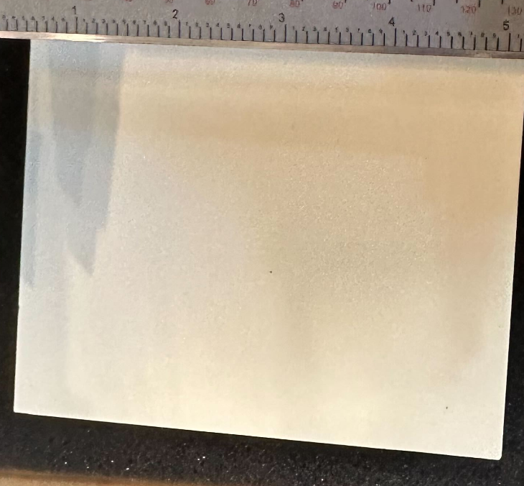
A bountiful harvest
We were able to harvest the neutron collimators from Chelsea’s spin flipper
One broke :( but we have the remaining piece that is intact as well as an additional piece of material that we have taken to the ORNL machine shop

Slide 14
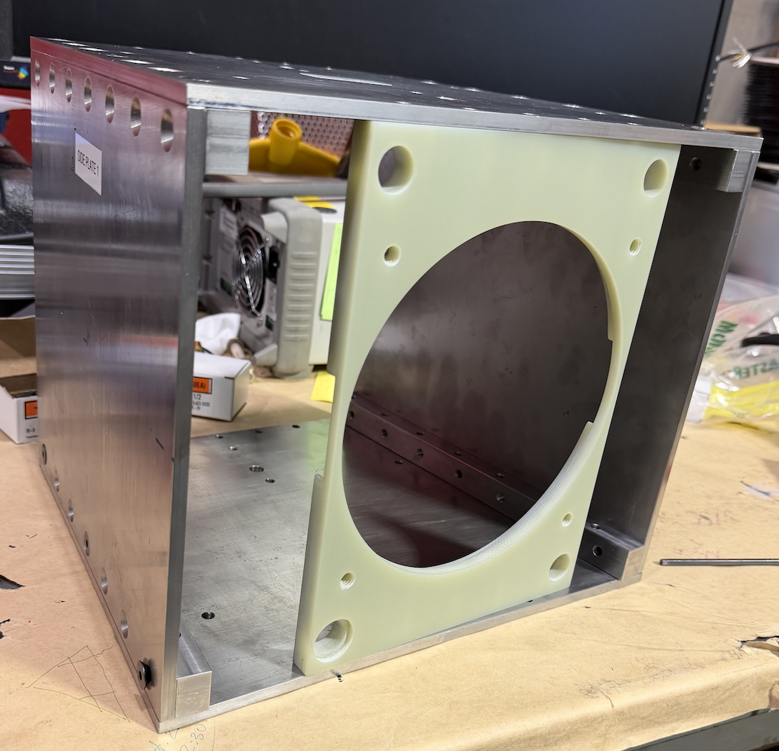
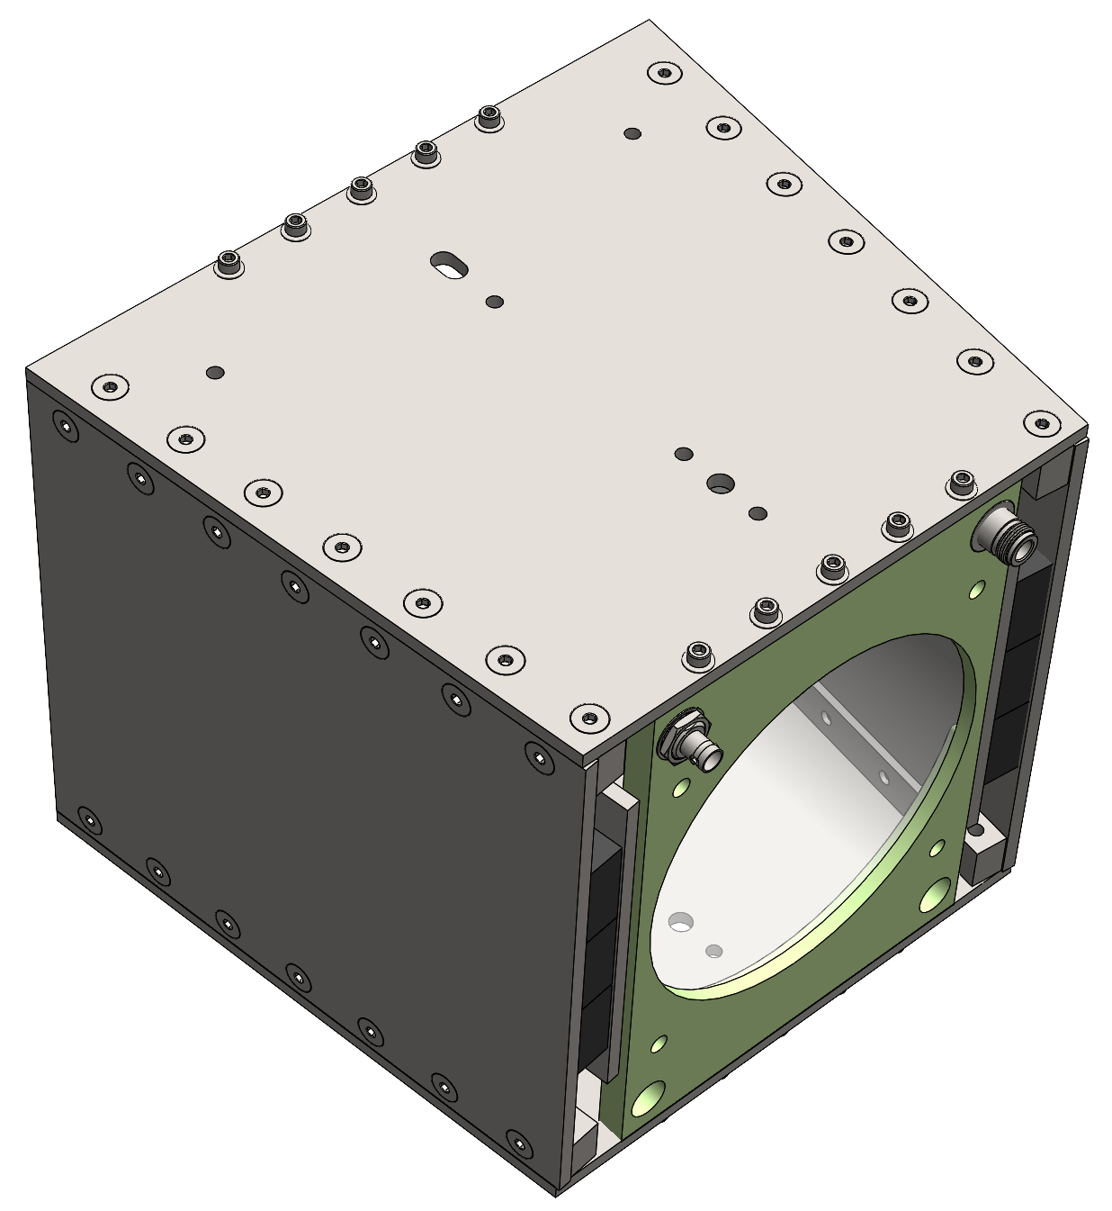
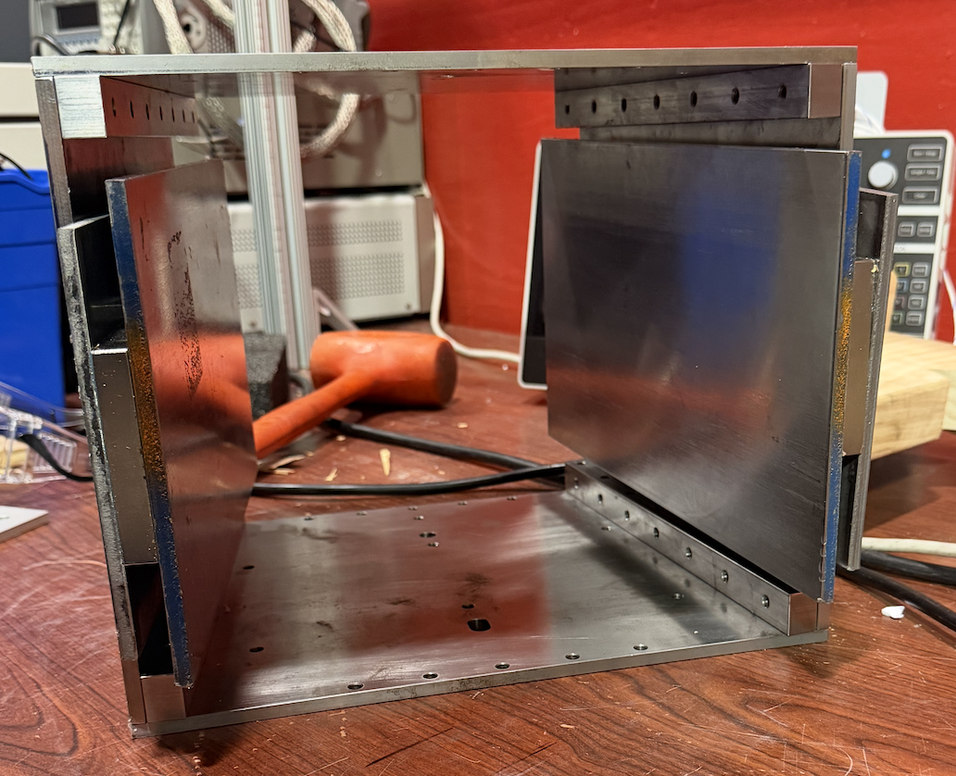
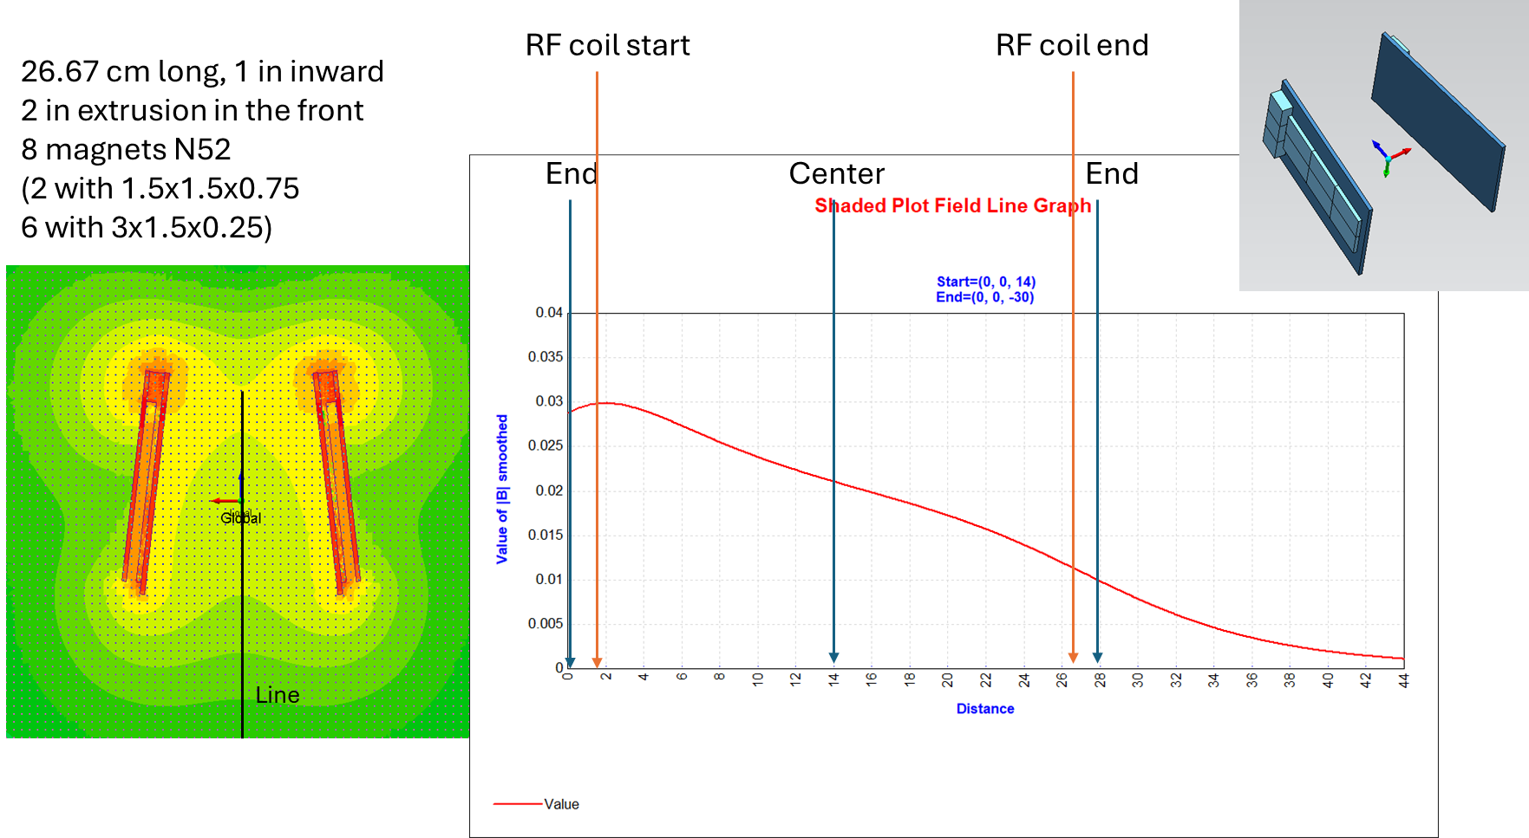
Introducing: the RGSF
Based on the MFSF
Uses 1018 cold-rolled steel
N52 magnets create the static field
RF coil will be wound around an acrylic tube that the G10 feeds through

Slide 15
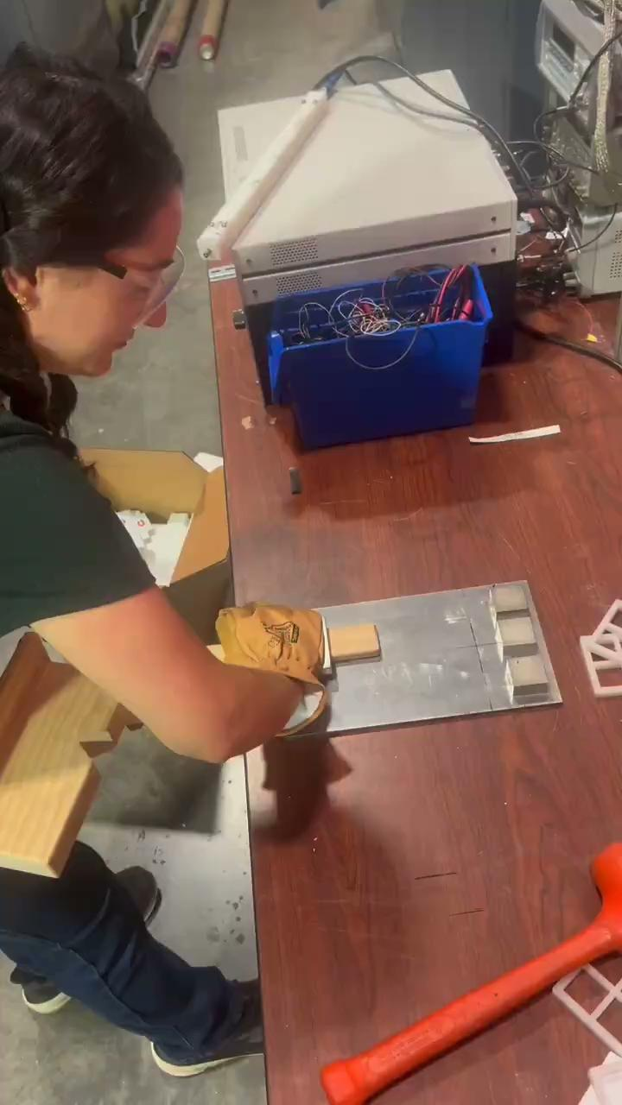
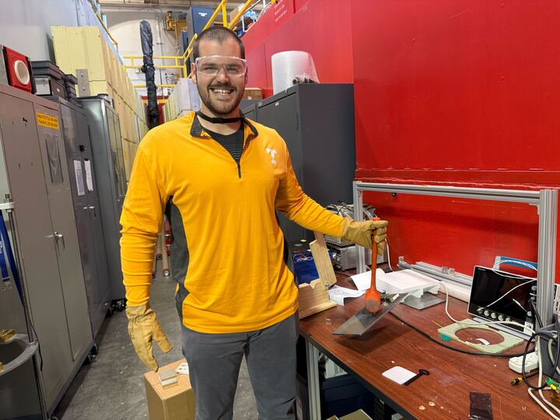
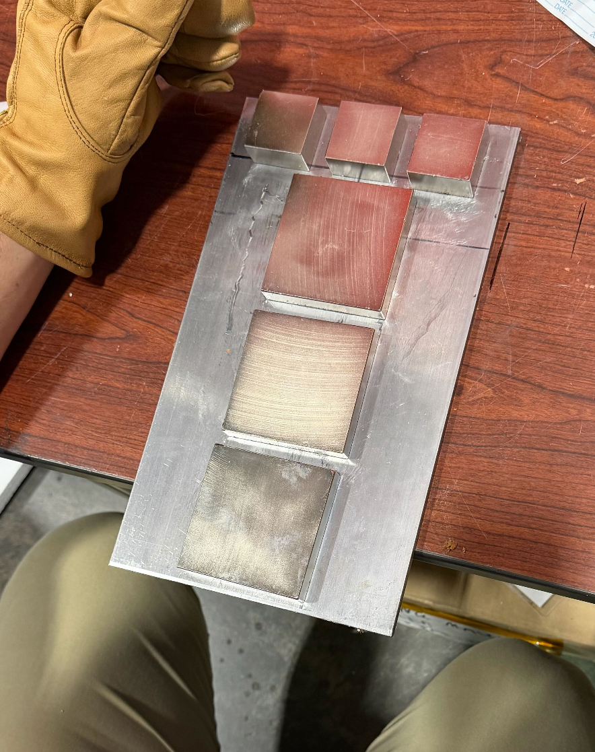
The permanent magnets deserve their own slide :)
These magnets are STRONG
Configured to make a smooth gradient field

Slide 16
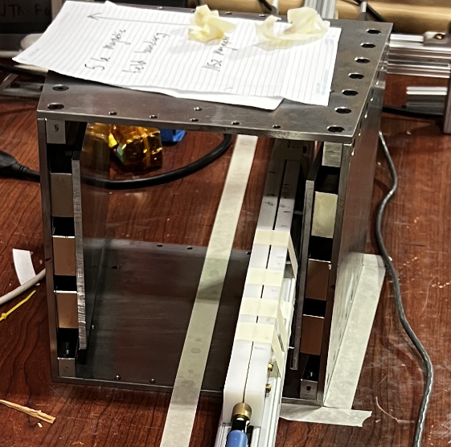
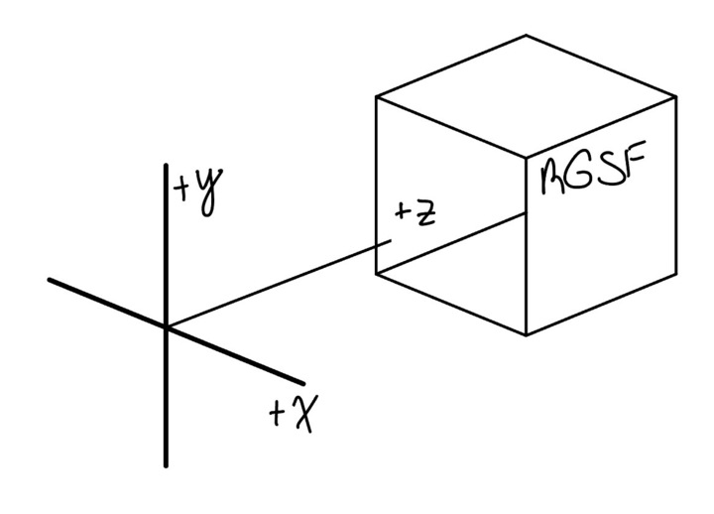
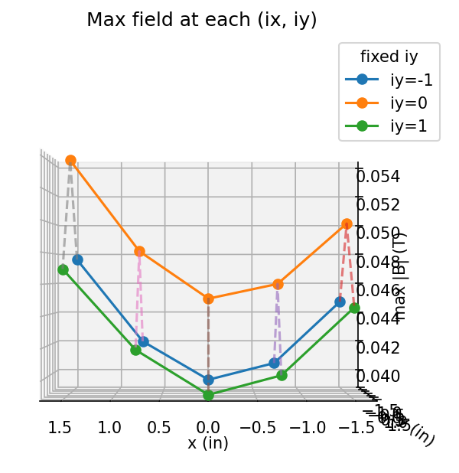
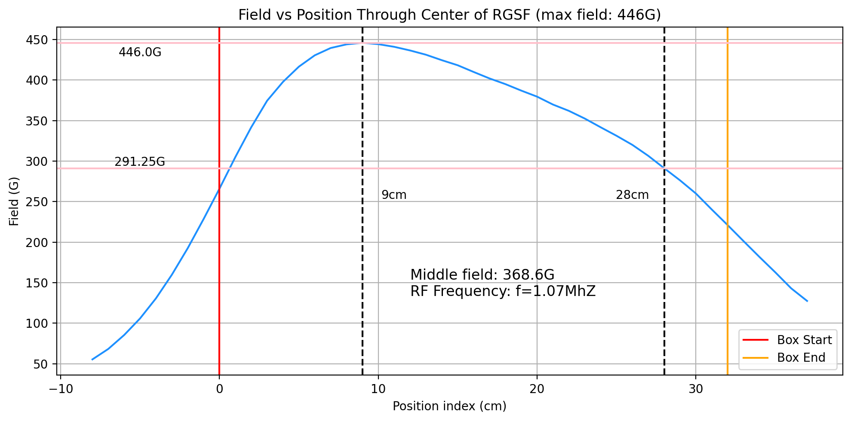
The static field
Measured using a 3-axis Hall probe
Tried to align magnets the best we could
Measured center and off-axis coordinates
All pictures stolen from Hunter

Slide 17
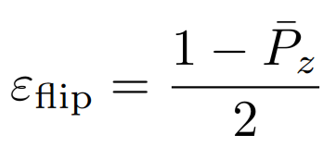
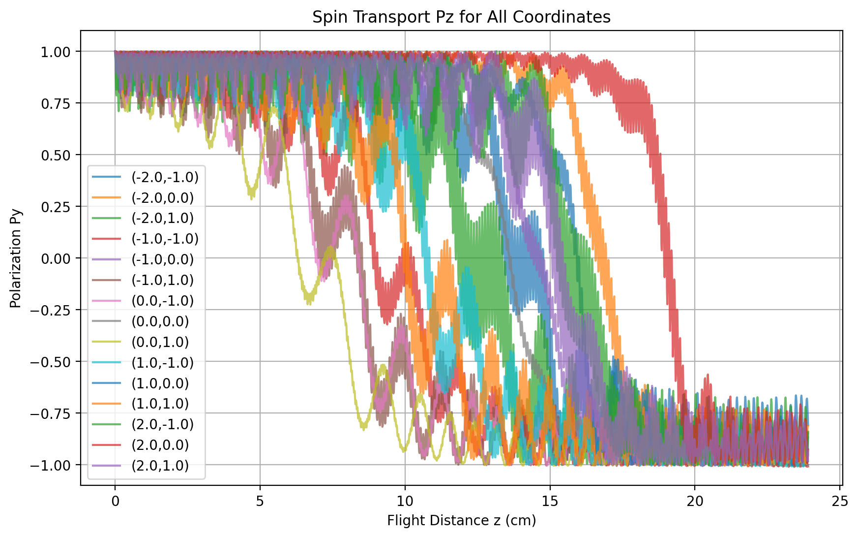
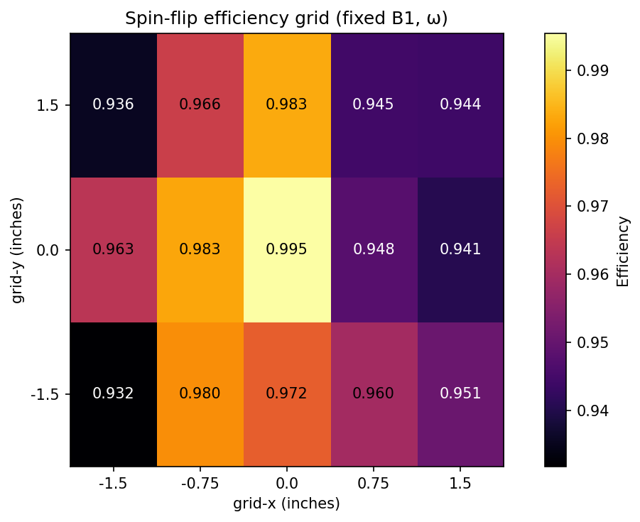
Spin transport stuff (stolen from Hunter)
Neutron wavelength: 4 Å, RF frequency: 1166.588 kHz, B1: 20.6 G

Slide 18
RGSF tasks: early 2026
Finish field characterization and RF assembly
Hopefully put spin flipper box on 13B for the magnetometry measurements!
Assemble spin flipper and take to HFIR for testing (February-March)
Final installation of spin flipper on 13B (mid March?)

Slide 19
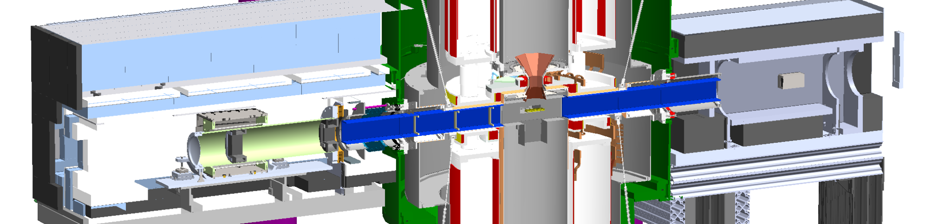
Other fun polarimetry characters
S-bender
RECEIVED EXPORT YAYYYYY
Neutron monitor
Will be installed in get-lost tube

Slide 20
Polarimetry Campaign Timeline
Spin Flipper Field Measurements
Simulation and Optimization of RF
12.01
~ 2 weeks
HFIR cycle
01.02
02.17
1 month
Spin Flipper Optimization and Running
2 weeks
Manufacture RF coil assembly
Characterize Spin Flipper Efficiency
03.20
3 months
01.16
3 weeks
1 month
Collimator and G10 installation at 13b
Installation of SF at 13b
02.01
2 weeks
03.13
1 week
Beam Polarization Measurement
03.04
SNS Neutron Production
TBD
1 week
06.22
SNS end of beam cycle
Present
Dec
Feb
Mar
April
Dec
Jan
May
Jun
2026
Analyzer and Monitor installation TBD

