Slide 1
DAQ System Upgrades
Andrew Mullins

Slide 2
DAQ 2 – Architecture
2.1
2.0

Slide 3
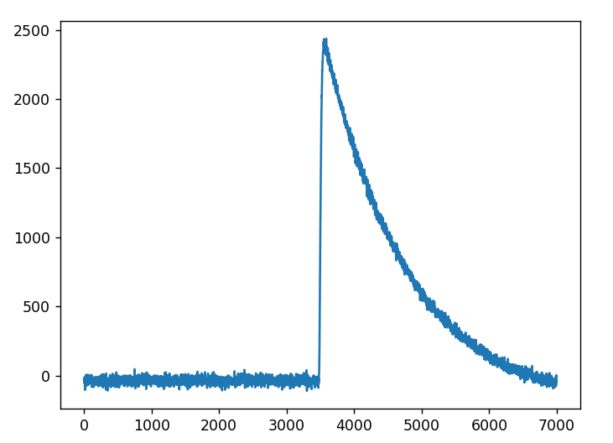
DAQ 2.0 – Current Status
Rewrite DAQ software in C++
FPGA Firmware still written in LabView
Implemented features
Run Manager
Handles all threads and FPGA controllers
FPGAs using DAQ 1.5 Firmware for now
Threshold settings updated without DAQ restart
Waveform readout
Controlled with Read Evaluate Print Loop (REPL)
Waveform recorded using DAQ 2.0

Slide 4
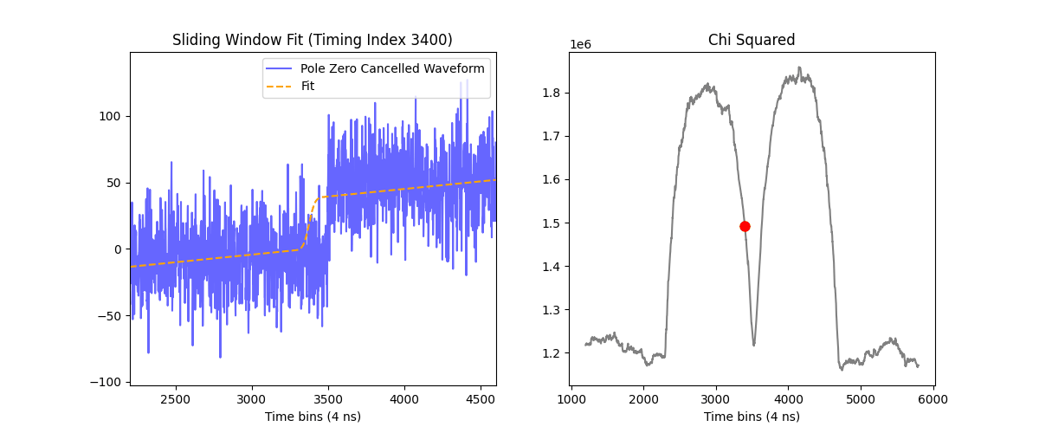
DAQ 2.0 – Future Plans
Control using ZeroMQ
DAQ computer to be stand alone (headless) and respond to commands from the slow controls computer
Seamless sub-run switching
DAQ 2.1 - Updated Firmware for Recursive Piecewise Polynomial (RPP) Filters

Slide 5
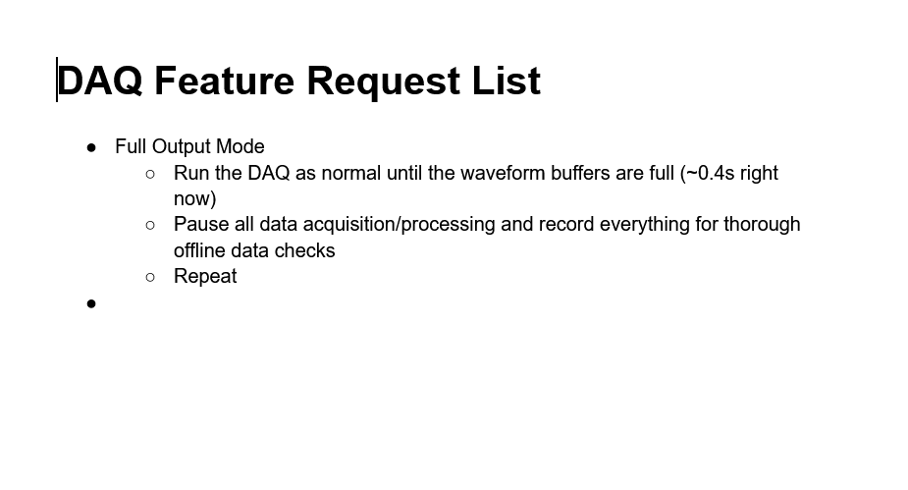
DAQ 2.0 – Suggestions/Discussion
DAQ 2.0 is still in development
Suggestions for features not available in current DAQ welcome
Suggestions Link

