Slide 1
in situ Polarized ³He Systems at ORNL
Chenyang “Peter” Jiang
Neutron Optics & Polarization Group
Neutron Technologies Division
12/17/2025

Slide 2
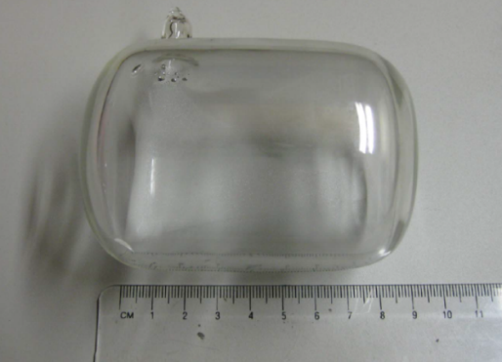
in situ Spin-exchange optical pumping system
A 3He cell
Laser and optics
A homogenous magnetic field
NMR/EPR
Heater and oven
Laser shielding

Slide 3
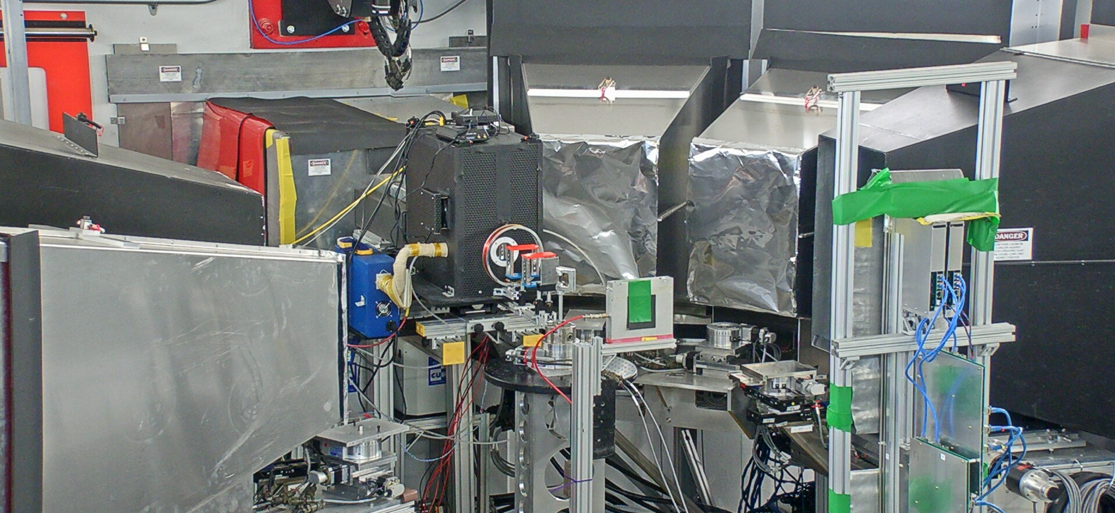
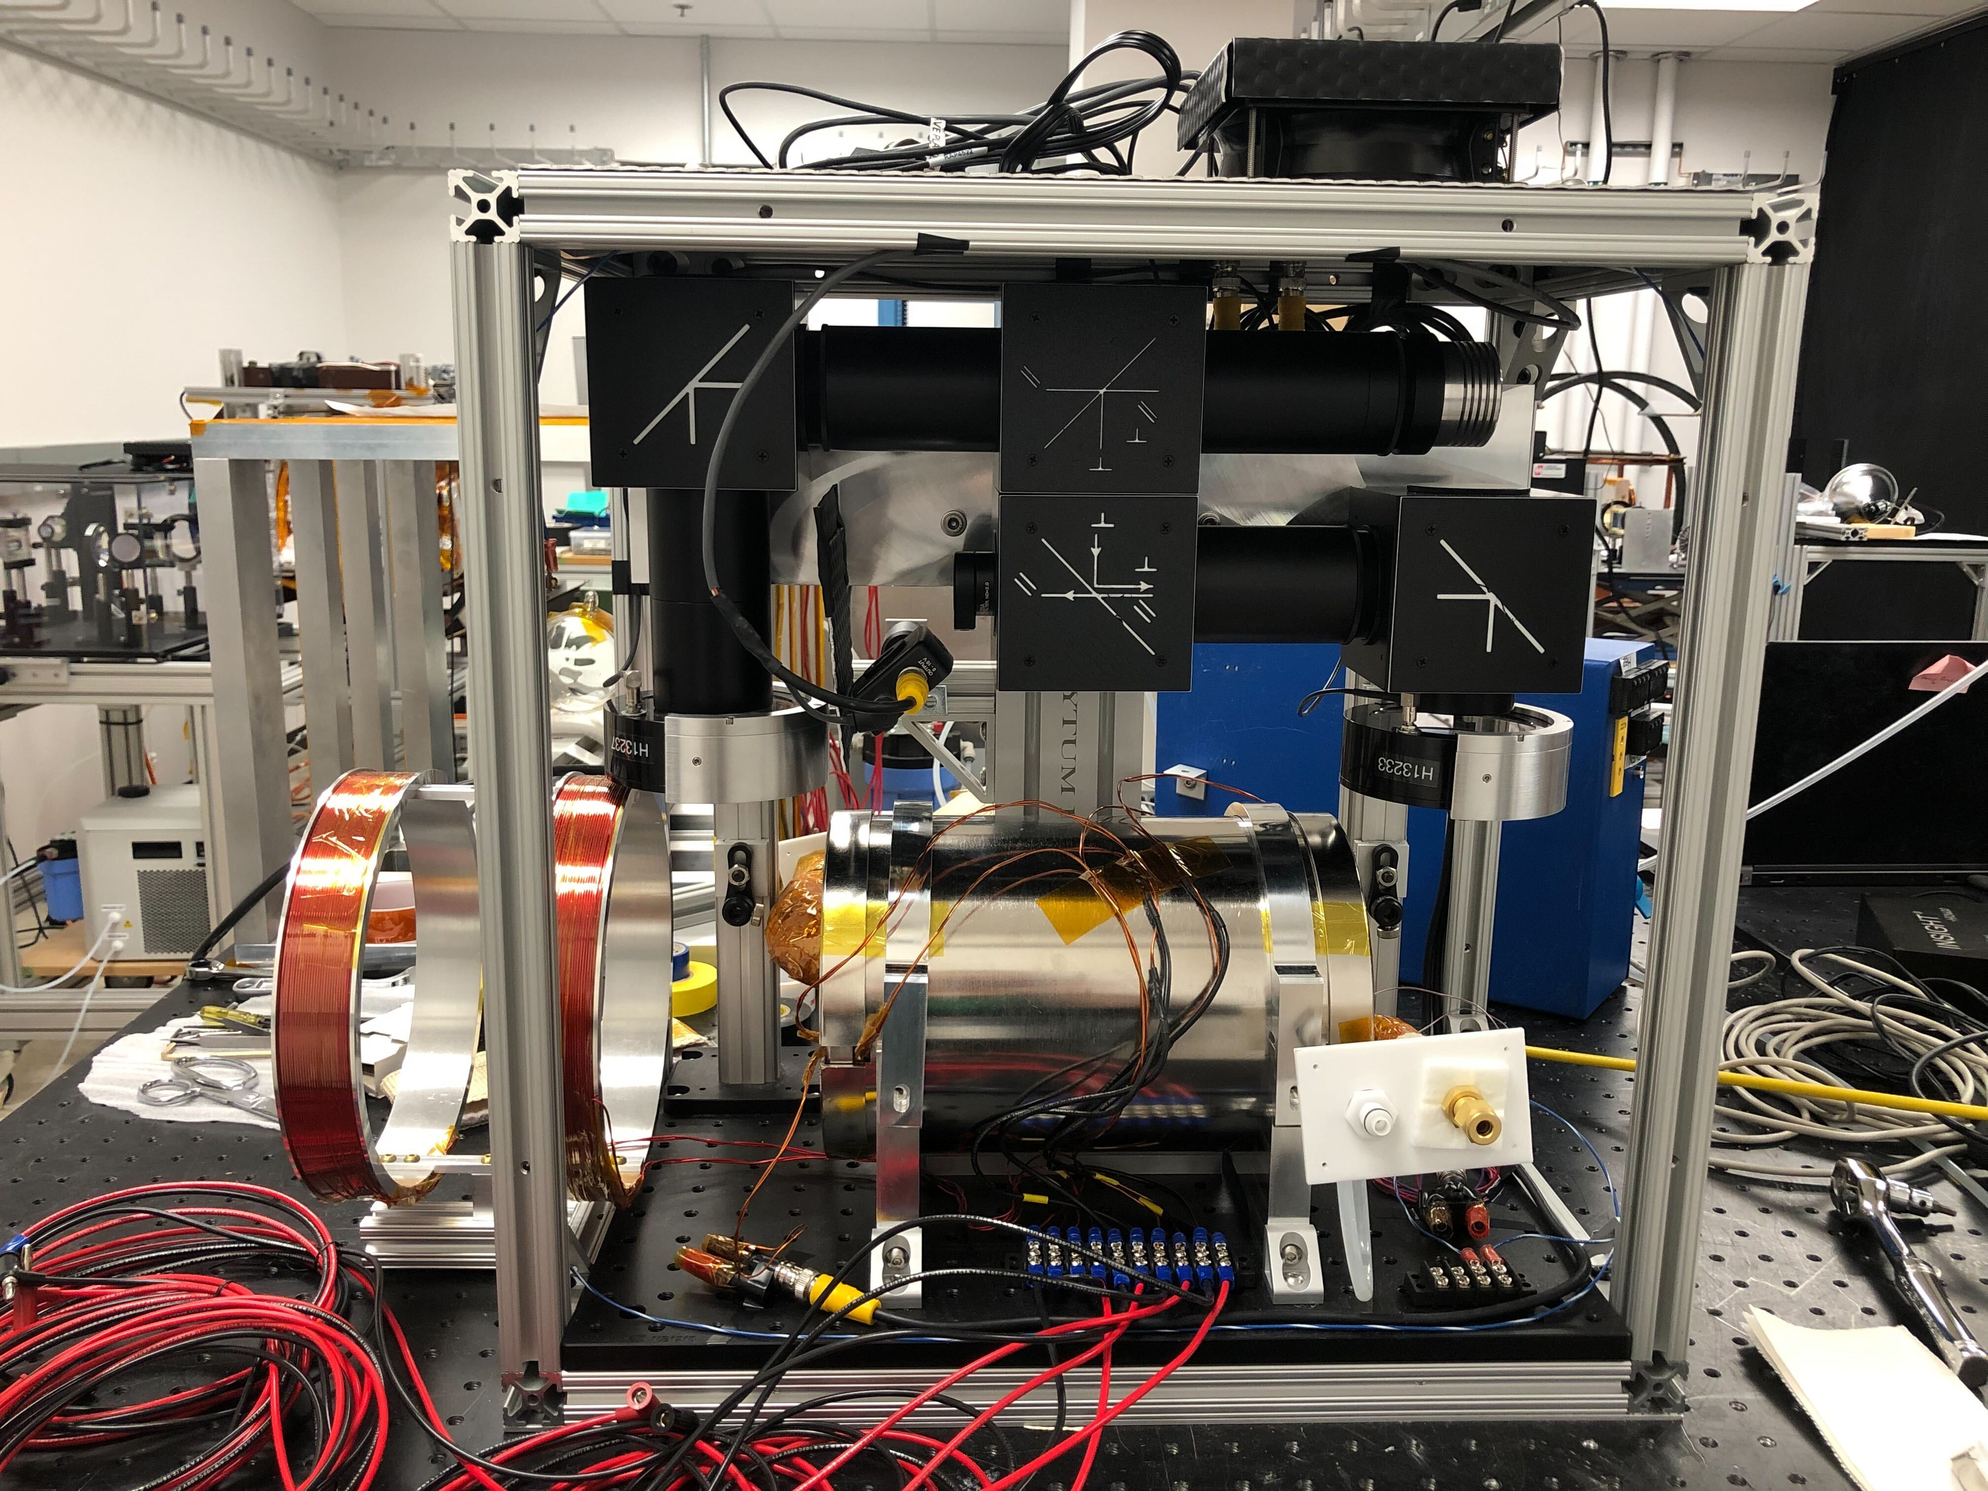
in-situ ³He polarizer for VULCAN at SNS
Applicable for wide range of wavelength (~0.5 – 5.6 Å), optimized for 2 Å
Compact and portable, 49 cm along the neutron beam
double-side pumping
~ 77% 3He polarized achieved, 6 cm OD 3He cell
Polarizer box
Heusler crystal
Beam monitor
³He detector
Online commissioning at VULCAN
In-situ ³He polarizer box

Slide 4
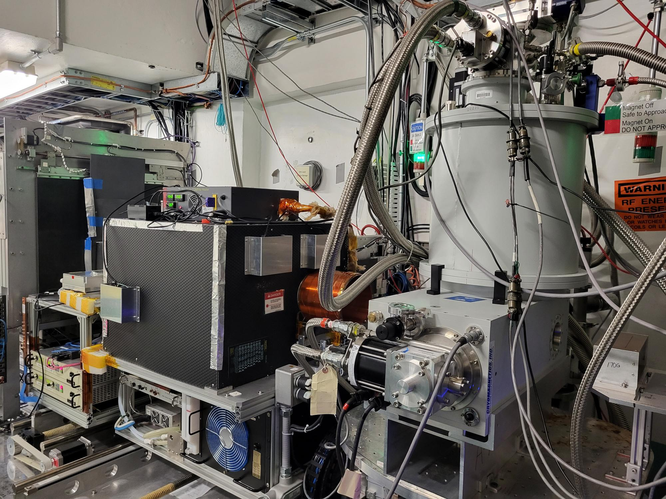
in-situ ³He analyzer for MAGREF at SNS
Working over 2.5 – 8 Å, optimized for 3 Å
Double side pumping
Up to 81% 3He polarization
8 cm OD cell
Work with magnetic field up to 4.8 T
69 cm along the neutron beam

Slide 5
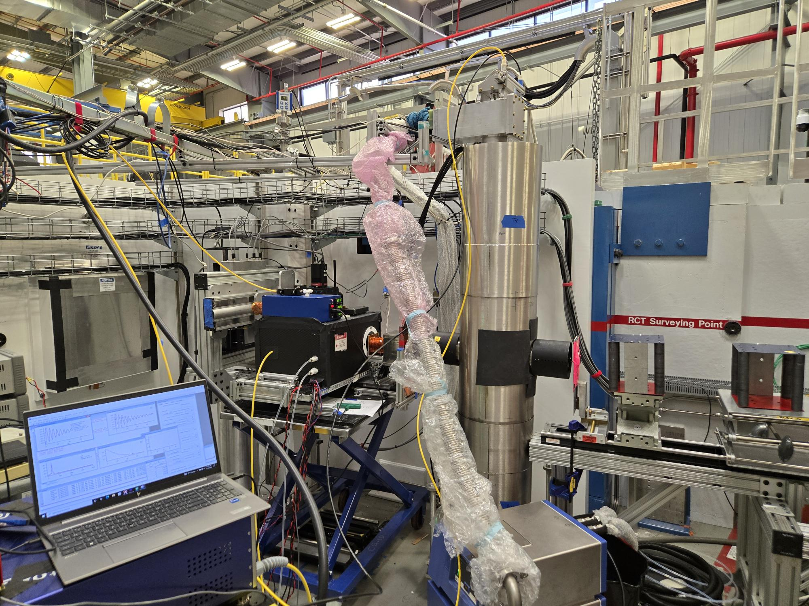
in-situ ³He analyzer for MARS at HFIR
Used for the white beam at MARS
Single side pumping
30 cm along the neutron beam
8 cm OD cell
~ 75% 3He polarization

Slide 6
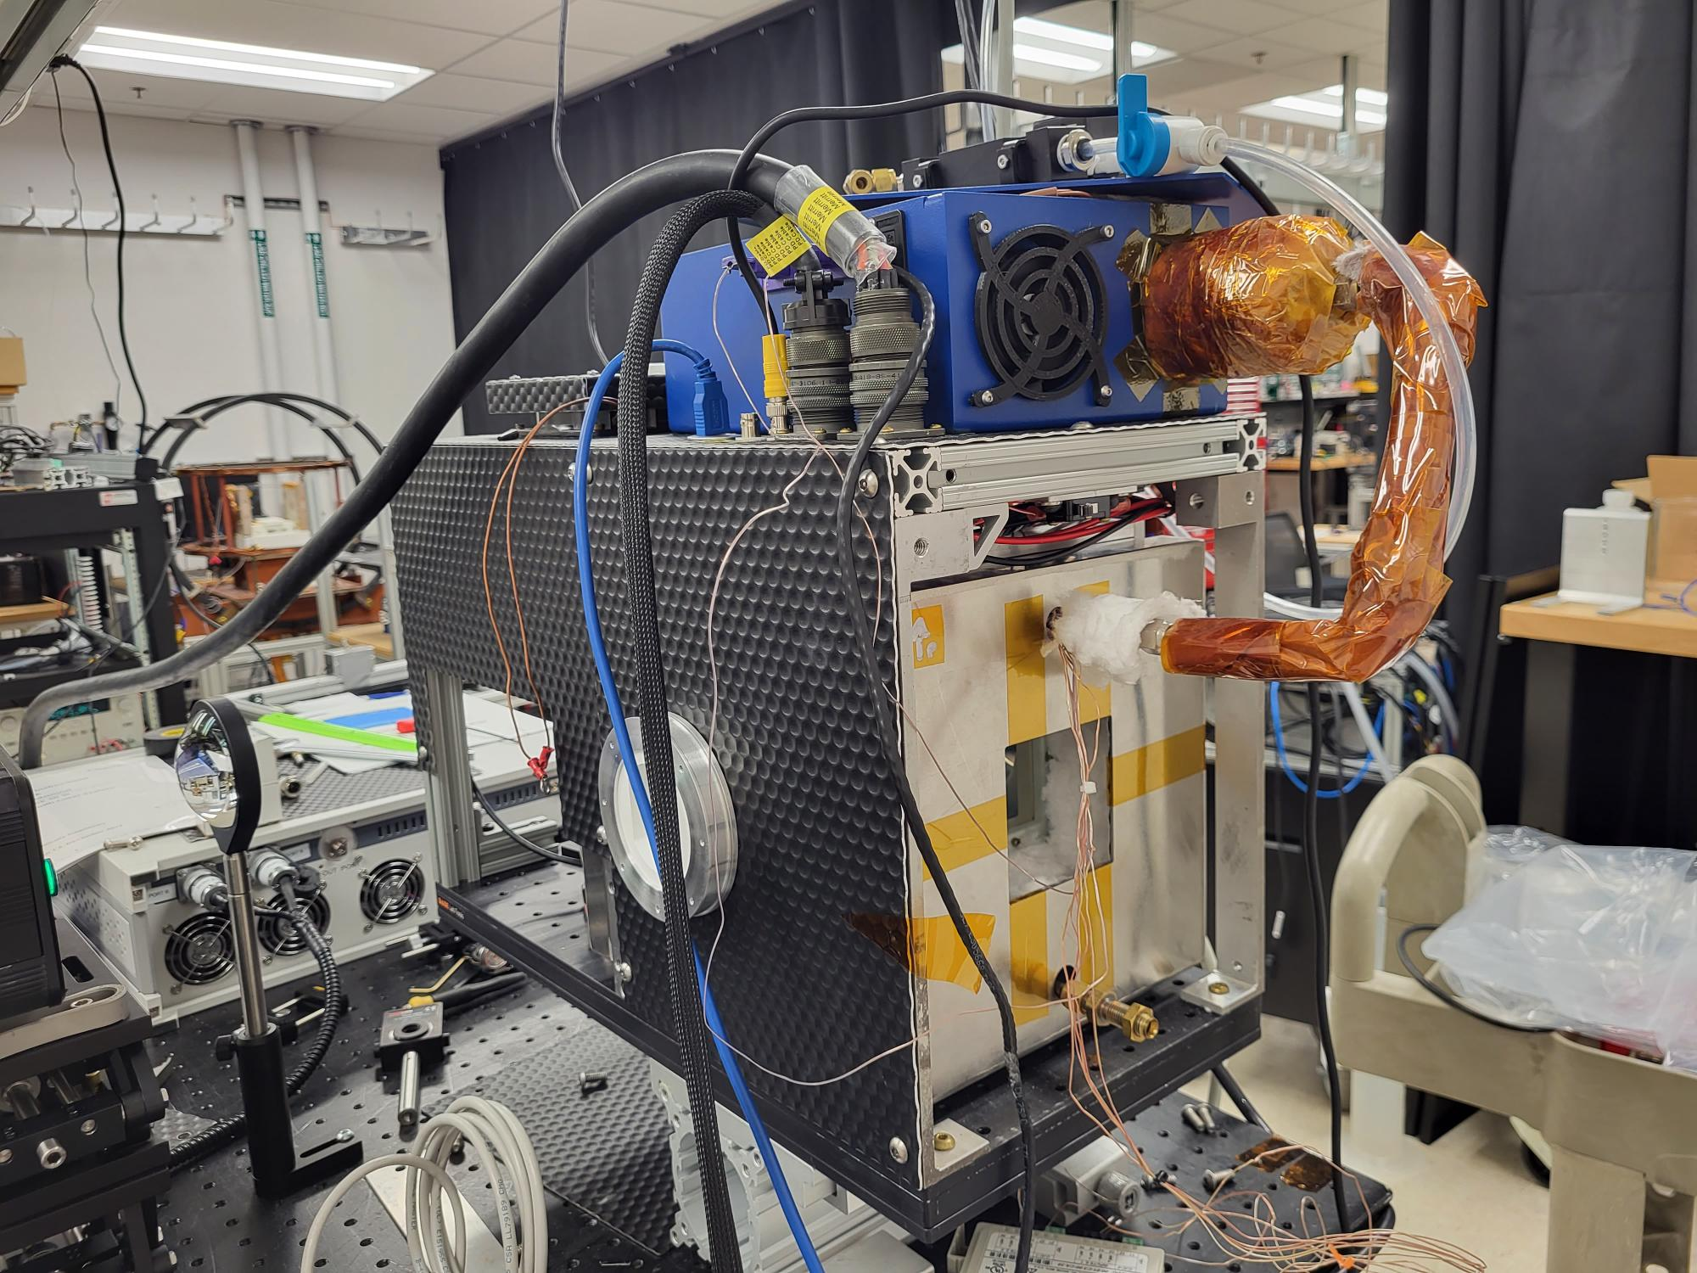
Micro in situ system Kavish worked on
Most compact system: only 25 cm along the neutron beam
Laser and neutrons perpendicular to each other
Mu-metal shielded four coil system to provide a very uniform field
770 nm laser used, but didn’t achieve good polarization

Slide 7
Neutron beam effect, should we care?
neutron beam-induced alkali-metal spin relaxation
Scale approximately with square root of flux
Lower the alkali metal polarization
Negligible for low to moderate flux
Can be mitigated with high power spectrally narrowed laser
Do you care if 3He polarization drops 5% but stable?

