Slide 1
3He analyzer (polarizer) specs for pNAB
December 17, 2025
Wolfgang Schreyer
pNAB workshop 2025
Notes:
Accessing Title Slide Options
The standard ORNL presentation template includes five branded title slide layouts:
Title | Standard. The preferred layout for lab-wide and general presentations. Features a default aerial photograph of the lab.
Title | Custom Image. Allows replacement of the default background with a custom full-slide image (16:9 or 4:3 landscape format).
Title | Custom Portrait Image. Supports inclusion of a custom 4:3 portrait image positioned next to the introductory text.
Title | Custom Landscape Image. Supports inclusion of a custom 16:9 landscape image positioned next to the introductory text.
Title | Text Only. Offers additional space for longer titles and multiple presenters.
Additional Lab-approved title slides specific to directorates and user facilities are available in PowerPoint under the following folders: Custom Title Slides and User Facility Templates, located in Presentation Templates.
Custom Title Slide Guidelines
Image Rights. Any custom images, graphics, or photography must be owned by ORNL or used with documented permission from the original creator or source.
Appropriate Image Use. Select images that work well with the layout. Ensure the focal point of the image is not obscured by the title text and white overlay box.
Relevance and Impact. Visuals are a key element of effective communication. Whenever possible, use imagery that enhances the message of your presentation and reflects ORNL’s mission and values.
Quality and Clarity. Use high-resolution images for clarity on large screens. Avoid overly complex or dark images that may conflict with the title text.
Text-Only Option. If no appropriate or approved imagery is available, or if imagery is not permitted for the subject matter, the Title | Text Only layout provides a clean, professional alternative.
Learn more about ORNL presentations
https://ornl.sharepoint.com/sites/branding/SitePages/presentations.aspx

Slide 2


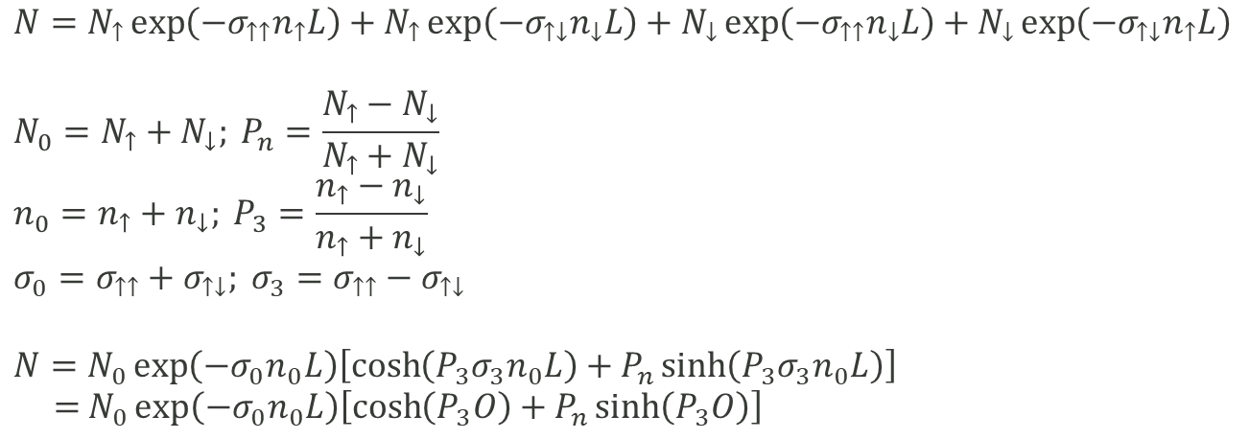



Polarized 3He gas can analyze neutron polarization
$$L$$
$$N=N_{↑}\exp\left(−σ_{↑↑}n_{↑}L\right)+N_{↑}\exp\left(−σ_{↑↓}n_{↓}L\right)+N_{↓}\exp\left(−σ_{↑↑}n_{↓}L\right)+N_{↓}\exp\left(−σ_{↑↓}n_{↑}L\right)$$
$$N_{0}=N_{↑}+N_{↓}; P_{n}=\frac{N_{↑}−N_{↓}}{N_{↑}+N_{↓}}$$
$$n_{0}=n_{↑}+n_{↓}; P_{3}=\frac{n_{↑}−n_{↓}}{n_{↑}+n_{↓}}$$
$$σ_{0}=σ_{↑↑}+σ_{↑↓}; σ_{3}=σ_{↑↑}−σ_{↑↓}$$
$$N=N_{0}\exp\left(−σ_{0}n_{0}L\right)\left[\cosh\left(P_{3}σ_{3}n_{0}L\right)+P_{n}\sinh\left({P_{3}σ}_{3}n_{0}L\right)\right]$$
$=$ $N_{0}\exp\left(−σ_{0}n_{0}L\right)\left[\cosh\left(P_{3}O\right)+P_{n}\sinh\left(P_{3}O\right)\right]$
³He
$$n_{↑}$$
$$n_{↓}$$
Neutron detector
$$N_{↑}$$
$$N$$
$$N_{↓}$$

Slide 3

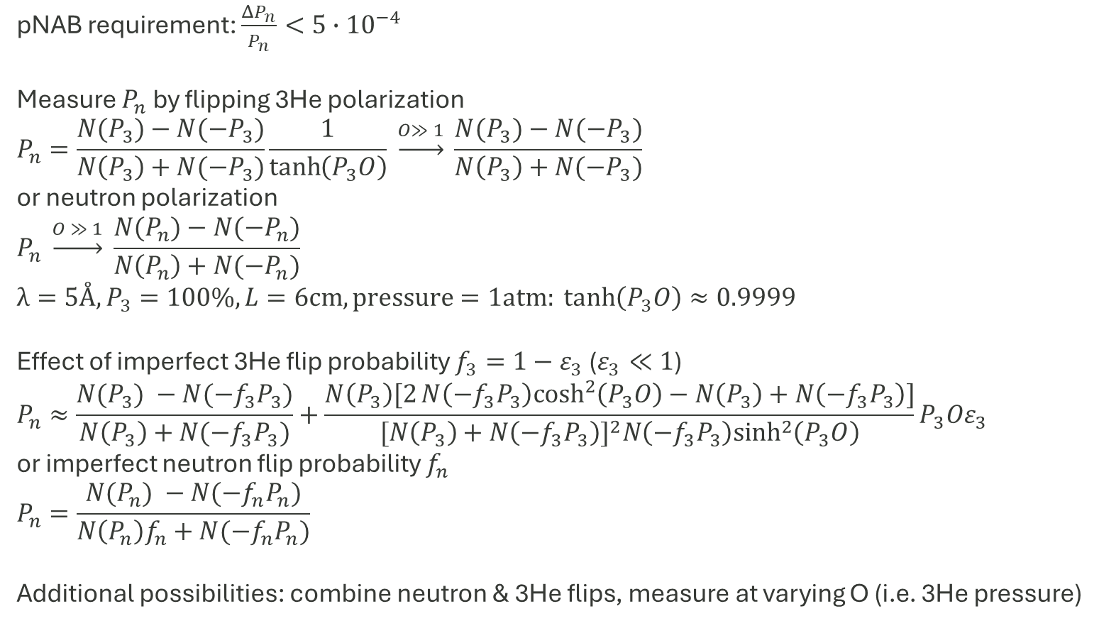

How to quantify specifications for analyzer
pNAB requirement: $\frac{ΔP_{n}}{P_{n}}<5∙{10}^{−4}$
Measure $P_{n}$ by flipping 3He polarization
$$P_{n}=\frac{N(P_{3})−N({−P}_{3})}{N\left(P_{3}\right)+N({−P}_{3})}\frac{1}{\tanh\left(P_{3}O\right)} \underset{→}{O≫ 1} \frac{N(P_{3})−N({−P}_{3})}{N\left(P_{3}\right)+N({−P}_{3})}$$
or neutron polarization
$$P_{n} \underset{→}{O ≫ 1} \frac{N(P_{n})−N({−P}_{n})}{N\left(P_{n}\right)+N({−P}_{n})}$$
$$λ=5Å, P_{3}=100\%,L=\text{6}\text{cm}, \text{pressure}=1\text{atm}: \tanh\left(P_{3}O\right)≈0.9999$$
Effect of imperfect 3He flip probability $f_{3}=1−ε_{3}$ ($ε_{3}≪1$)
$$P_{n}≈\frac{N(P_{3}) −N({−f_{3}P}_{3})}{N\left(P_{3}\right)+N({−f_{3}P}_{3})}+\frac{N\left(P_{3}\right)[2N\left({−f_{3}P}_{3}\right)\cosh^{2}\left(P_{3}O\right)−N\left(P_{3}\right)+N\left({−f_{3}P}_{3}\right)]}{{[N\left(P_{3}\right)+N\left({−f_{3}P}_{3}\right)]}^{2}N\left({−f_{3}P}_{3}\right)\sinh^{2}\left(P_{3}O\right)}P_{3}Oε_{3}$$
or imperfect neutron flip probability $f_{n}$
$$P_{n}=\frac{N(P_{n}) −N({−f_{n}P}_{n})}{N\left(P_{n}\right)f_{n}+N({−f_{n}P}_{n})}$$
Additional possibilities: combine neutron & 3He flips, measure at varying O (i.e. 3He pressure)
³He
$$n_{↑}$$
$$n_{↓}$$
Neutron detector
$$N_{↑}$$
$$N$$
$$N_{↓}$$

Slide 4
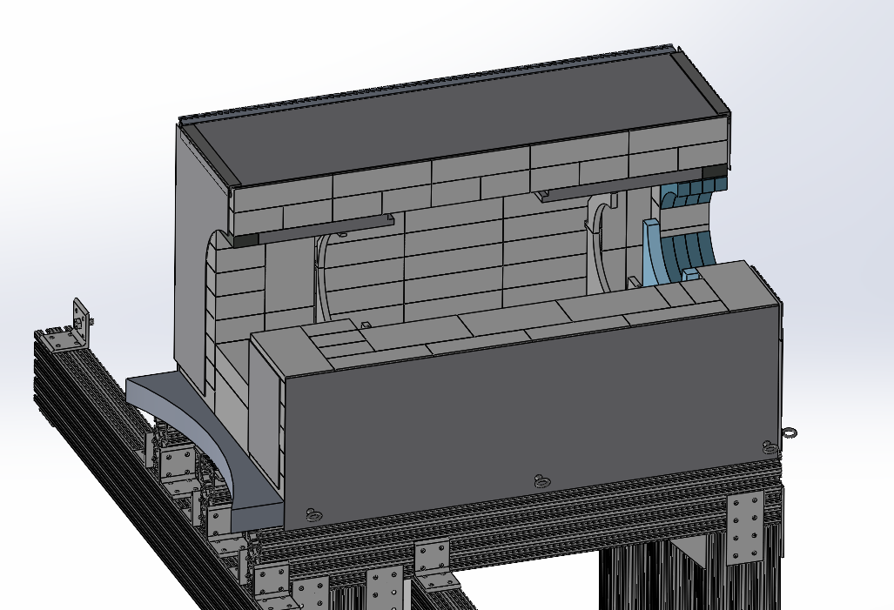
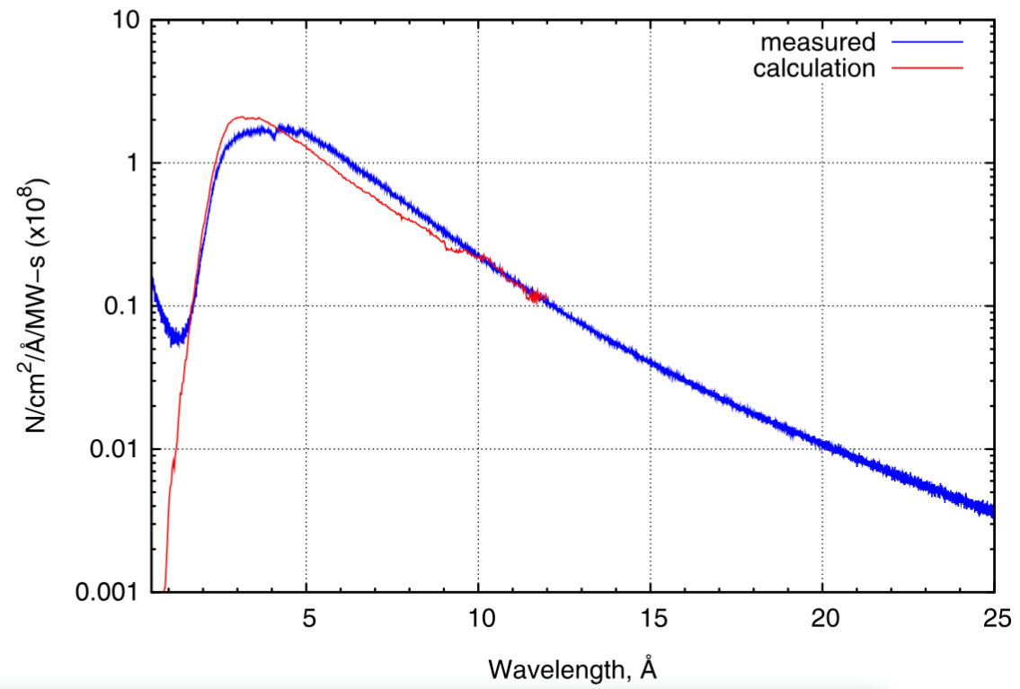
Dimensions
Available space in shield stack:
LxWxH 70cm x 30cm x 30cm
Beam cross section 7cm x 5.4cm

Slide 5



3He as neutron polarizer
Nab
Resulting neutron polarization:
$$P_{n}=\frac{N_{↑}−N_{↓}}{N_{↑}+N_{↓}}=\tanh\left(P_{3}O\right)$$
Large opacity $O$ gives better polarization but less transmission
➔ There is an opacity that maximizes pNAB statistical sensitivity
³He
$$n_{↑}$$
$$n_{↓}$$
Unpolarized
neutrons
$$N_{↑}$$
$$N_{↓}$$

