Slide 1
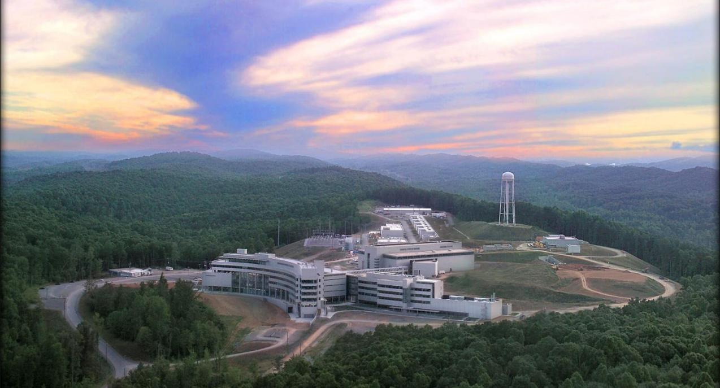


pNAB count rate estimate
Stefan Baeβler,
for the pNAB collaboration
Inst. Nucl. Part. Phys.

Slide 2
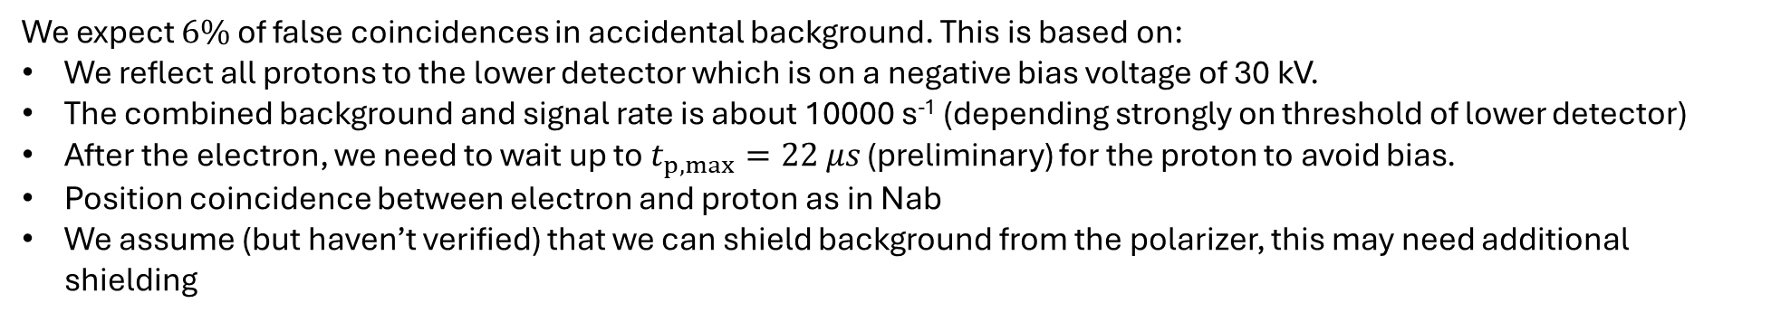
Count rate and background estimates for SSPV
The counting time is based on a count rate estimate of 250 decays/s @ 2 MW proton power. This count rate is based on:
Size of the decay volume: 160 cm³
Neutron decay density of 1.6 decays/s/cm³ @ 2 MW (estimate from Nab), which is based on a polarizer transmission of 15%
SNS operating schedule for later years https://neutrons.ornl.gov/hfir/hfir-sns-5-year-working-schedule
Our nominal run time is now 2.5 years and includes the assumption that we spend 35% of the time for data taking, with the remainder being used for calibrations and downtimes. In addition to this, we need ½ year for the polarization measurements. Note that this is more than said in the proposal, when we didn’t have a measured count rate estimate.
We expect $6\%$ of false coincidences in accidental background. This is based on:
We reflect all protons to the lower detector which is on a negative bias voltage of 30 kV.
The combined background and signal rate is about 10000 s⁻¹ (depending strongly on threshold of lower detector)
After the electron, we need to wait up to $t_{p,max}=22 μs$ (preliminary) for the proton to avoid bias.
Position coincidence between electron and proton as in Nab
We assume (but haven’t verified) that we can shield background from the polarizer, this may need additional shielding
Accidental background at this level can be measured by requiring coincidence between electron and proton in incorrect times or pixels, and is not making a substantial contribution to the statistical uncertainty.

