Slide 1
pNAB Workshop, discussion
Assembly: Stefan Baessler
This is not a summary. I am not summarizing the summaries of the speakers. But I am adding a few things not covered, and I am trying to entice a general discussion

Slide 2
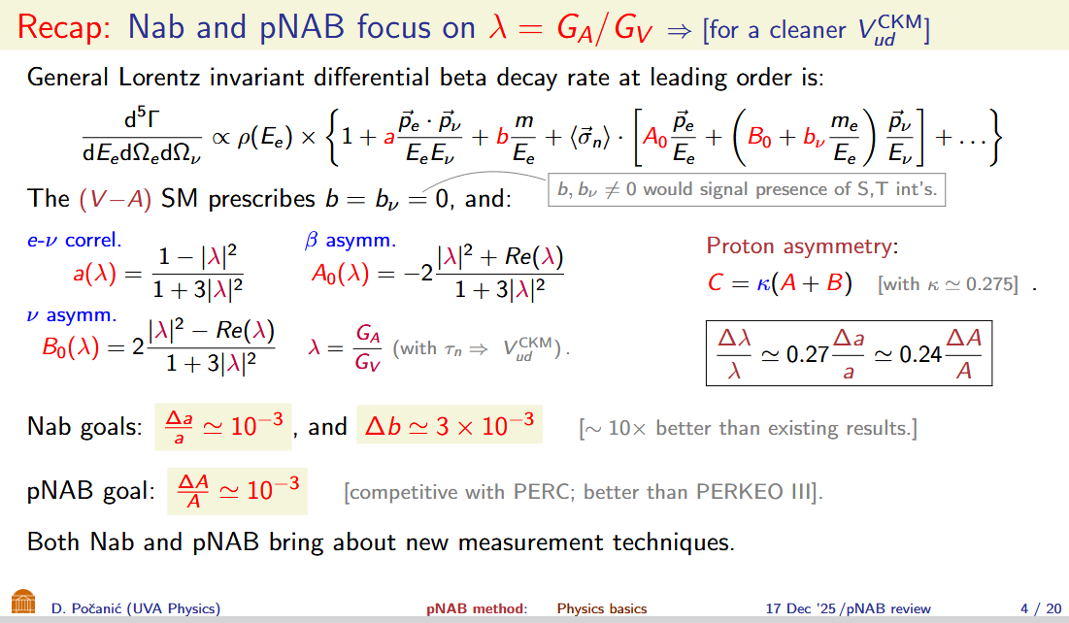
What?

Slide 3
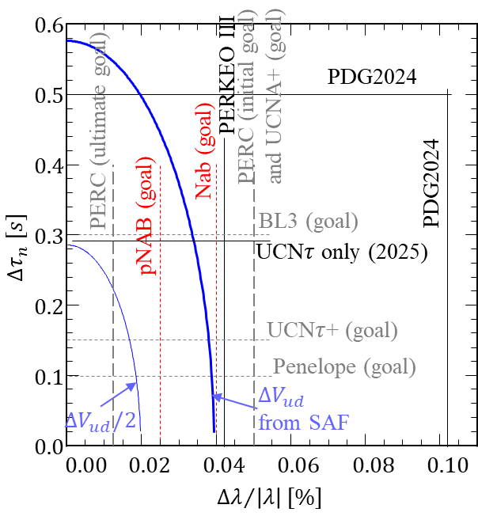
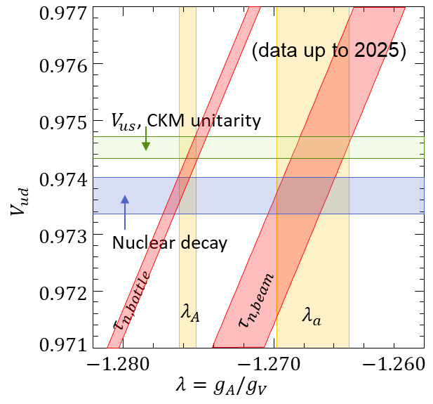
Why?
Main motivation is the test of the CKM Unitarity

Slide 4
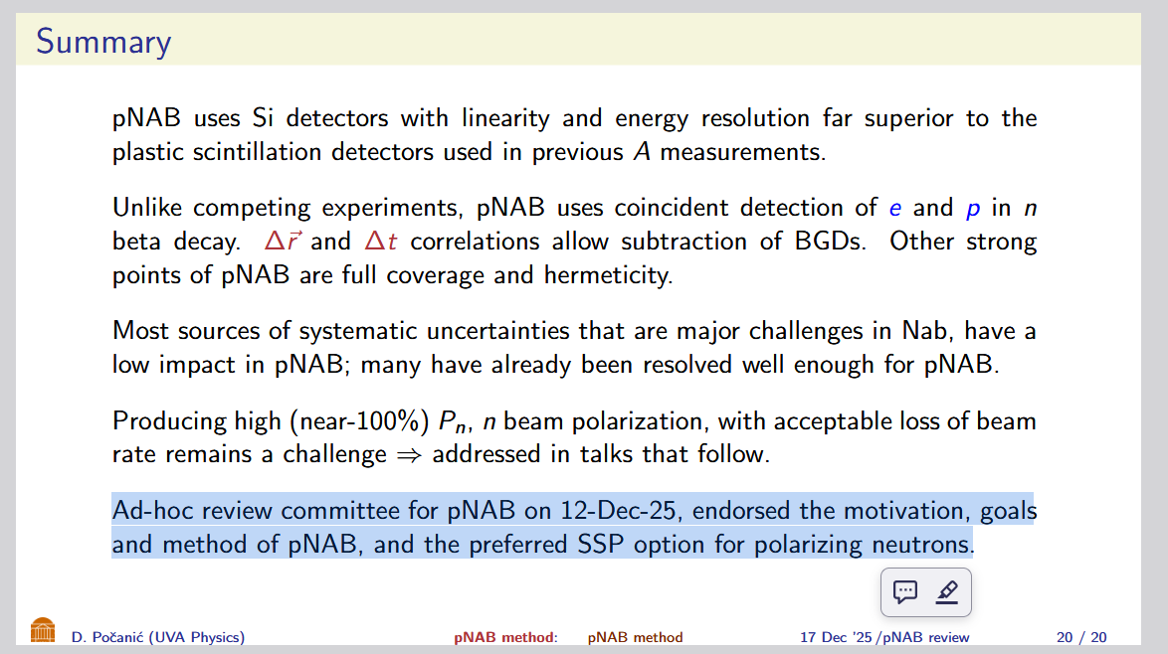
Where are we? Status of pNAB proposal

Slide 5
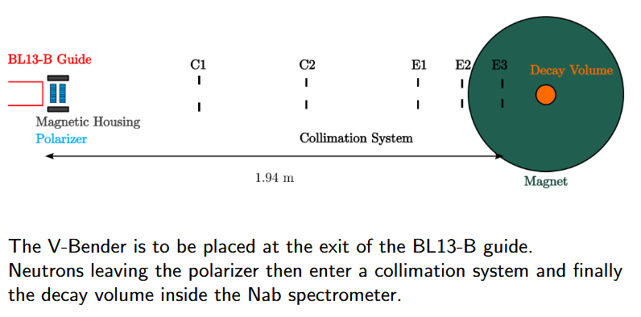
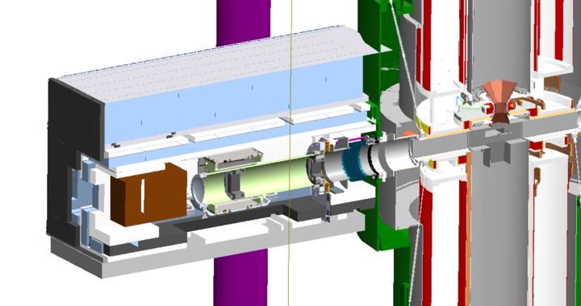
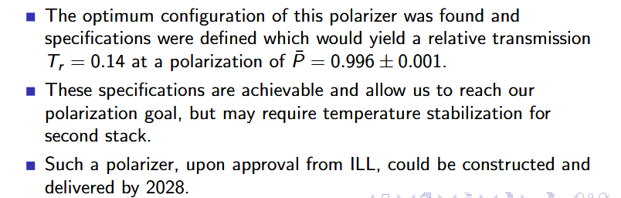
How? The SSPV polarizer
John Ramsey
J. Pioquinto, UVa

Slide 6
How: Other things to worry about concerning beam polarization
SF
Polarization monitor
Stern-Gerlach effect -> Position-dependent polarization
Actual uncertainty budget for polarimetry

Slide 7

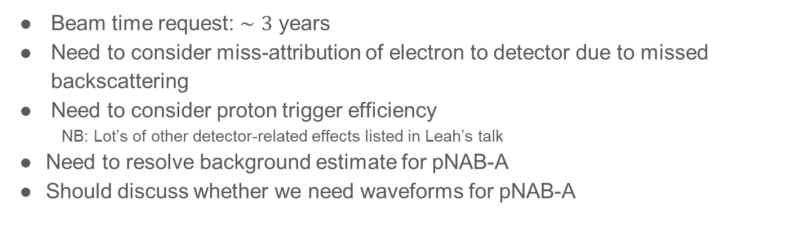
How: Other things to worry about NOT concerning beam polarization
Beam time request: $∼3$ years
Need to consider miss-attribution of electron to detector due to missed backscattering
Need to consider proton trigger efficiency
NB: Lot’s of other detector-related effects listed in Leah’s talk
Need to resolve background estimate for pNAB-A
Should discuss whether we need waveforms for pNAB-A

Slide 8

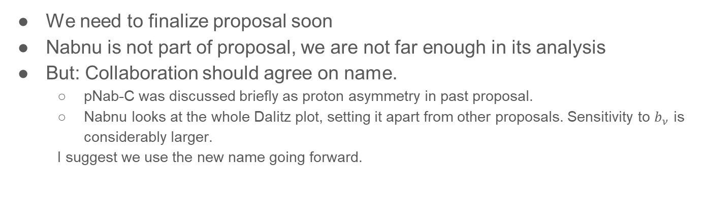
NabNU / pNAB-C
We need to finalize proposal soon
Nabnu is not part of proposal, we are not far enough in its analysis
But: Collaboration should agree on name.
pNab-C was discussed briefly as proton asymmetry in past proposal.
Nabnu looks at the whole Dalitz plot, setting it apart from other proposals. Sensitivity to $b_{ν}$ is considerably larger.
I suggest we use the new name going forward.
Thank you for lively discussion! Lunch!

