Slide 1
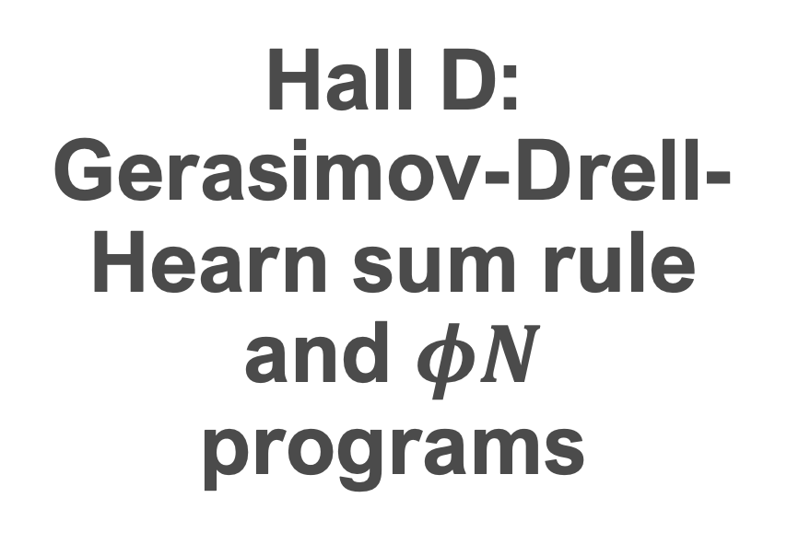
Hall D:
Gerasimov-Drell-Hearn sum rule and $φN$ programs
Vicente Corral
Stolen from Mark D. Dalton proposals

Slide 2
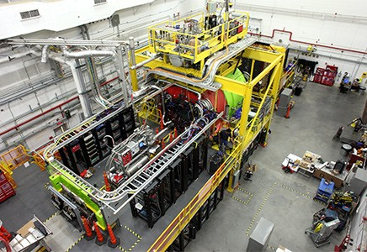
Contents
Gerasimov-Drell-Hearn sum rule at high momentum
  Background
  Motivation
  Experimental set up
Phi-nucleon cross section
  Background
  Vector polarization
  Tensor polarization

Slide 3
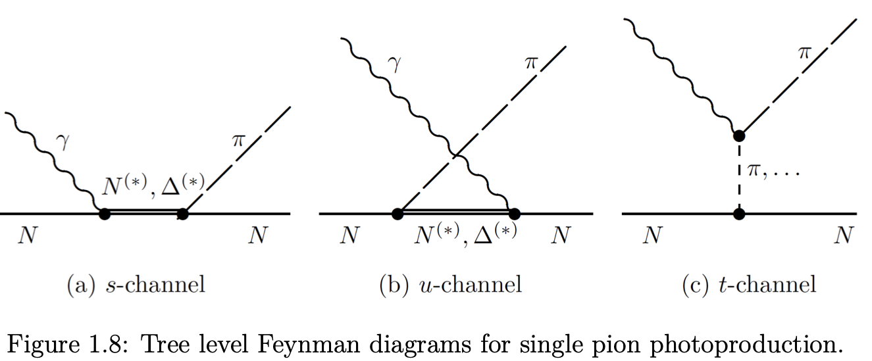
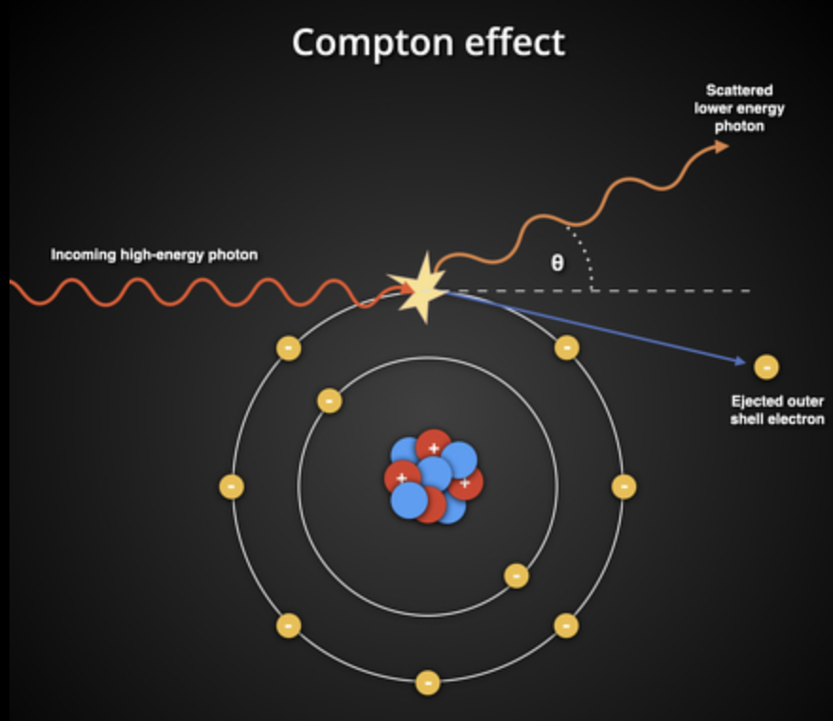
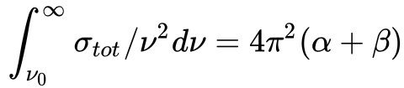
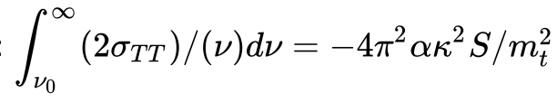
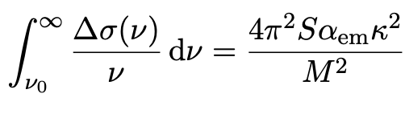
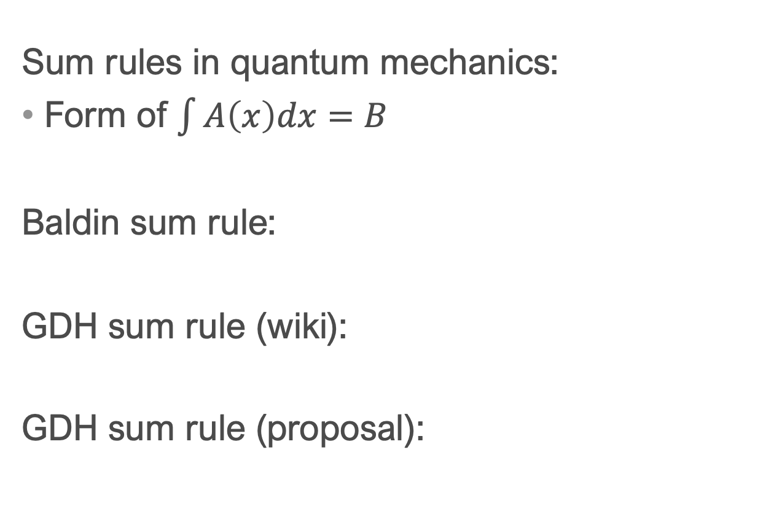
Background
Sum rules in quantum mechanics:
Form of $\int{A\left(x\right)dx}=B$
Baldin sum rule:
GDH sum rule (wiki):
GDH sum rule (proposal):

Slide 4
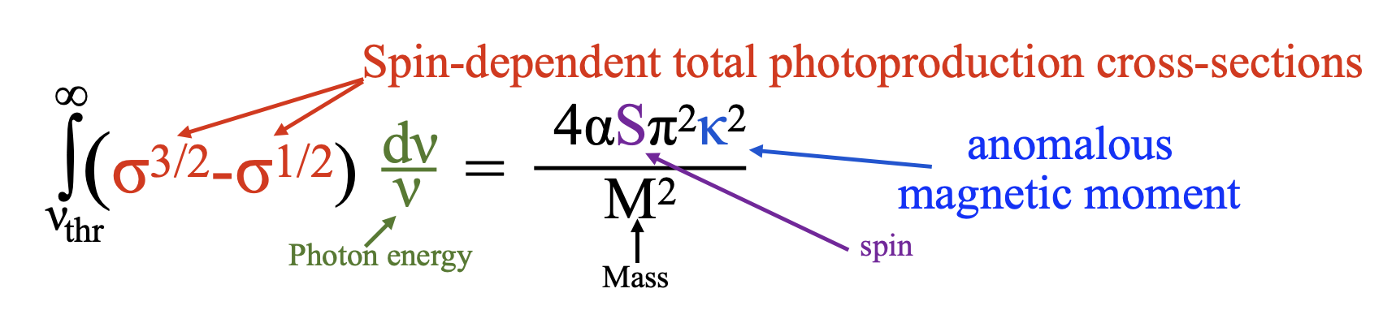
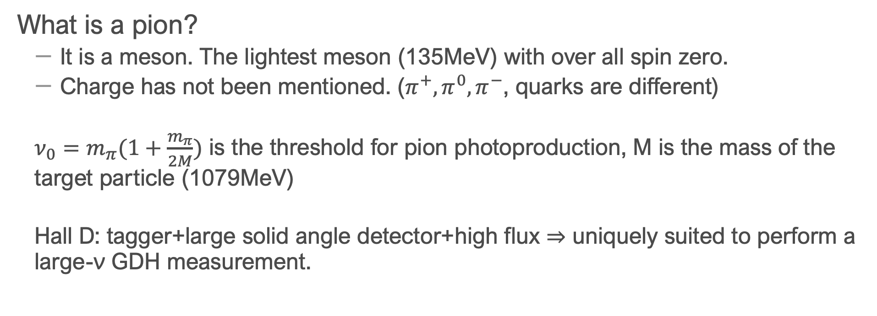
What is a pion?
  It is a meson. The lightest meson (135MeV) with over all spin zero.
  Charge has not been mentioned. ($π^{+},π^{0},π^{−}$, quarks are different)
  $ν_{0}=m_{π}(1+\frac{m_{π}}{2M})$ is the threshold for pion photoproduction, M is the mass of the target particle (1079MeV)
  Hall D: tagger+large solid angle detector+high flux ⇒ uniquely suited to perform a large-ν GDH measurement.

Slide 5
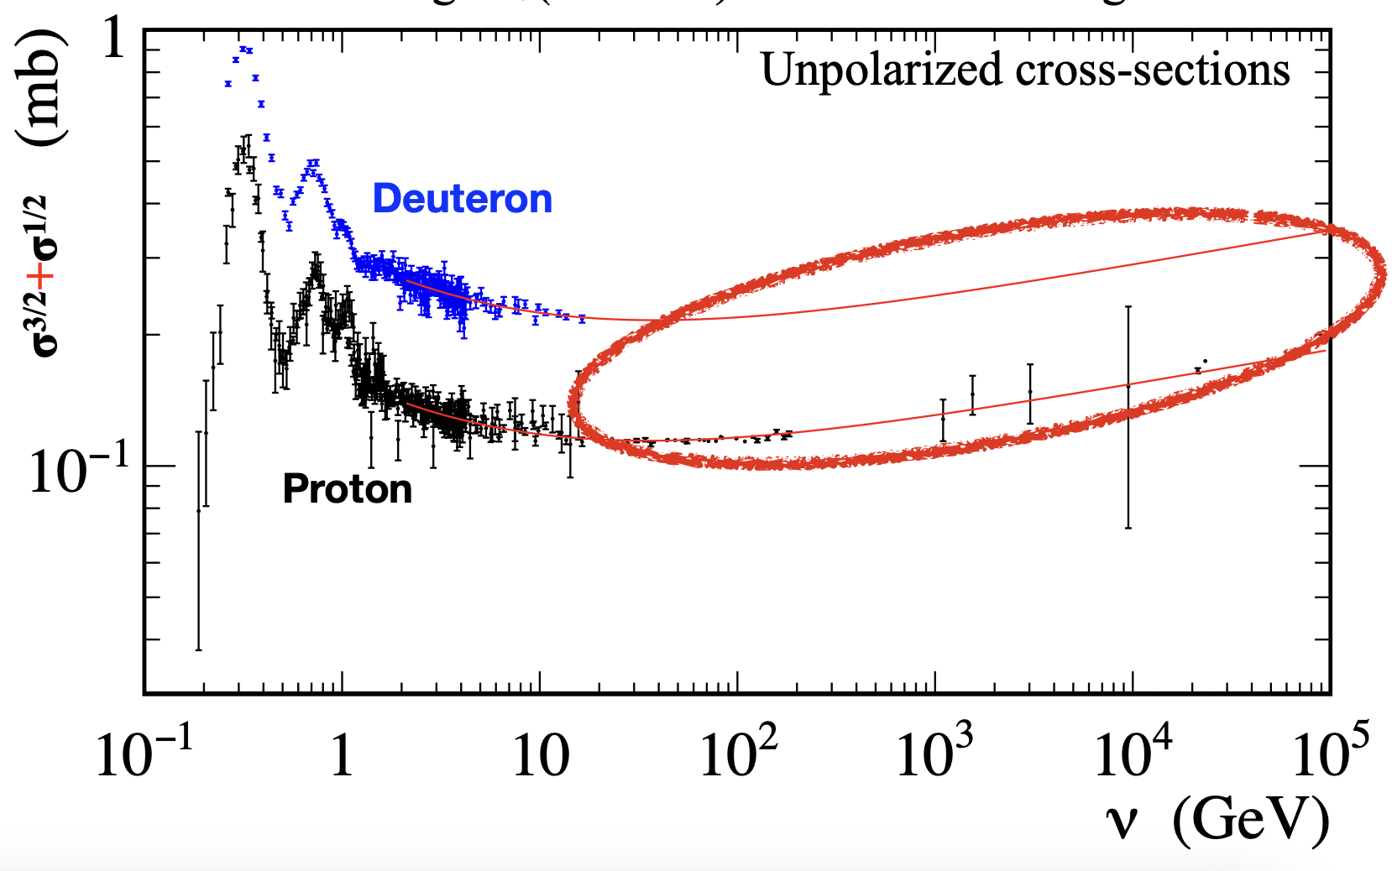
Motivation
Convergence occurs at high momentum, however only low energy data is available
  Proton: v>3Gev not measured
  Neutron: v>1.8Gev not measured
Baldin sum rule does not converge
Large-v uncertainty dominates proton GDH test
Go beyond resonance bumps to reliably do Regge-fits:
  Checking Regge theory in polarized case.

Slide 6
Motivation
Hall D’s 3-12 GeV range:
extend coverage by factor 4 for proton and 7 for neutron/deuteron.
  Sensitive domain for sum rule violation; smooth cross-section allows Regge-based fit.
  Regardless of the sum rule validity, it is an important domain to explore:
    Constrains spin-dependent Compton amplitude f2. Test of Chiral Perturbation Theory.
    No non-zero deuteron signal seen yet at large ν or in the diffractive domain.
    Discrepancy between Regge expectation and DIS data.
    Q2=0 baseline for EIC diffractive measurements. Study transition between DIS and diffractive regimes.
    Constraint on hydrogen hyperfine splitting.

Slide 7
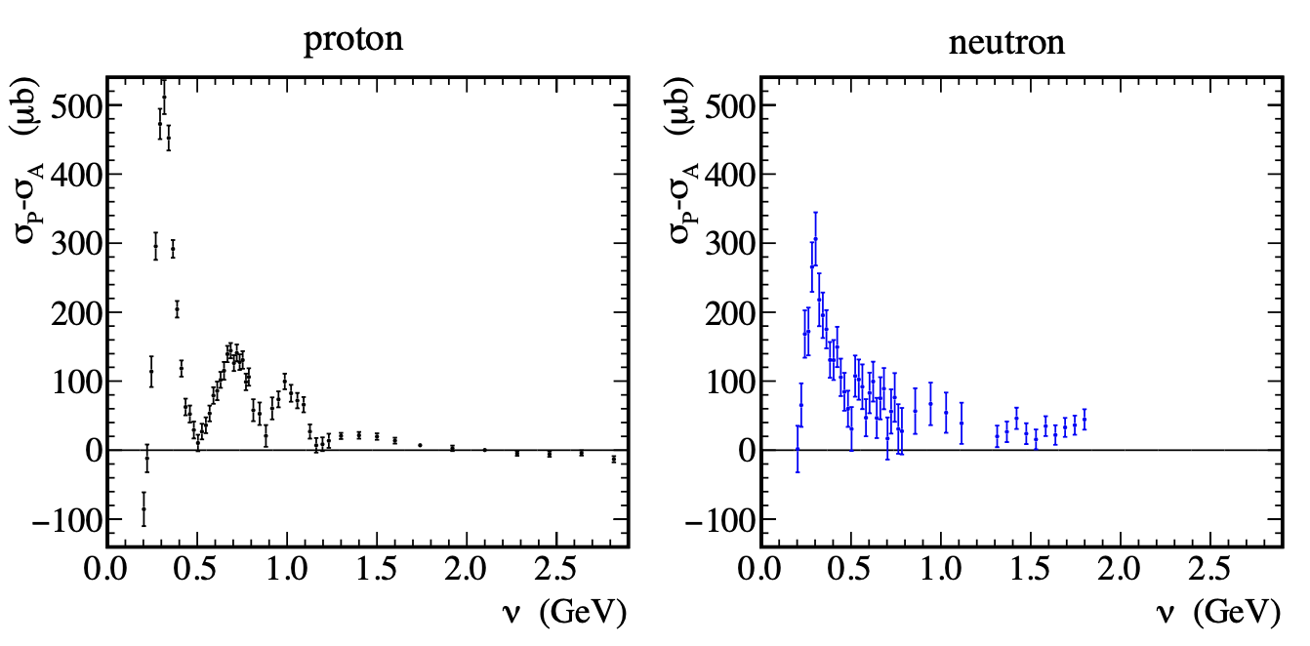
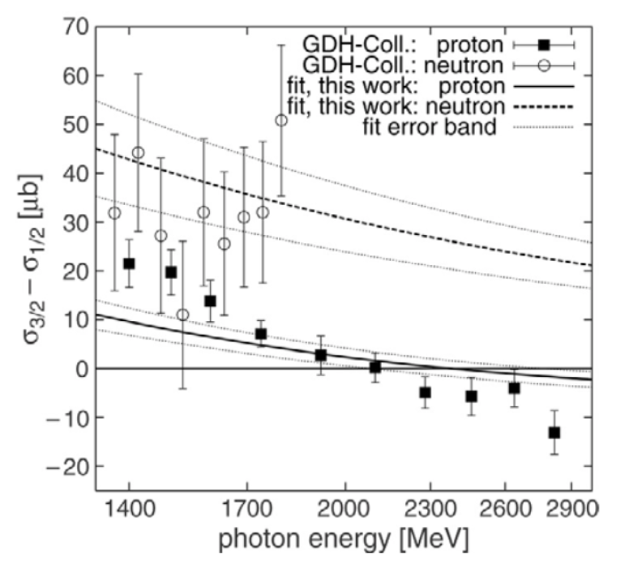
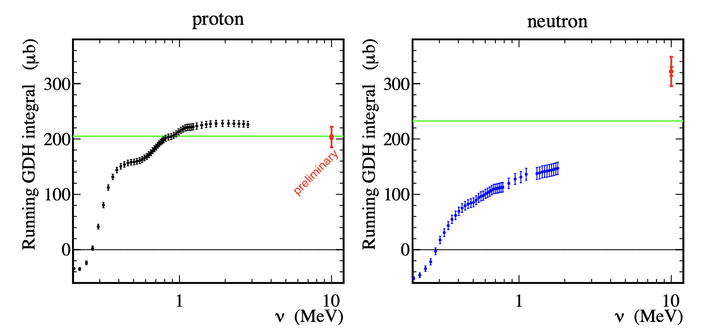
Motivation

Slide 8
Experimental set up
Proton and neutron (deuteron) targets:
  Isospin separation. Regge theory: isoscalar and isovector contributions to cross section difference come from different meson families (f1 and a1, respectively)
  Deuteron:
    No non-zero cross section difference seen yet at large momentum. (photo- and electro-production)
Energy coverage:
  3<v<12Gev standard CEBAF at 12Gev
  1<v<4Gev CEBAF run at 4Gev, low energy summer run

Slide 9
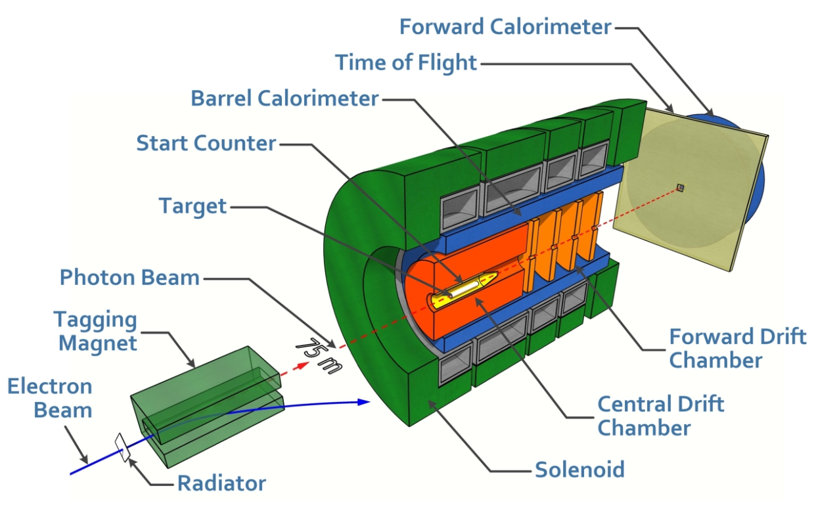
Experimental set up
3 main ingredients needed:
  Circularly polarized tagged photon beam; polarized electron beam, amorphous radiator
  Longitudinally polarized target; FROST target
  Large solid-angle detector. Hall D

Slide 10
High precision measurement of phi-nucleon cross-section and tensor asymmetry with tensor polarized target
Phi-meson: strange and anti-strange quark. M=1019Mev.
Lifetime ~ 1.5E-22 seconds
“Photoproduction of the phi meson off a tensor-polarized target can uniquely constrain the phi-nucleon cross section, providing a means to solve the long-standing puzzle of what this cross section is.”
Vector meson dominance (VMD) analysis of forward gamma-proton to phi-proton scattering produces a value of ~10mb
A-dependence of incoherent phi photon production and Glauber-type multiple scattering produces a value of ~30mb.

Slide 11
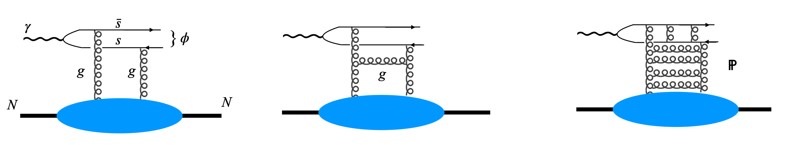
Motivation
The quark-interchange component of the hadron-hadron interaction is highly suppressed during phi-nucleon cross section. Measuring this cross section isolates the purely gluonic component of the interaction, the pomeron exchange.
Pomeron exchange: effective exchange of two, or more, gluons.

Slide 12
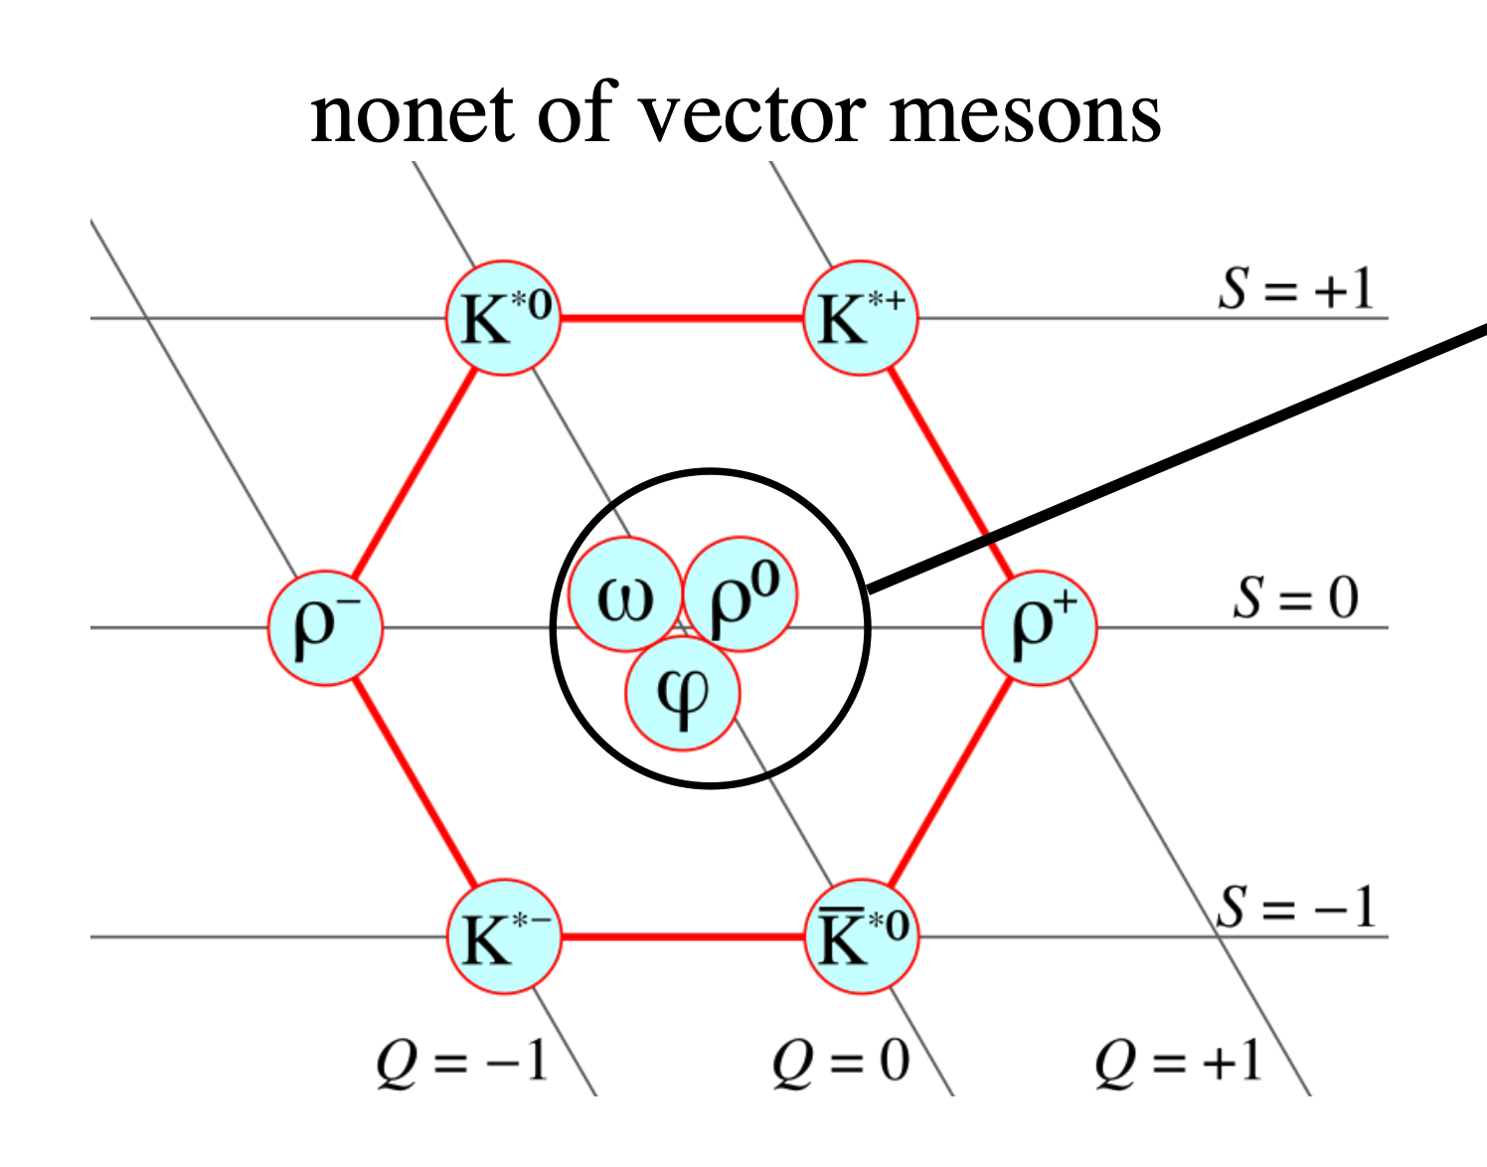

Slide 13

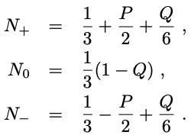
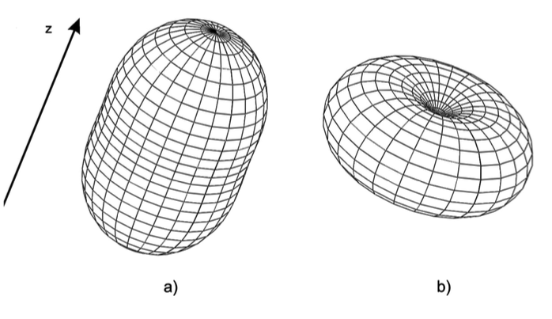



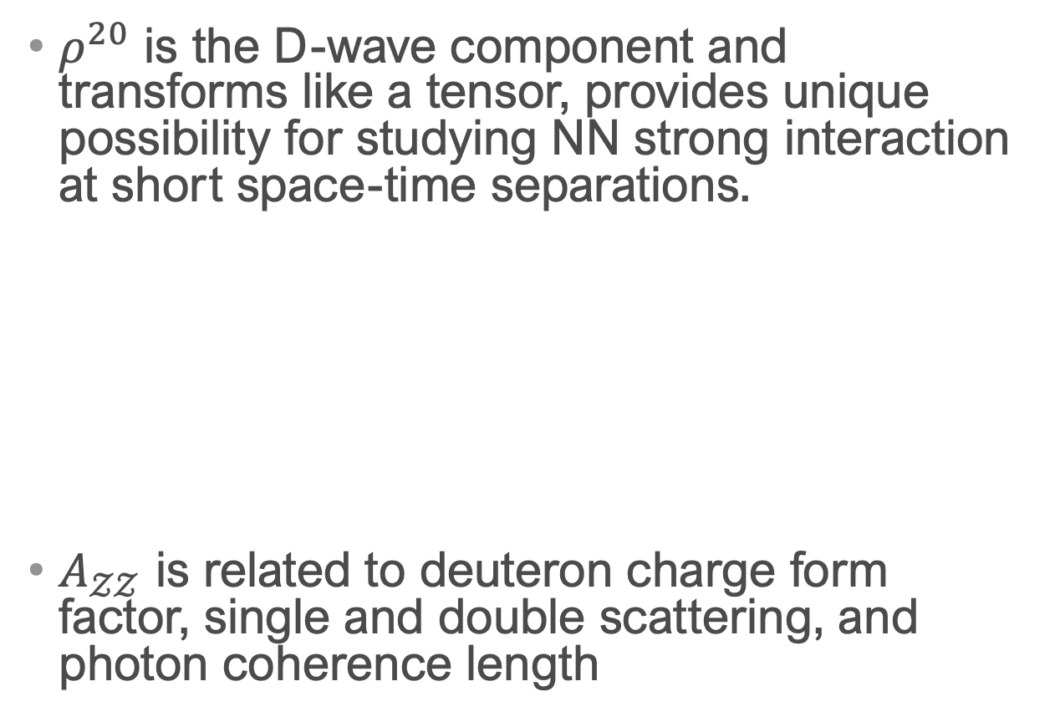
Polarized Deuteron target
$ρ^{20}$ is the D-wave component and transforms like a tensor, provides unique possibility for studying NN strong interaction at short space-time separations.
$A_{𝒵𝒵}$ is related to deuteron charge form factor, single and double scattering, and photon coherence length

Slide 14
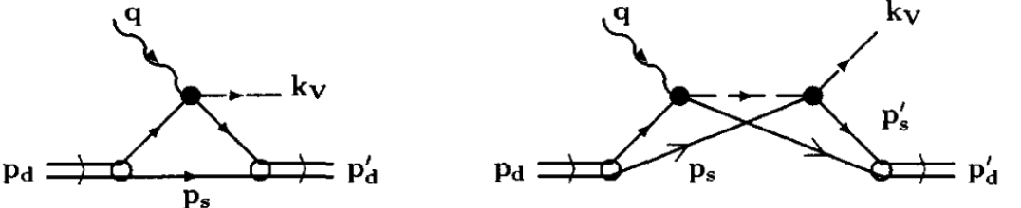
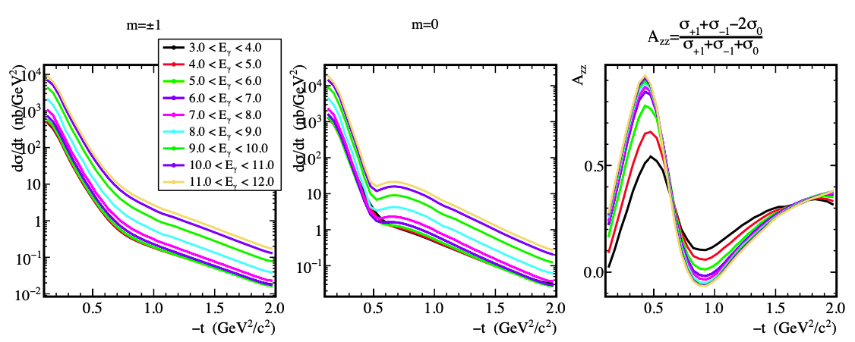
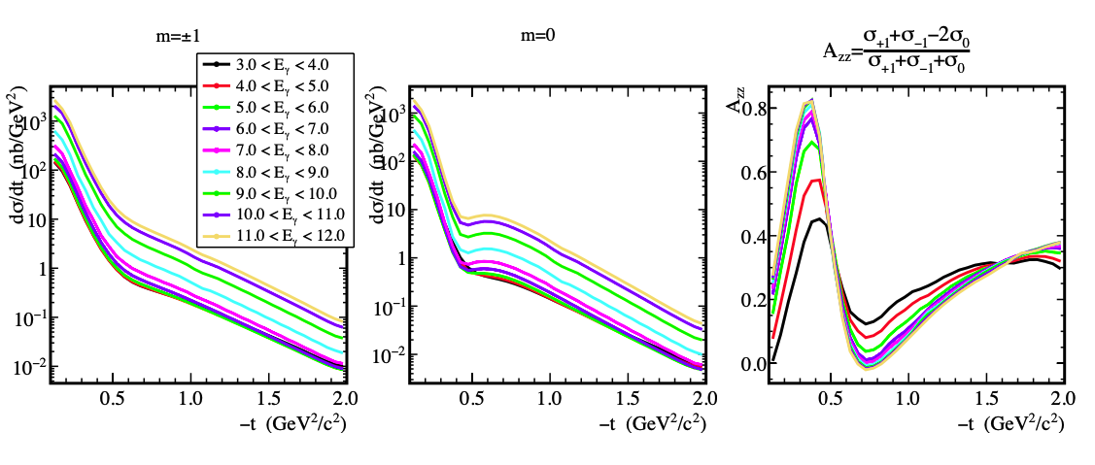

Use of tensor polarization
Shift in m=0 node to lower –t, leads to a markedly different shape for A_zz, which can be exploited to determine $σ_{φN}$

Slide 15
Experiment Equipment
GlueX spectrometer:
  Large acceptance (4pi solid angle), solenoid spectrometer (2T).
  Tracking detectors; central drift chamber, forward tracking.
  Particle identification; TOF, Cherenkov, calorimeter
Beam:
  Circularly and linearly polarized photons will be produced form Hall D diamond radiator.
Target:
  Target will be polarized using the DNP method, using a 3He-4He dilution refrigerator.
  While microwaves are switched off, Adiabatic Fast Passage (AFP) can be employed to produce negative vector polarizations, up to ~-.71.

Slide 16
Conclusion
GDH sum rule
  Background
  Motivation
  Experimental set up
Precision measurement of phi-nucleon cross sections
  Background
  Use of vector polarized target
  Experimental set up

