Slide 1
MEOP UTK efforts
What do we do in the lab all the time??

Slide 2

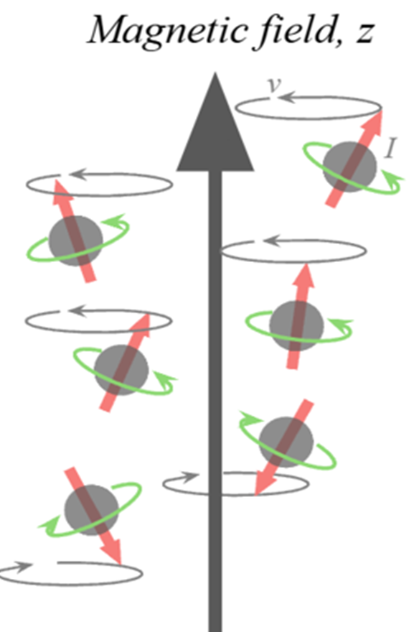
Why is this important?
The Spin Crisis: what makes up nuclear spin?
  Quarks? Gluons? Sum of angular momentum?
  How do we study this?
Develop polarization technique
Ultimate goal: understand neutron spin structure within the nucleus
UTK JLab Physics Collab 12/3/25
Notes:
how do we study: electron scattering at JLab, need polarized target
polarization: isolate contributions of spin with alignment along a magnetic field

Slide 3
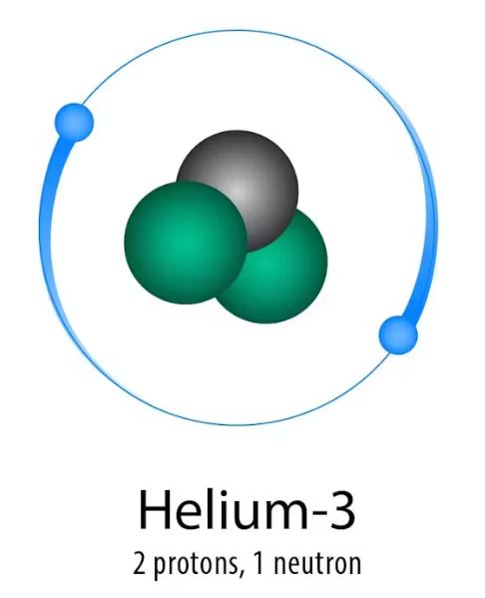
Why ³He?
Quark decomposition
  Protons, gluons, quark flavor?
Need to understand contributions of both proton AND neutron
³He target: proton spin cancel out
UTK JLab Physics Collab 12/3/25
Notes:
how to separate from different quarks to total nucleon spin
have extensive studies on proton spin already, need neutron contribution

Slide 4
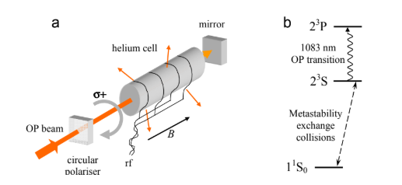
What is MEOP?
Metastability Exchange Optical Pumping
High polarization target at a high (or low, in our case) magnetic field
  RF excitation on ³He cell
  30 gauss magnetic field
  1084 nm laser
UTK JLab Physics Collab 12/3/25
Notes:
3 physical components
3he cell at resonance frequency
mag field for aligning and zeeman splitting
tuned laser actually polarizes with circularly polarized light

Slide 5
The physics of MEOP
Zeeman splitting → 2 excited states
  Metastable 2³S state: electron collisions
  Hyperfine interaction: coupling between nucleons and electrons
Relaxation time difference
UTK JLab Physics Collab 12/3/25
Notes:
population of electron collisions drive the polarization of the nucleons
relaxation time difference important for speeding up polarization, unreasonable time scale otherwise

Slide 6
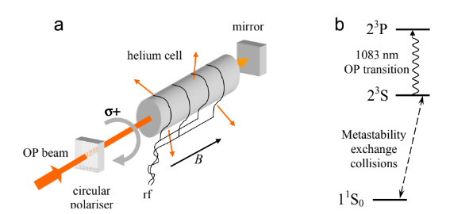
More MEOP!
Polarization Technique:
RF signal allows electrons to excite into the 2S metastable state
Pump Helium 3 cell with 1083 nm laser that is circularly polarized
Electrons now circularly polarized and excited in higher energy state
Polarization of atoms in excited state transfer to GS via metastability exchange collisions
UTK JLab Physics Collab 12/3/25

Slide 7
Our Lab!

Slide 8
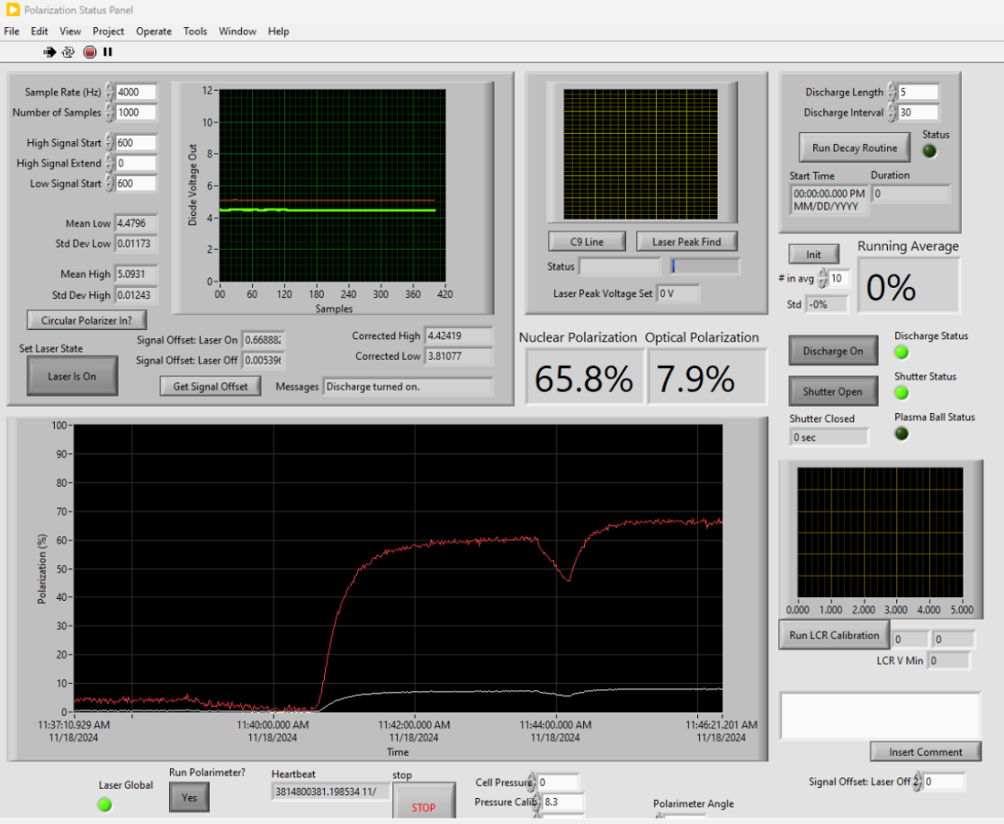
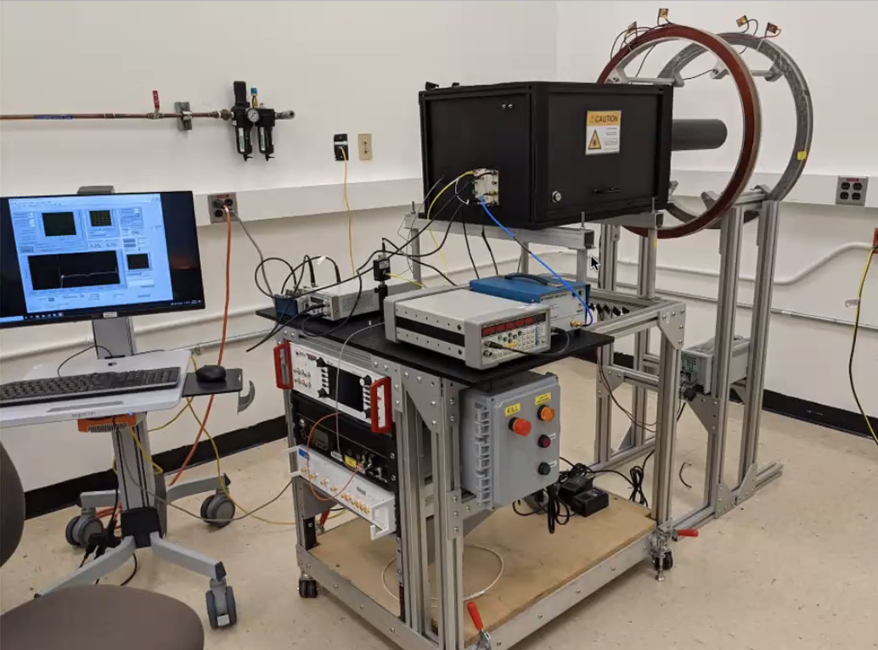
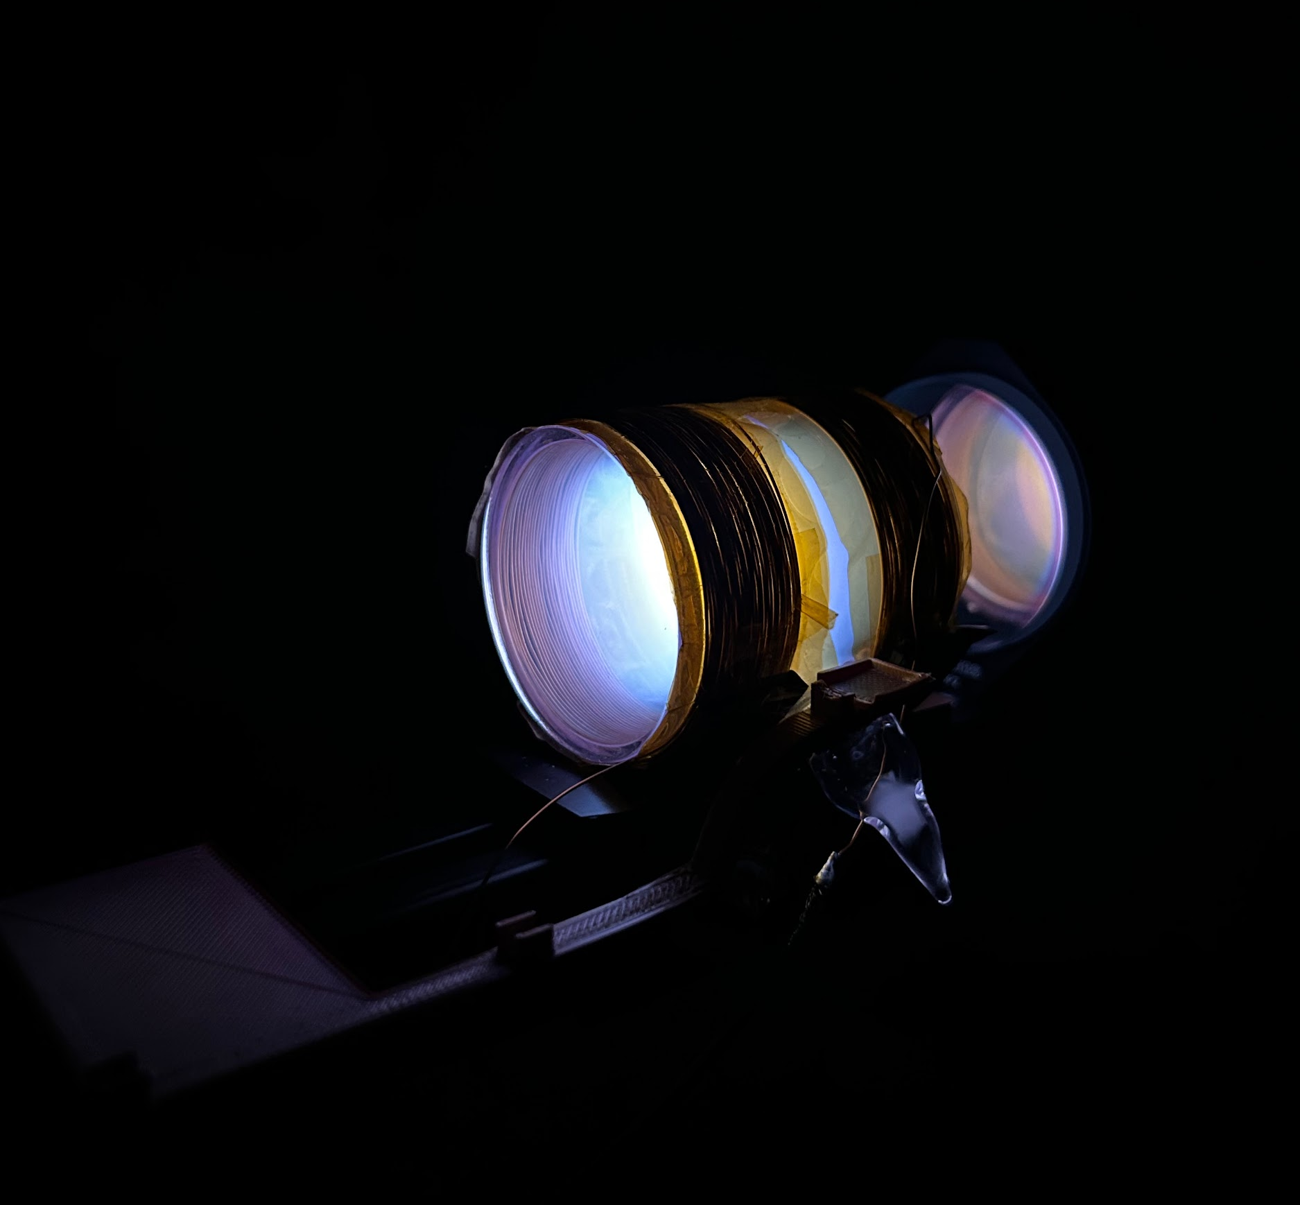
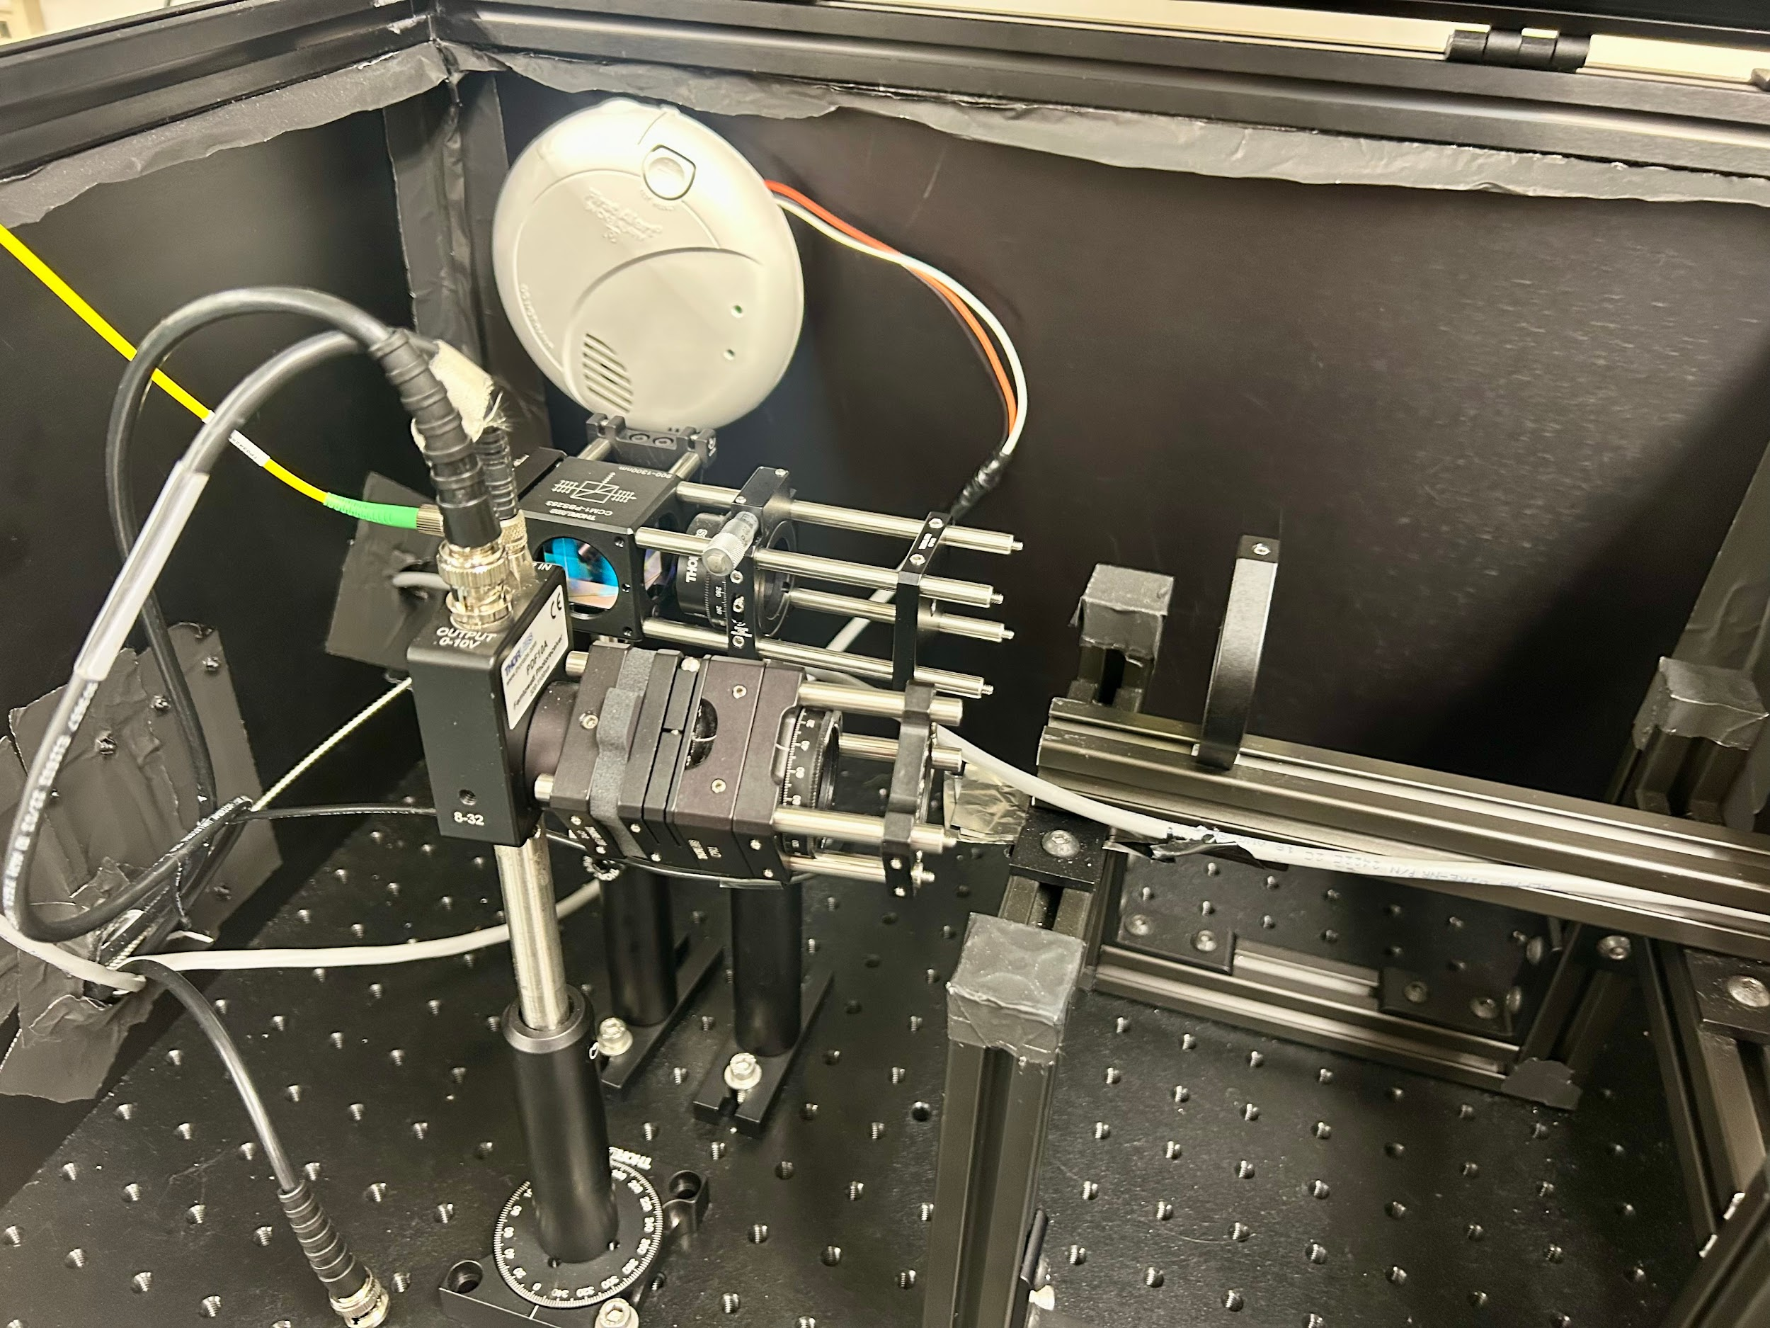
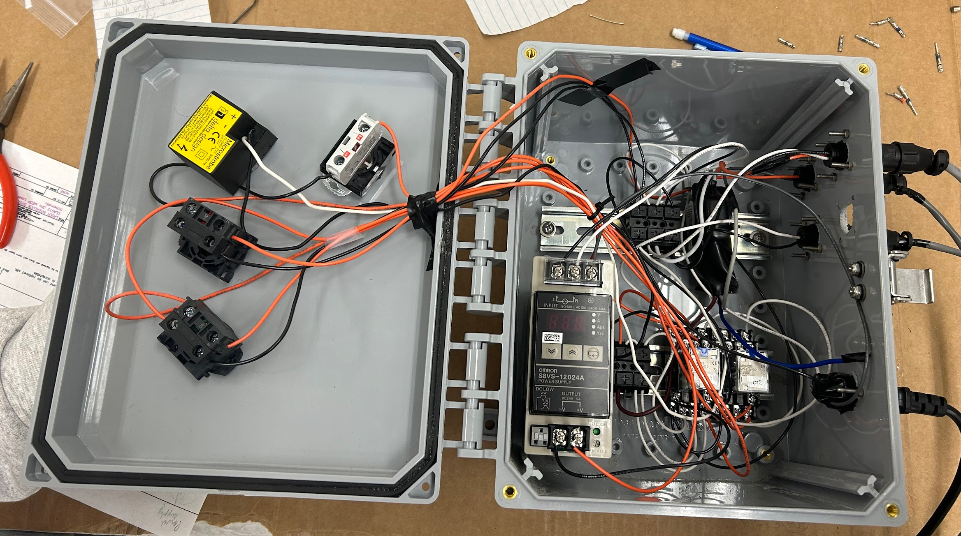
Building the lab
UTK JLab Physics Collab 12/3/25
Notes:
ESTABLISHED the lab in the past 9 months, did foundational work in building it
interlock box/laser
DAQ and labview → run system and calculate pol in real time
optics apparatus
tube inside of the double helmholz coils is cell, image of it when resonance frequency is applied

Slide 9
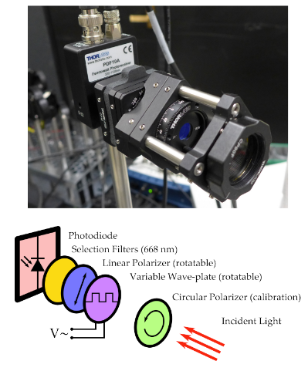
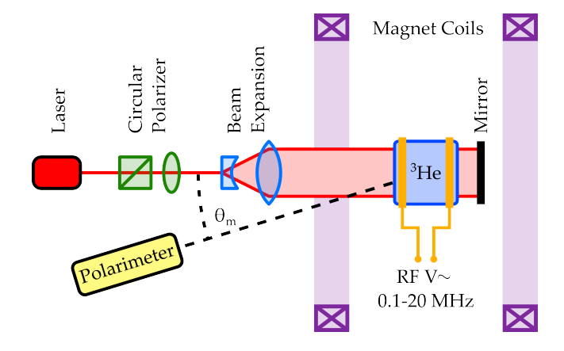
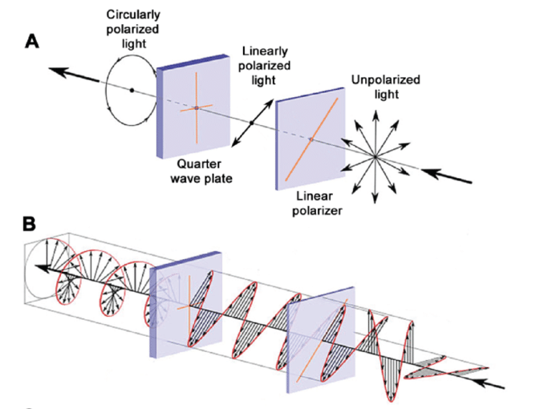
Optics
UTK JLab Physics Collab 12/3/25
Notes:
circular polarizer: converts unpolarized laser light to circularly polarized pumping light
set of lenses: size at cell so it maximizes volume hit by the light while minimizing refractions from the cell walls
mirror: repolarize

Slide 10
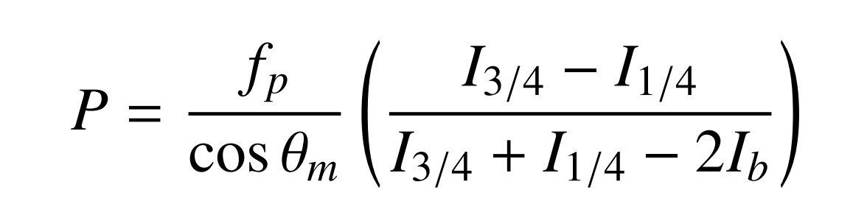
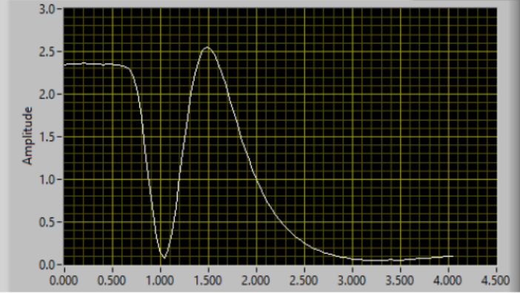
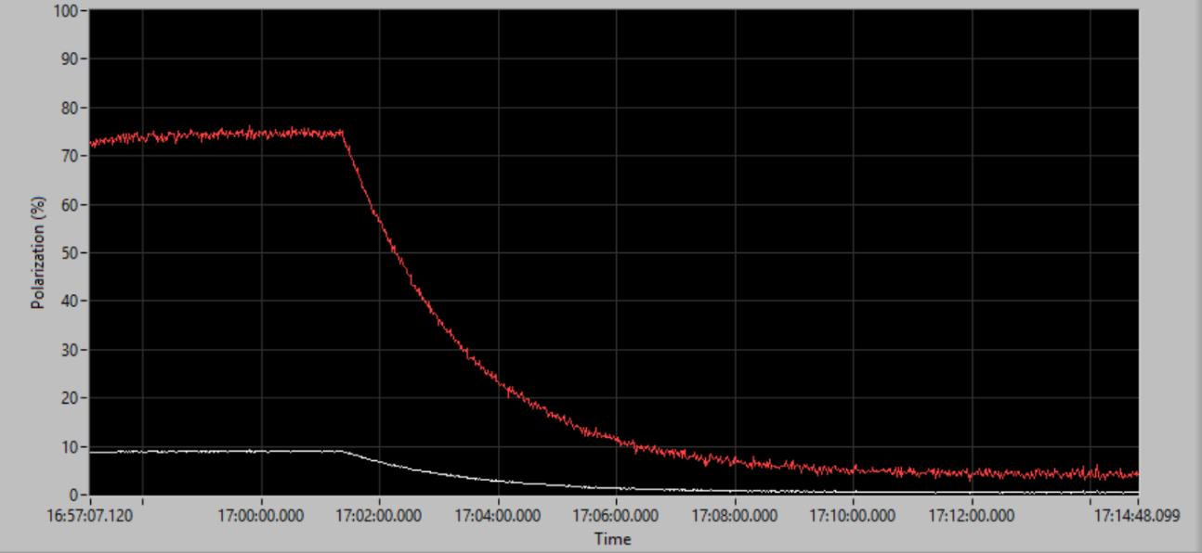
Polarization
¾
Max: 75%
~120 second relaxation
¼
Liquid Crystal Retarder (LCR) Voltage
UTK JLab Physics Collab 12/3/25
Notes:
explain calibration curve → find from a frequency scan, ¾ and ¼ is difference between left handed and right handed polarized light

Slide 11
Polarization
75% !!!
UTK JLab Physics Collab 12/3/25
Notes:
explain calibration curve → find from a frequency scan, ¾ and ¼ is difference between left handed and right handed polarized light

Slide 12
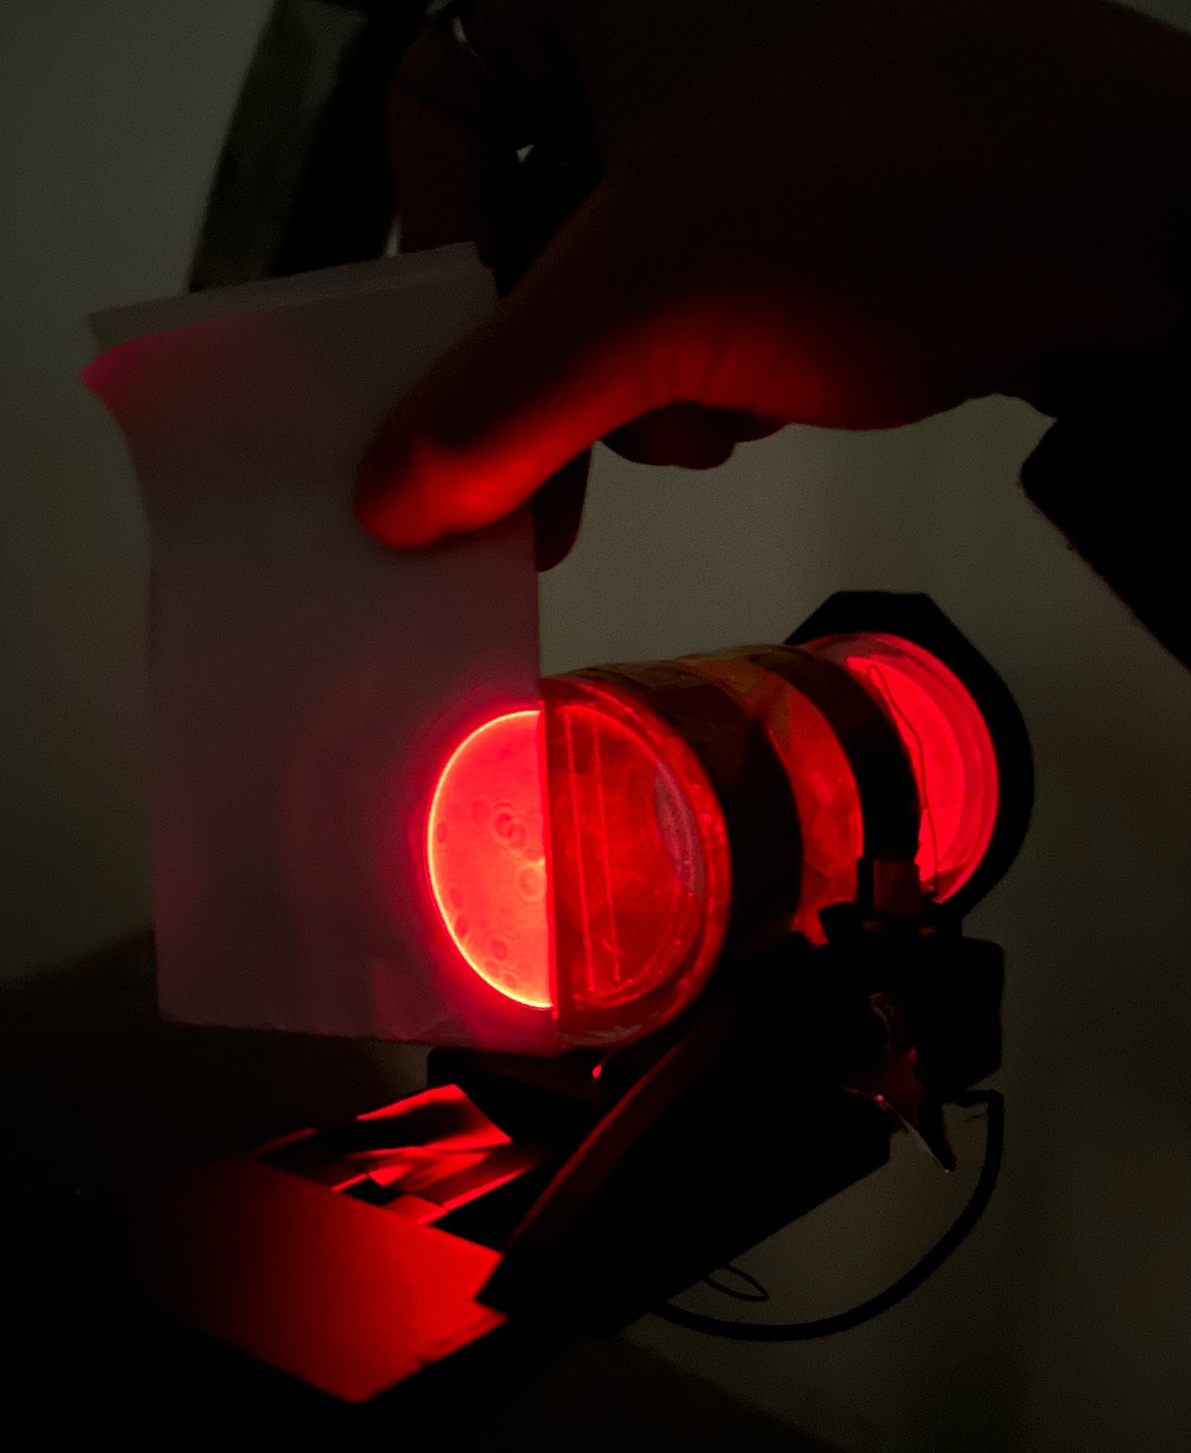
Current Plans
Big takeaway from Hao’s visit:
  Fit beam profile to the discharge distribution
Optimization
  Optics! so much aligning
Recentering in Magnetic field
Higher laser power: 6W
Fitting code (in progress)
UTK JLab Physics Collab 12/3/25
Notes:
currently in process of optics optimization
EIC ion source, future technology

Slide 13
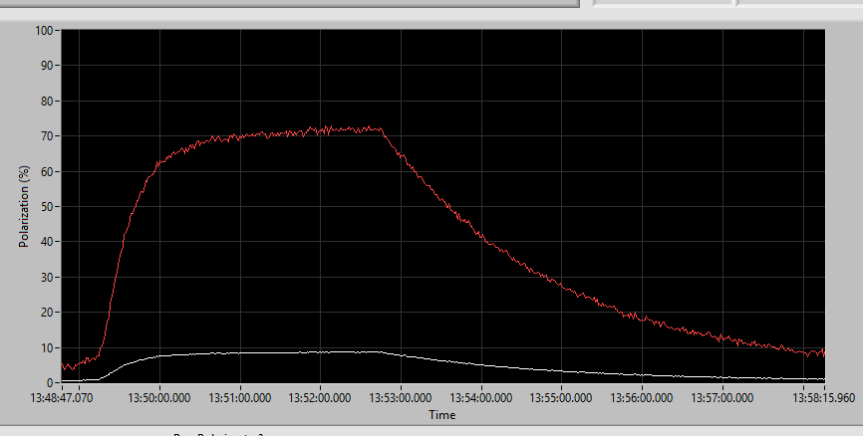
Future Data Collection
Important to understand:
Max Polarization
Relaxation Time
Pump Up Time
With this in mind we will test:
Beam size impact on P_{max} and T_{relax}
Magnetic field strength affect on (1, 2, 3)
Laser power affect on (1, 2, 3)
Discharge “intensity” ~ relaxation time impacts P_{max} and T_{Pump}
UTK JLab Physics Collab 12/3/25
Notes:
currently in process of optics optimization
EIC ion source, future technology

Slide 14
Timeline
Test beam profile (size) on P_{max}
Mass amounts of meticulous DAQ
Data Analysis
LANL: Silicon Detector Work
Finalize paper for publication
After Exams
Latest: early Jan
Before Spring Sem ‘26 begins
Throughout Spring 2026
May/June - July
Fall ‘26
UTK JLab Physics Collab 12/3/25

Slide 15

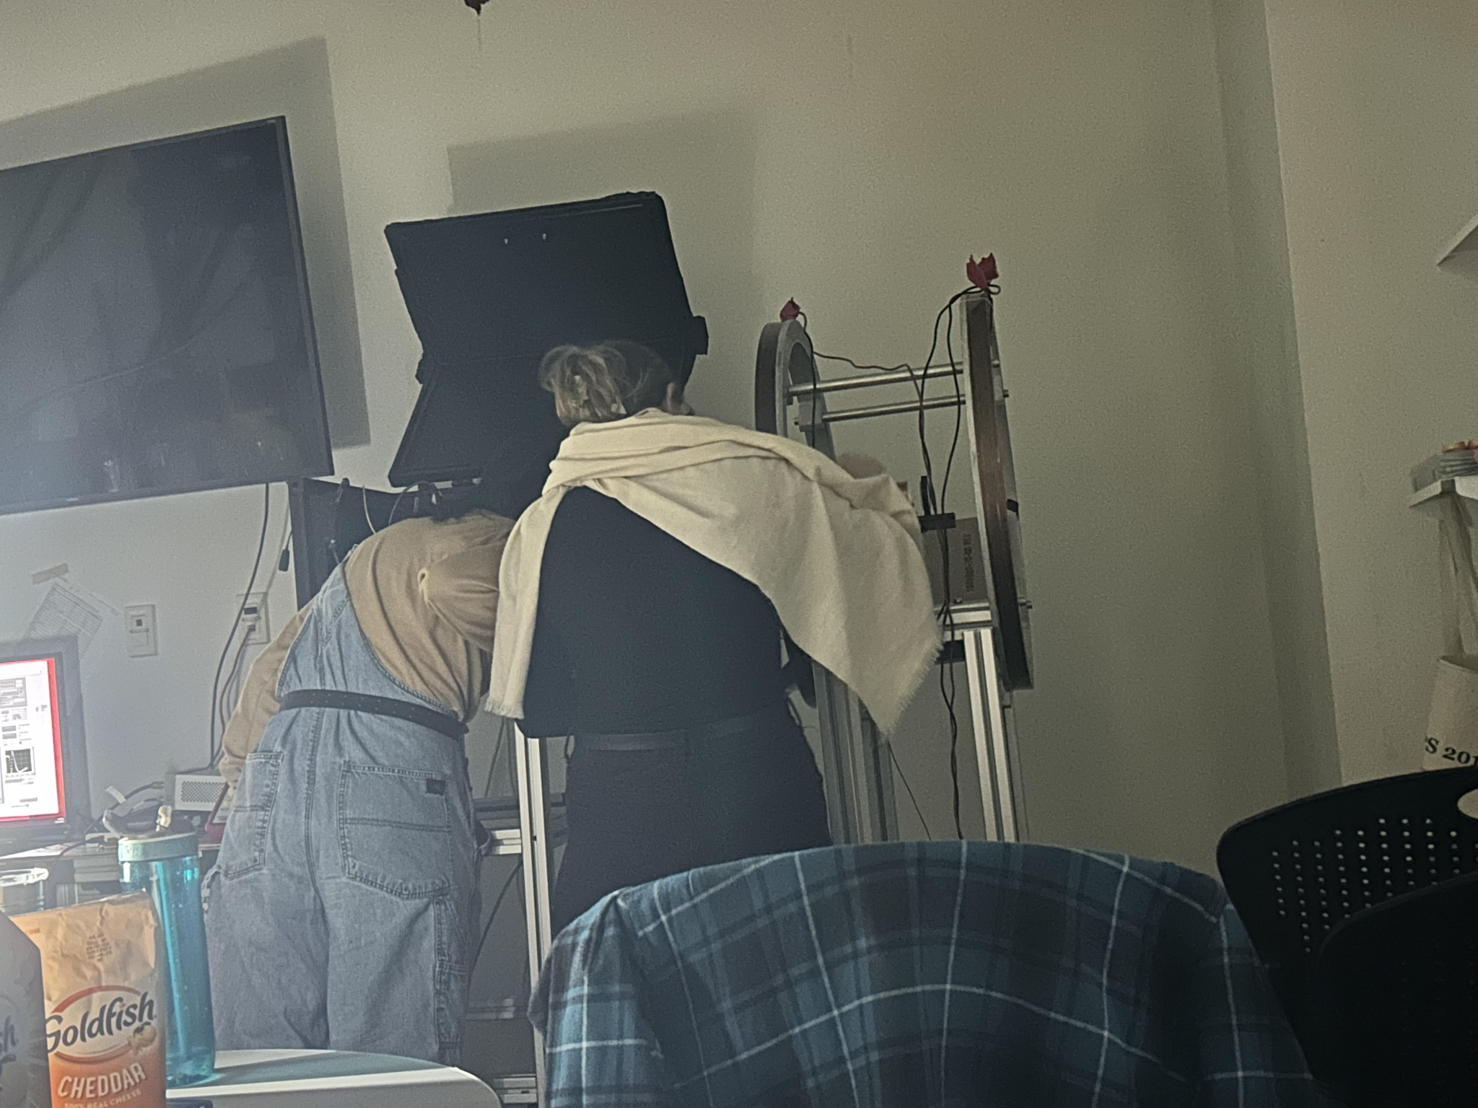
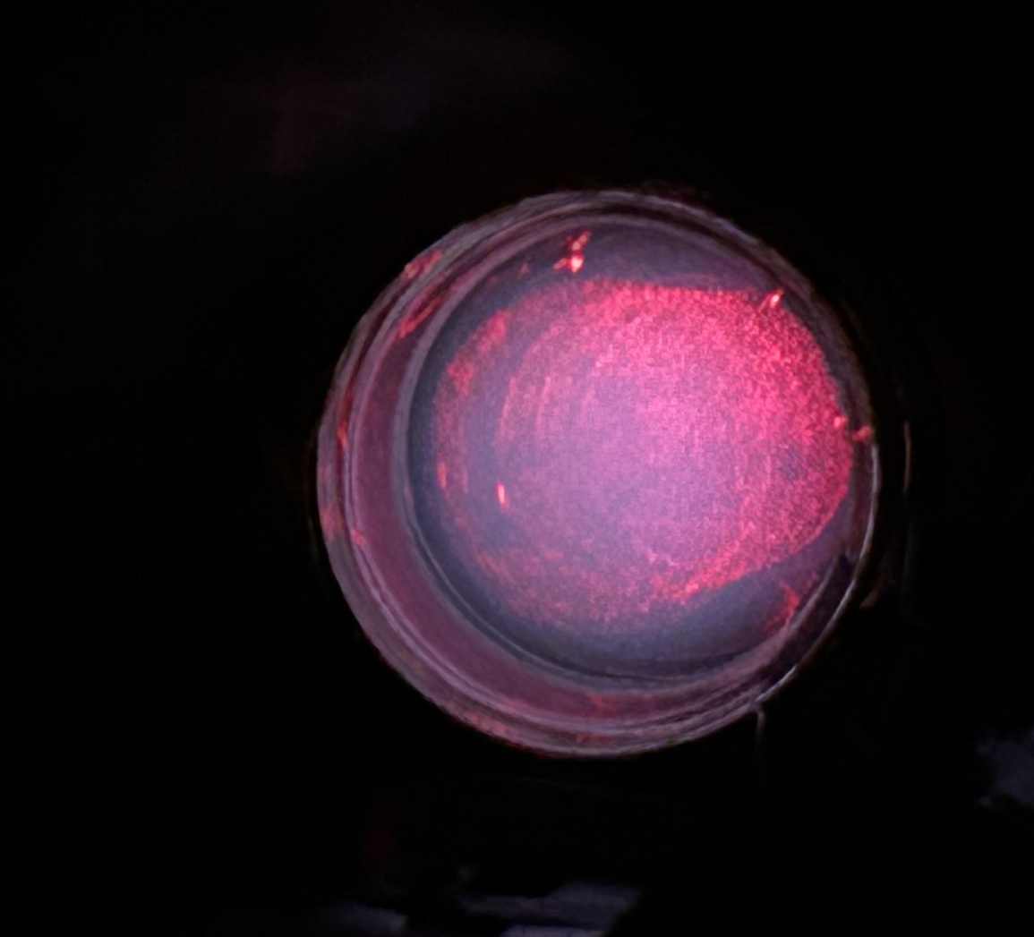
Fun Pictures

