Slide 1
How Can Neutrinoless Double-Beta Decay Help Us Understand Neutrinos?
Lotta Jokiniemi (she/her/hers)
Postdoctoral Fellow, Theory Department, TRIUMF
Physics Colloquium,
University of Tennessee, Knoxville
01/23/2025

Slide 2
What We Know and Don’t Know about Particles
– The Standard Model and Beyond

Slide 3
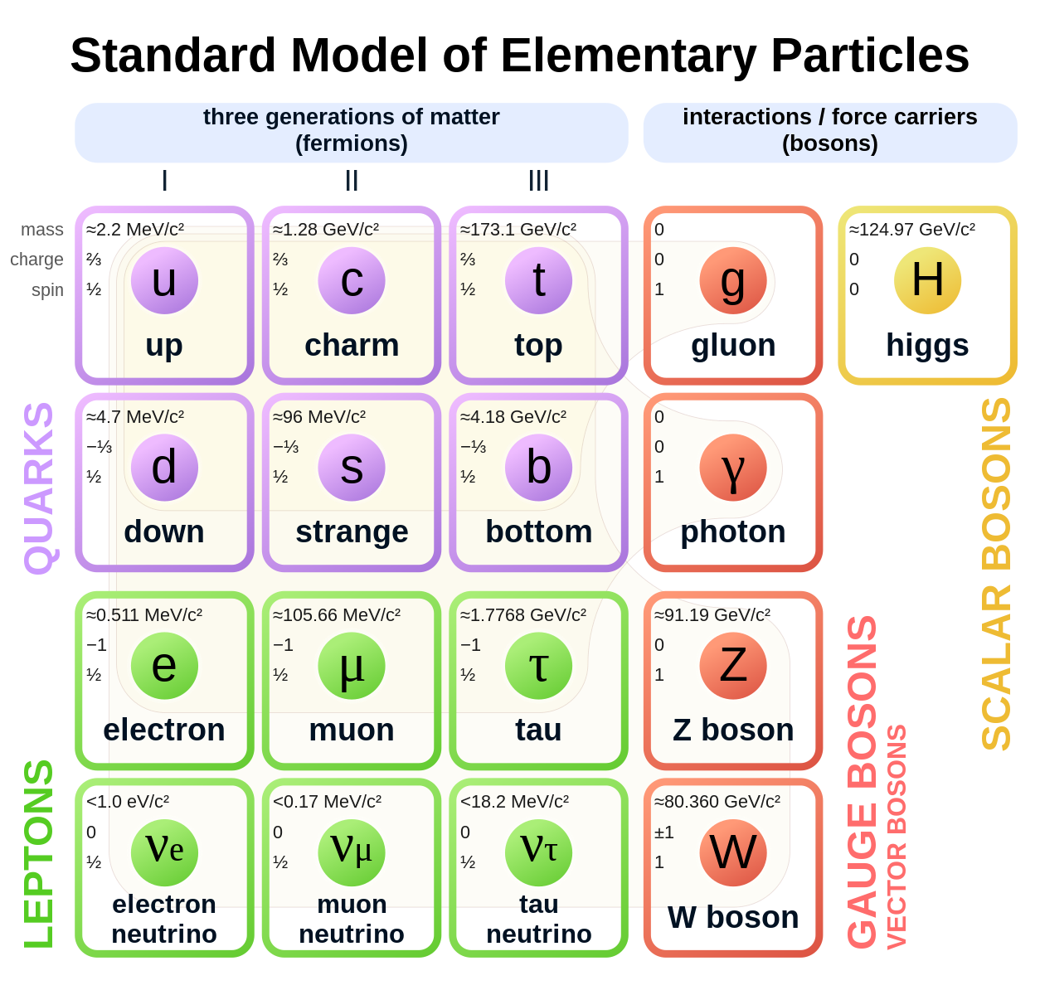
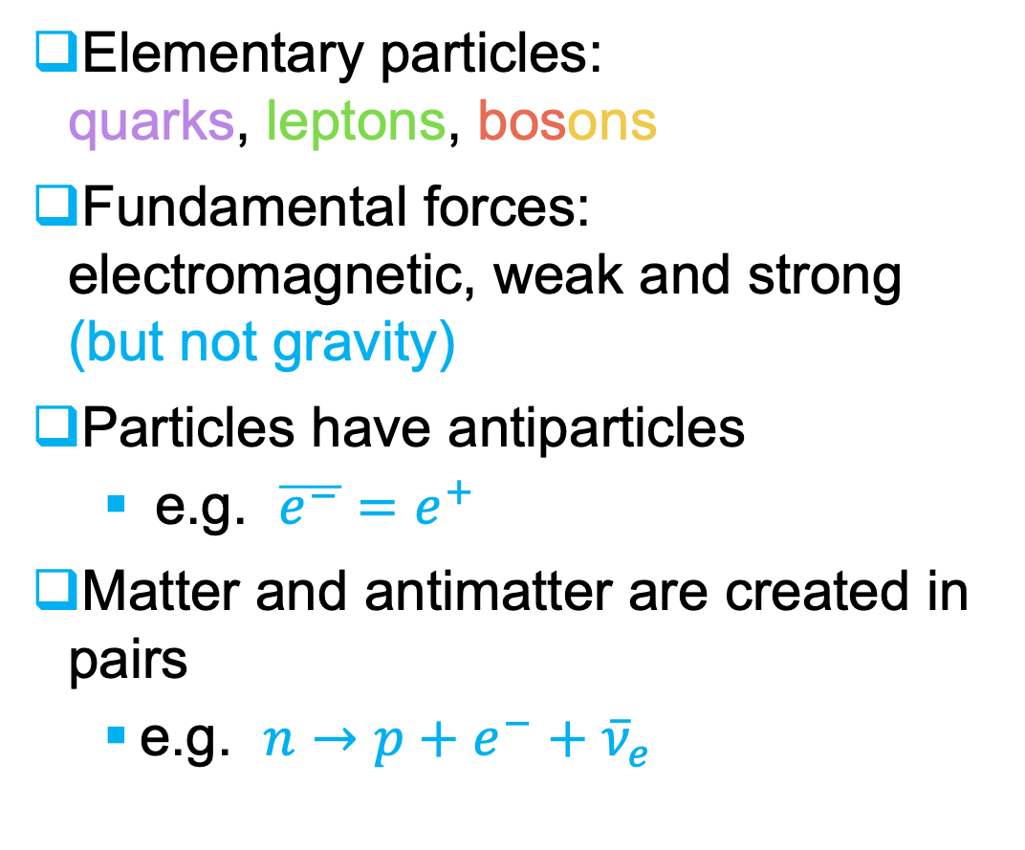
Standard Model of Particle Physics
Elementary particles: quarks, leptons, bosons
Fundamental forces: electromagnetic, weak and strong (but not gravity)
Particles have antiparticles
e.g. $\overline{e^{−}}=e^{+}$
Matter and antimatter are created in pairs
e.g. $n→p+e^{−}+{\overline{ν}}_{e}$
Wikimedia Commons

Slide 4



















Physics Beyond the Standard Model
Mostly atomic nuclei
BIG BANG
Dark matter and dark energy
Matter-antimatter asymmetry
Matter
Antimatter
$$μ^{+}$$
$$\overline{p}$$
$${\overline{ν}}_{e}$$
$$n$$
$$p^{+}$$
$$ν_{μ}$$
$$\overline{n}$$
$${\overline{ν}}_{τ}$$
$$ν_{e}$$
$$ν_{τ}$$
$$e^{−}$$
$$τ^{−}$$
$${\overline{ν}}_{μ}$$
$$τ^{+}$$
$$μ^{−}$$
$$e^{+}$$
Annihilation
$$e^{+}+e^{−}→2γ$$
????
Energy

Slide 5
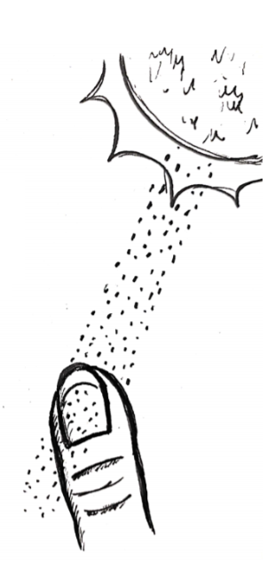
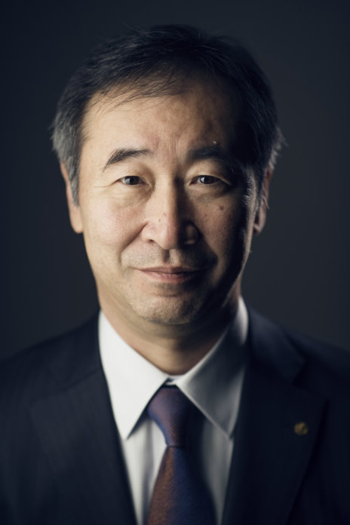
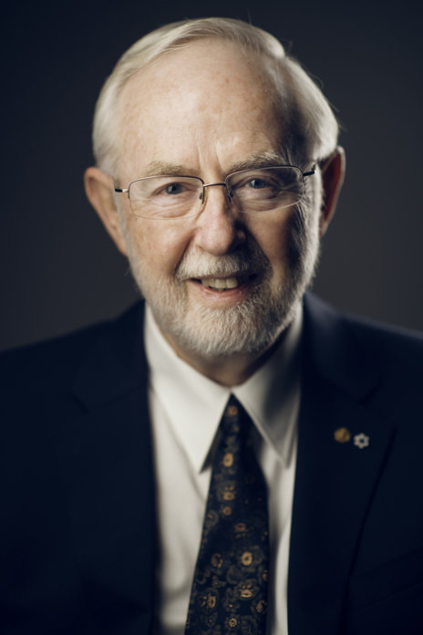
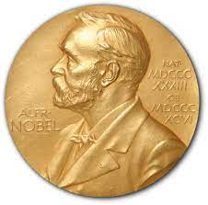
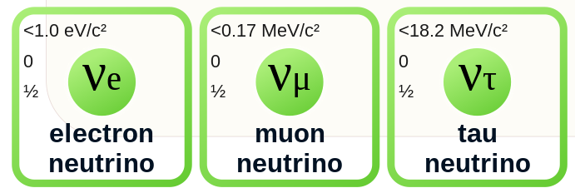
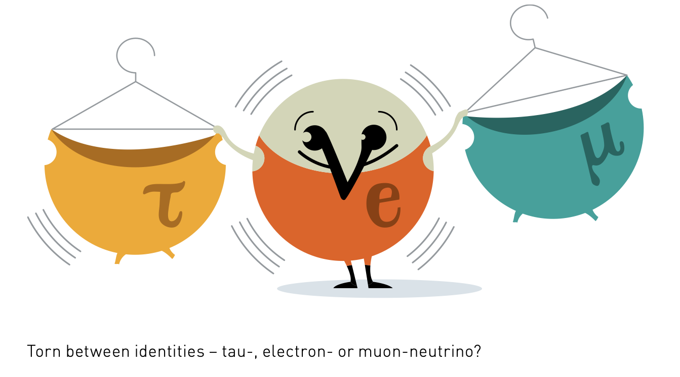
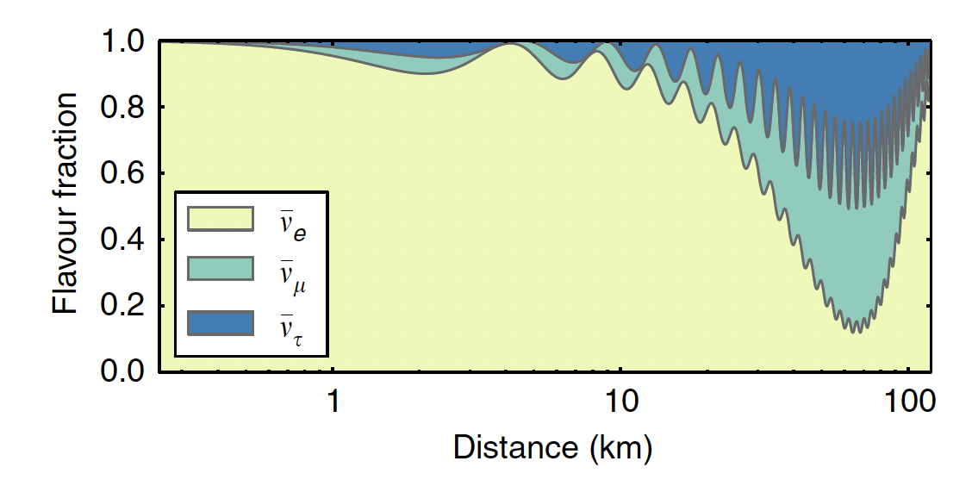
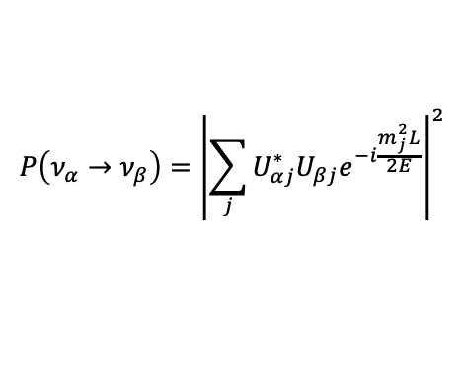
Mysterious neutrinos
Nobel Price in Physics 2015
Neutrino: electrically neutral and massless particle (SM)
Created in radioactive decays (e.g. in the Sun)
Most abundant particles
Very hard to detect “I have done a terrible thing. I have postulated a particle that cannot be detected”–W. Pauli, ca. 1930
Later, neutrinos are detected and found to oscillate between different flavor states
Neutrinos must have a mass
Kajita
McDonald
$$P\left(ν_{α}→ν_{β}\right)={\left|\sum_{j}{U_{αj}^{∗}U_{βj}e^{−i\frac{m_{j}^{2}L}{2E}}}\right|}^{2}$$
P. Vogel, L.J. Wen, C. Zhang, Nature Comm. 6, 6935 (2015)
Nobelprize.org

Slide 6
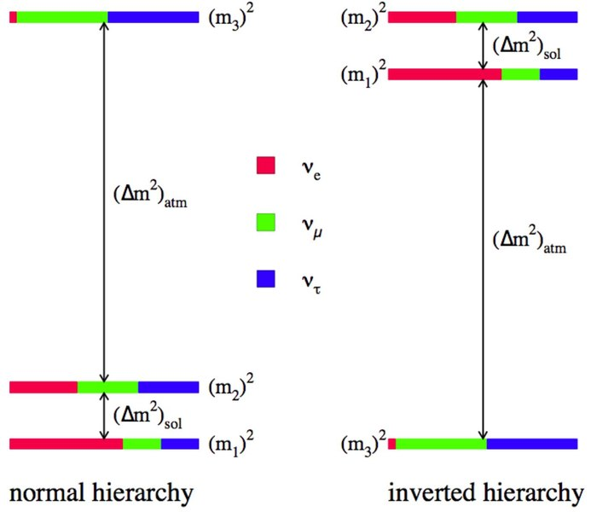
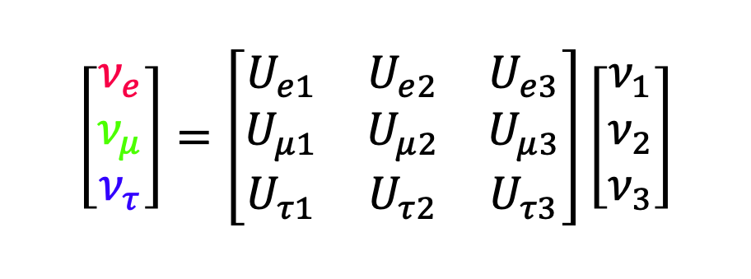
Neutrinos are massive – but what are the masses?
?
$$\left[\begin{matrix}ν_{e} \\ ν_{μ} \\ ν_{τ}\end{matrix}\right]=\left[\begin{matrix}U_{e1} & U_{e2} & U_{e3} \\ U_{μ1} & U_{μ2} & U_{μ3} \\ U_{τ1} & U_{τ2} & U_{τ3}\end{matrix}\right]\left[\begin{matrix}ν_{1} \\ ν_{2} \\ ν_{3}\end{matrix}\right]$$
?
Flavor eigenstates
Mass eigenstates
?
Neutrino mixing matrix
Normal or inverted hierarchy?
Notes:
Mention that normal hierarchy comes from that of quarks

Slide 7
Atomic Nuclei and How to Compute Them

Slide 8
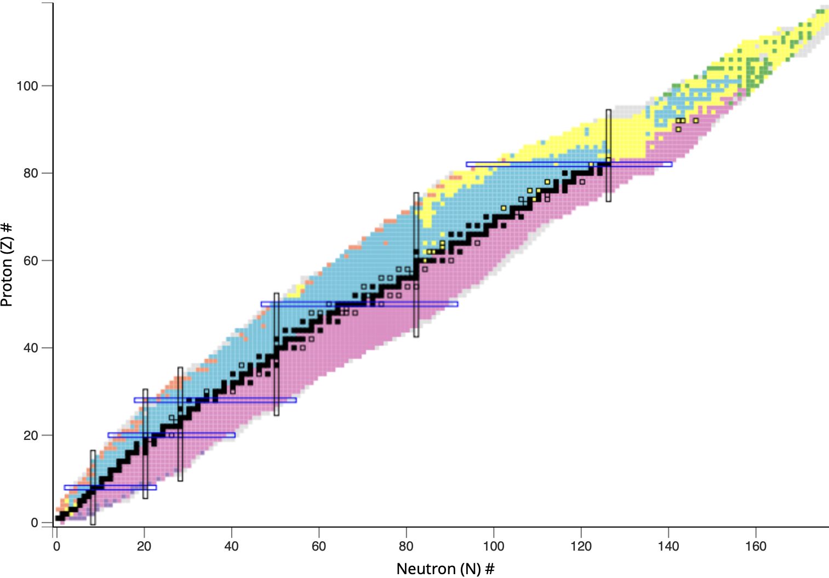


Chart of nuclides
$${}_{Z}^{A}{X_{N}}$$
Decay type:
Electron capture
$β^{−}$ decay
$α$ decay
Proton emission
Neutron emission
“Magic” numbers
Stable nuclei
nndc.bnl.gov

Slide 9
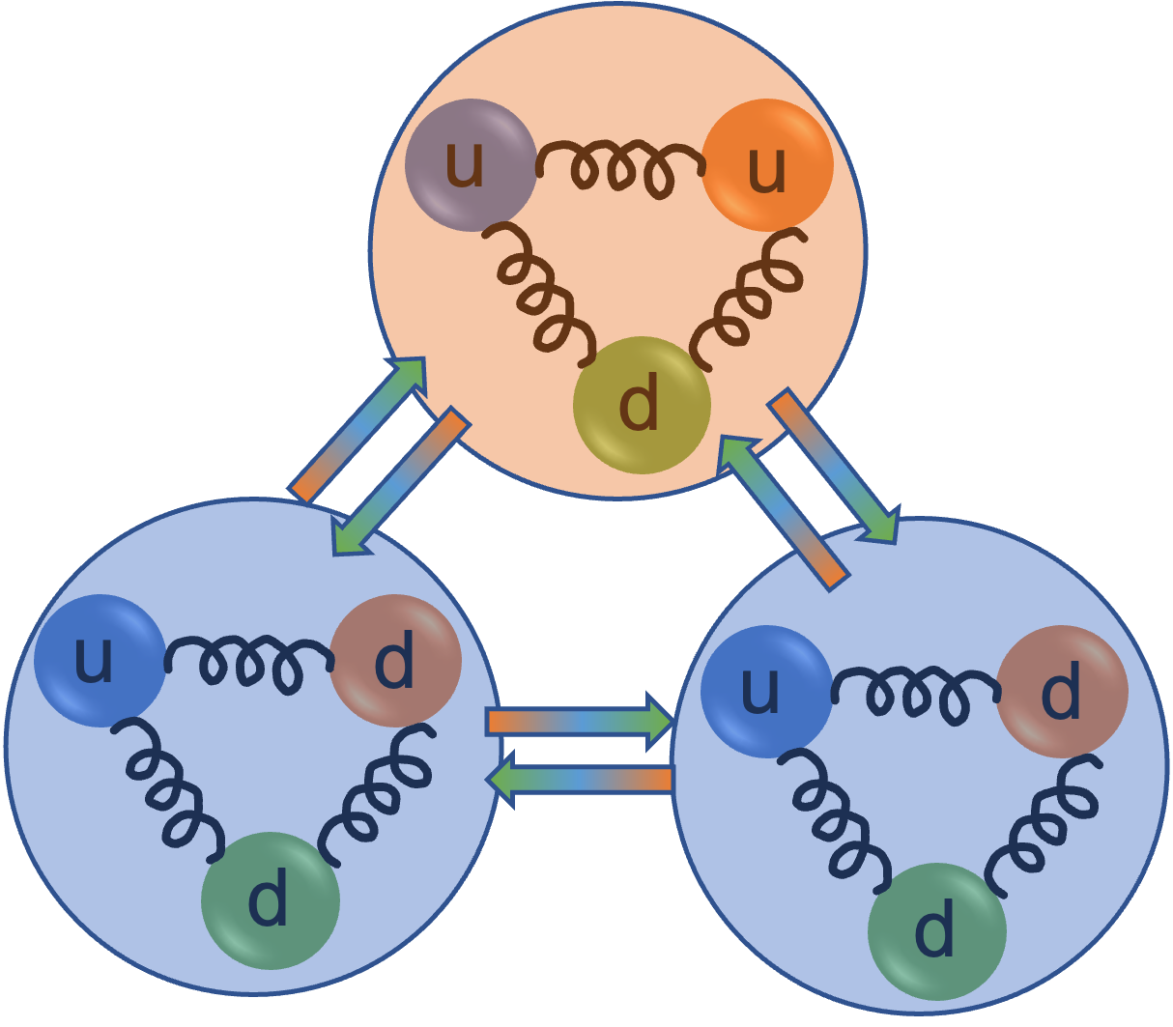

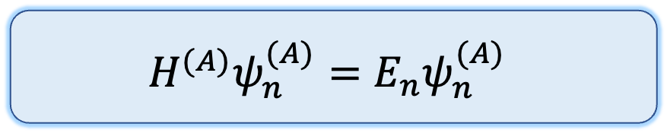





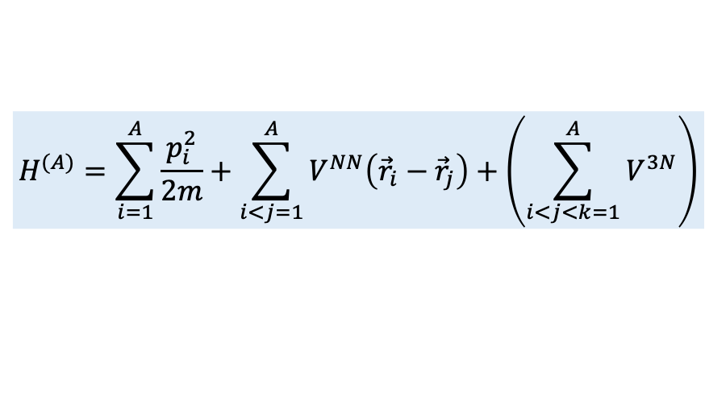

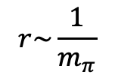
Nuclear many-body problem
$$H^{(A)}ψ_{n}^{(A)}=E_{n}ψ_{n}^{(A)}$$
Groundstate: lowest eigenstate
Excited state: any other eigenstate
Nuclear Hamiltonian
Eigenstate
Eigenenergy
$$H^{(A)}=\sum_{i=1}^{A}{\frac{p_{i}^{2}}{2m}+\sum_{i<j=1}^{A}{V^{NN}\left({\vec{r}}_{i}−{\vec{r}}_{j}\right)}+\left(\sum_{i<j<k=1}^{A}{V^{3N}}\right)}$$
How to model the nuclear force?
?
?
Kinetic energy of a nucleon
Interaction between two nucleons
Interaction between three nucleons
?
How to solve the nuclear many-body problem?
(Pion exchange)
$$r\sim \frac{1}{m_{π}}$$
N
N

Slide 10
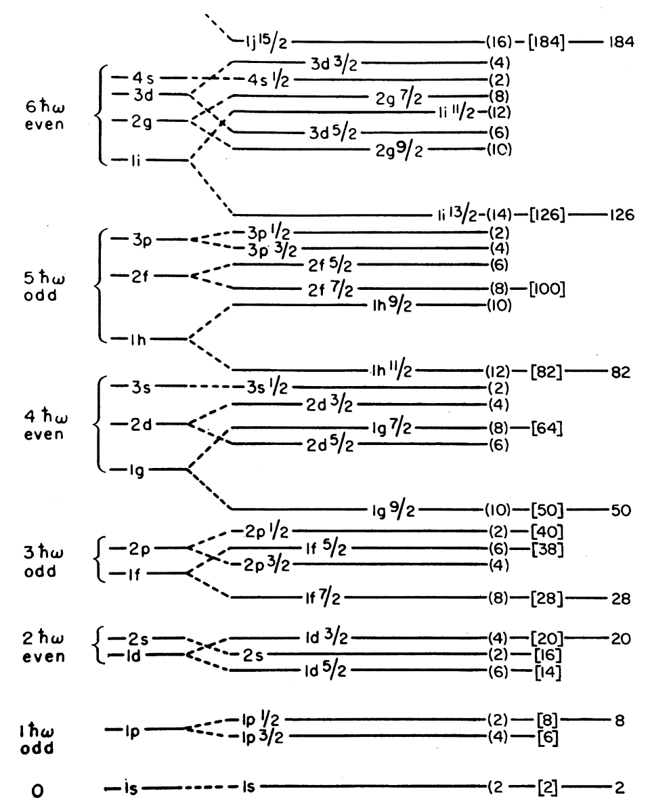
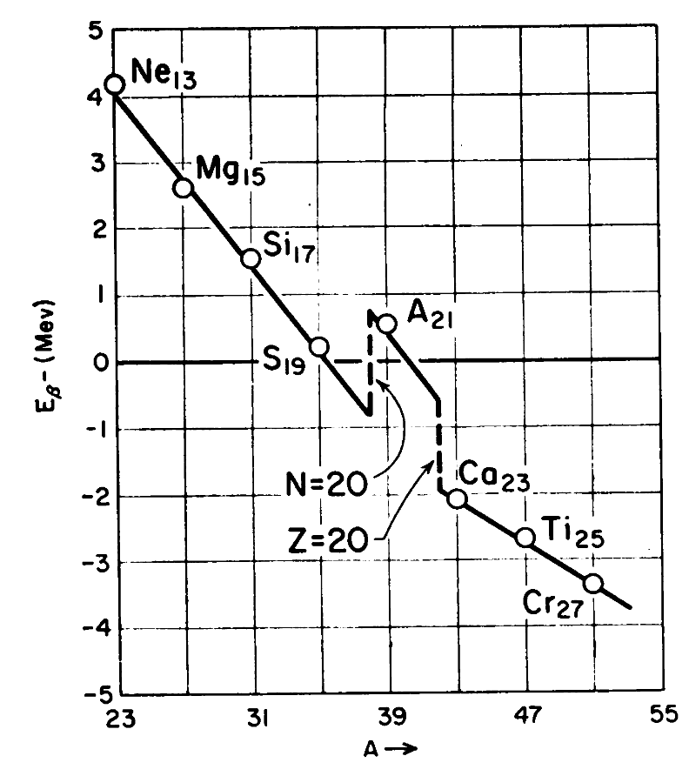
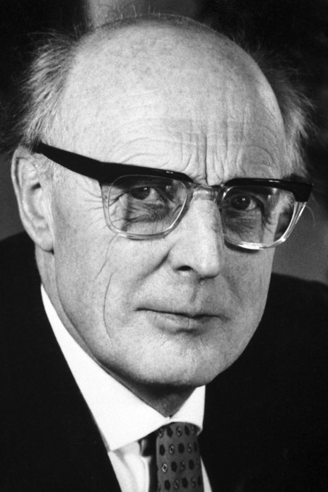
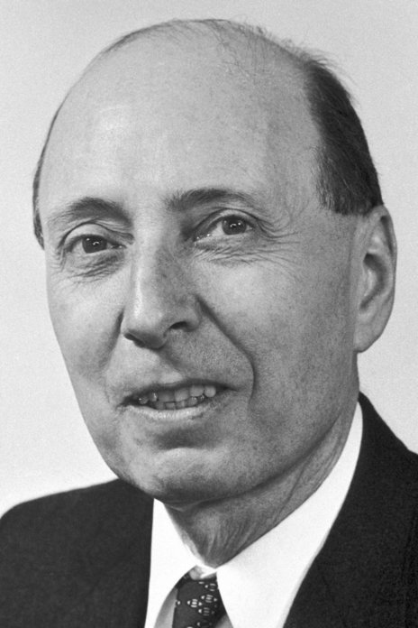
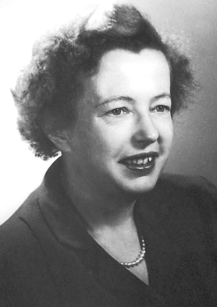
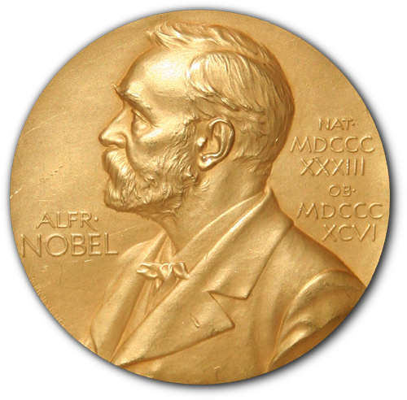
Phenomenological methods based on observations
“Magic” numbers
Nuclear shell model
Wigner
Göppert-Mayer
Jensen
Nobel prize in Physics 1963
M. Göppert-Mayer, Science 145, 999 (1964)

Slide 11
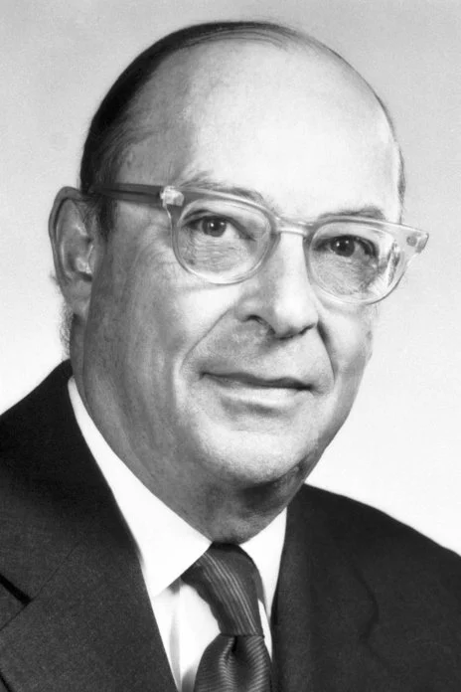
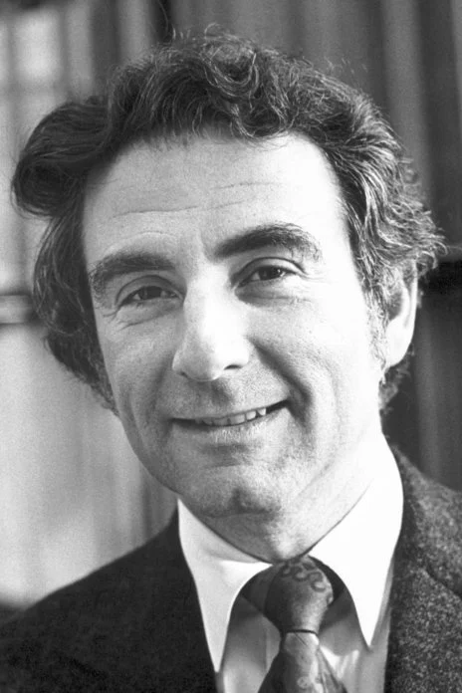
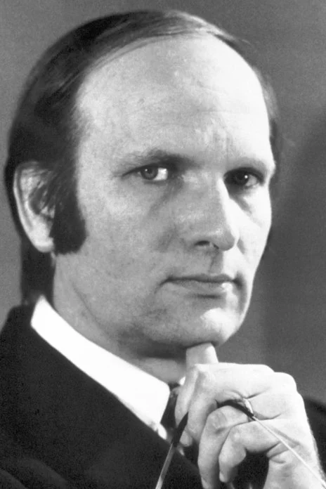
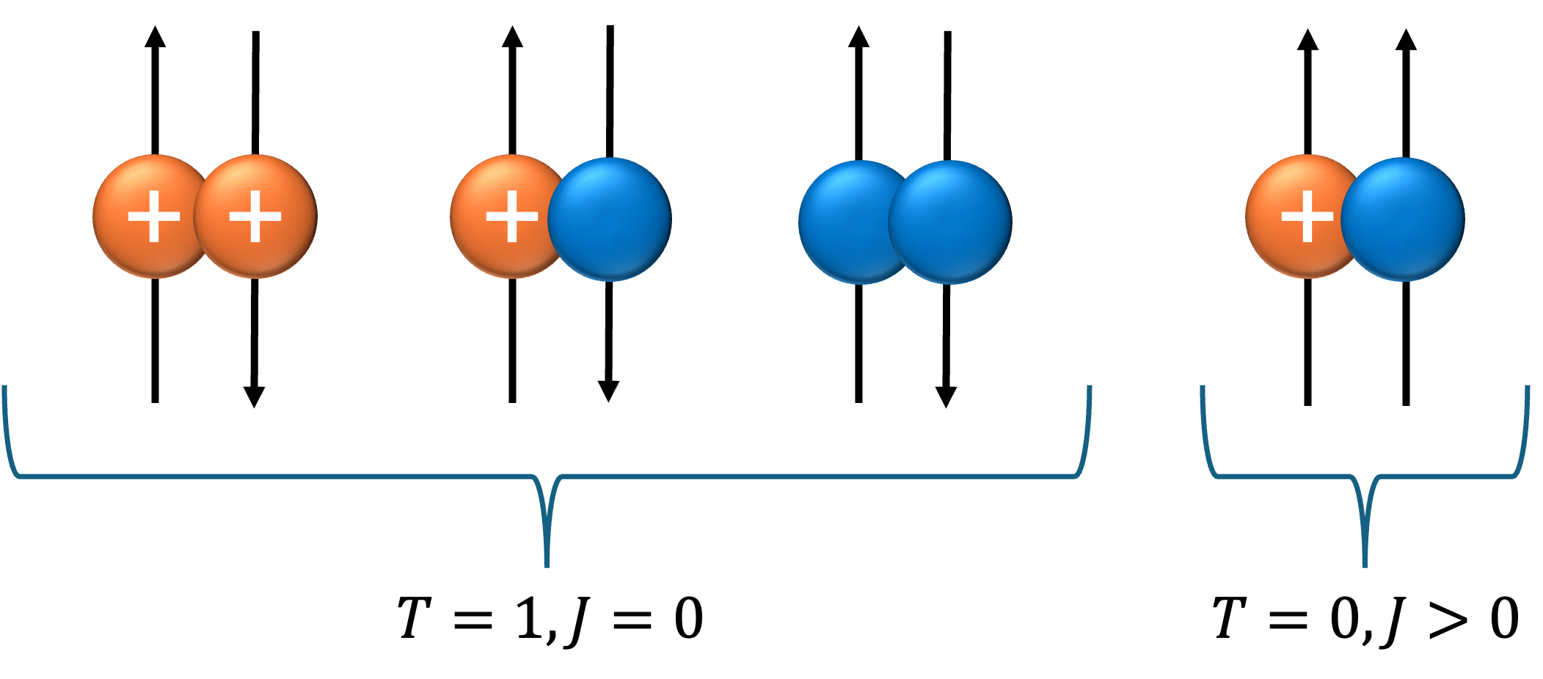
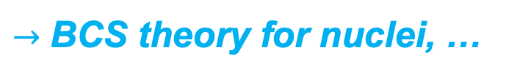


Phenomenological methods based on observations
Nuclear pairing
Bardeen
Cooper
Scrieffer
$$2Δ$$
$$2Δ$$
Nobel prize in Physics 1972
$→$ BCS theory for nuclei, …

Slide 12
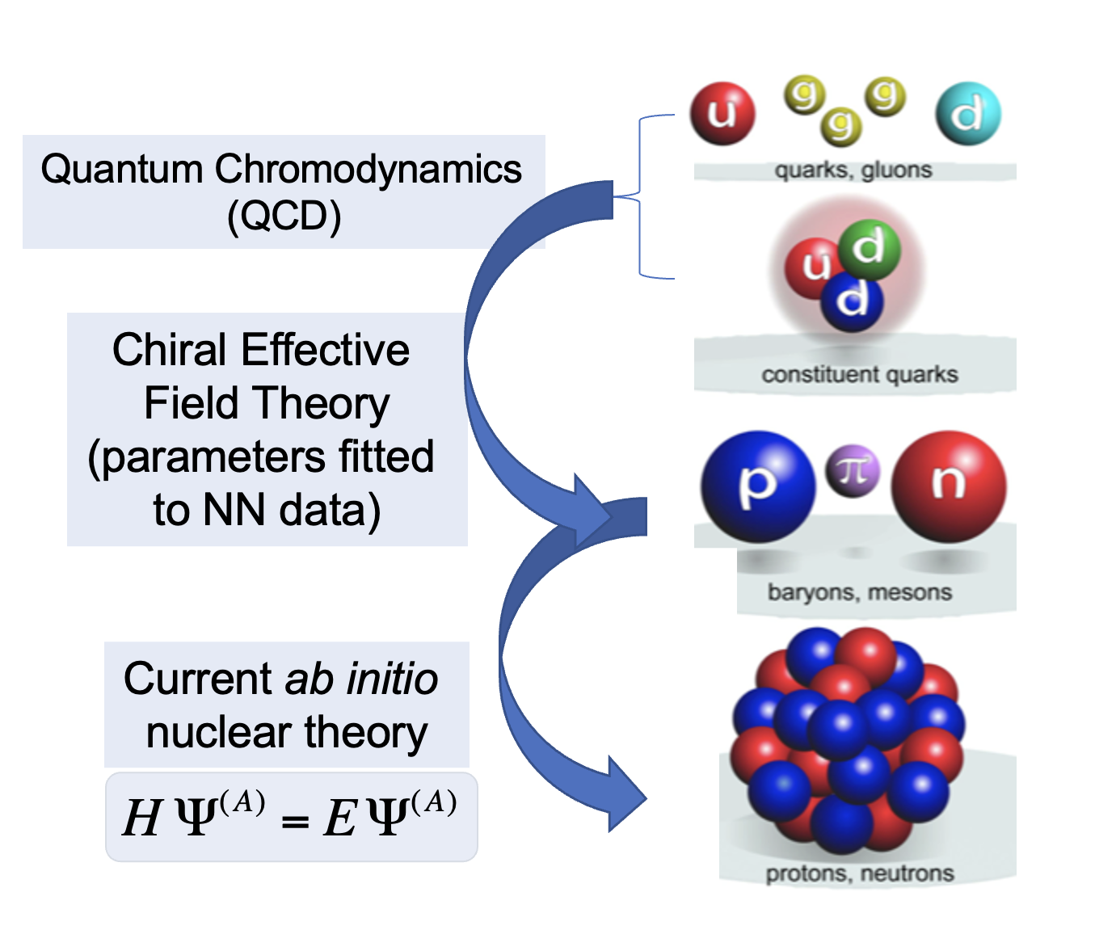
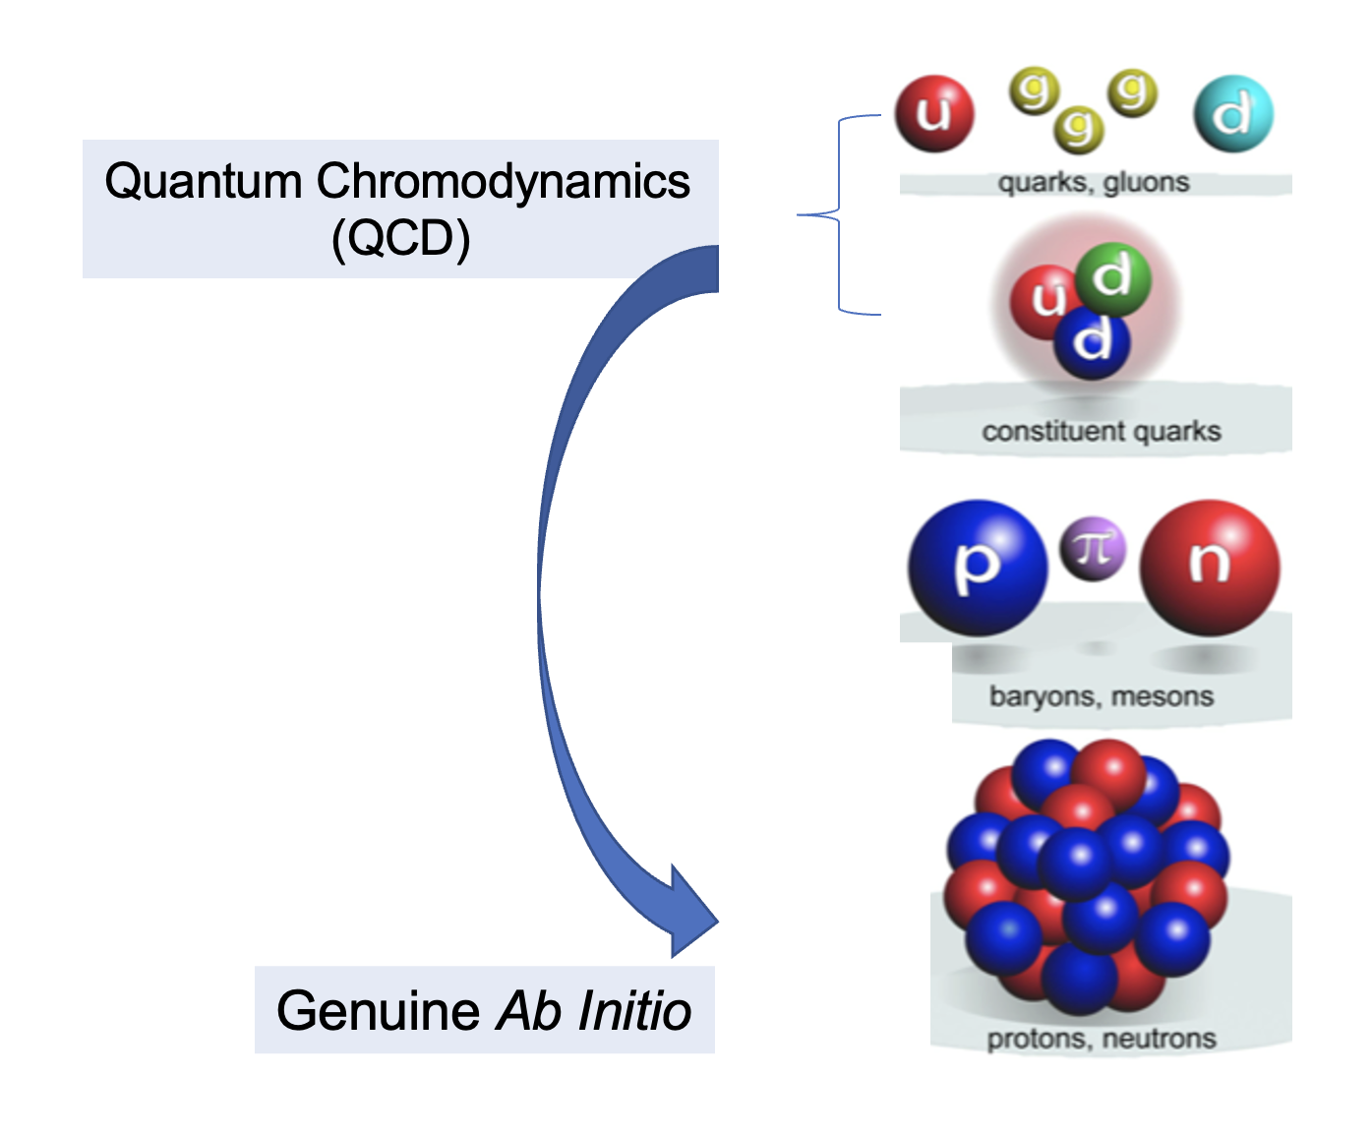
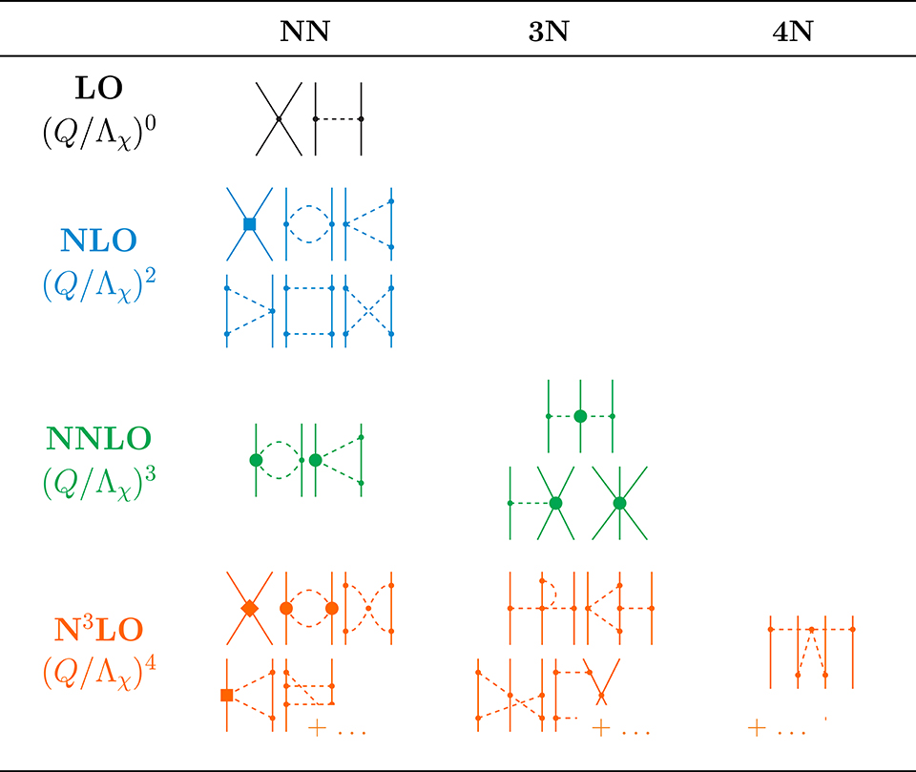

Ab initio (lat. ‘from the beginning’) nuclear theory
Currently
Ideally
Chiral expansion of the nuclear force
$$H^{eff}Ψ^{(A)}=EΨ^{\left(A\right)}$$
Courtesy of Petr Navrátil
H. Hergert, Front. Phys. 8 (2020)
Notes:
Highlight that ab initio methods are systematically improvable

Slide 13
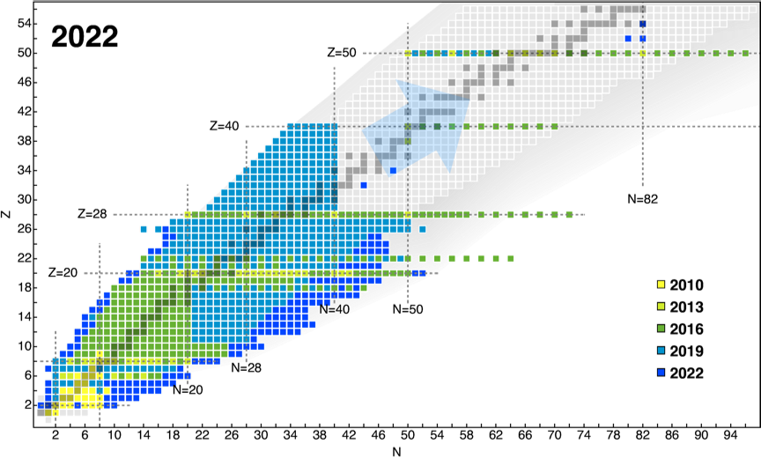
What can we do with ab initio nuclear methods?
Figure courtesy of A. Belley, (adapted from H. Hergert, Front. Phys. 8 (2020))

Slide 14
What is Neutrinoless Double-Beta Decay?

Slide 15
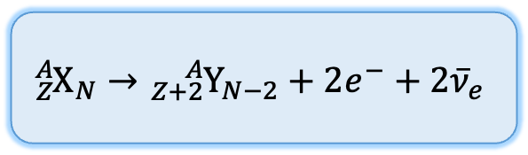
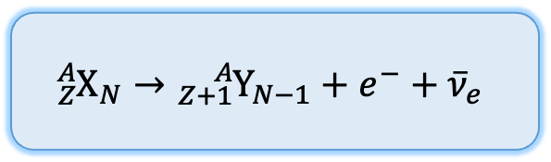
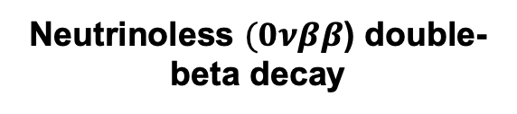
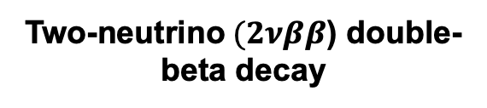

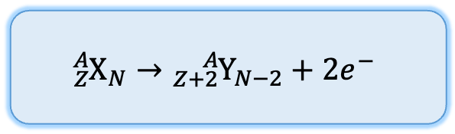
$β$ decays of nuclei
Two-neutrino$(2νββ$) double-beta decay
Neutrinoless $(0νββ$) double-beta decay
Beta ($β^{−}$) decay of a nucleus
$${{}_{Z}^{A}X}_{N}→{{}_{Z+1}^{A}Y}_{N−1}+e^{−}+{\overline{ν}}_{e}$$
$${{}_{Z}^{A}X}_{N}→{{}_{Z+2}^{A}Y}_{N−2}+2e^{−}+{2\overline{ν}}_{e}$$
$${{}_{Z}^{A}X}_{N}→{{}_{Z+2}^{A}Y}_{N−2}+2e^{−}$$
One of the most common decays
VERY rare
As yet hypothetical

Slide 16
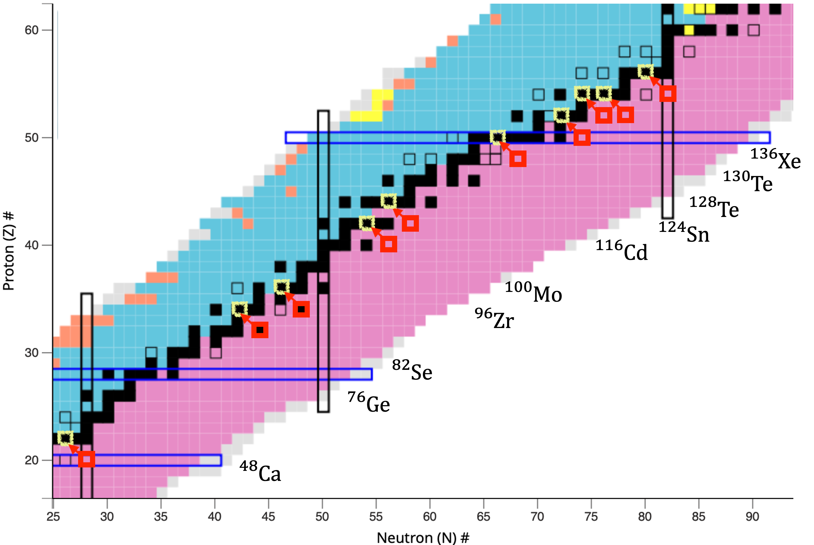
When can nuclei double-$β$ decay?
Modified from nndc.bnl.gov/nudat3/

Slide 17



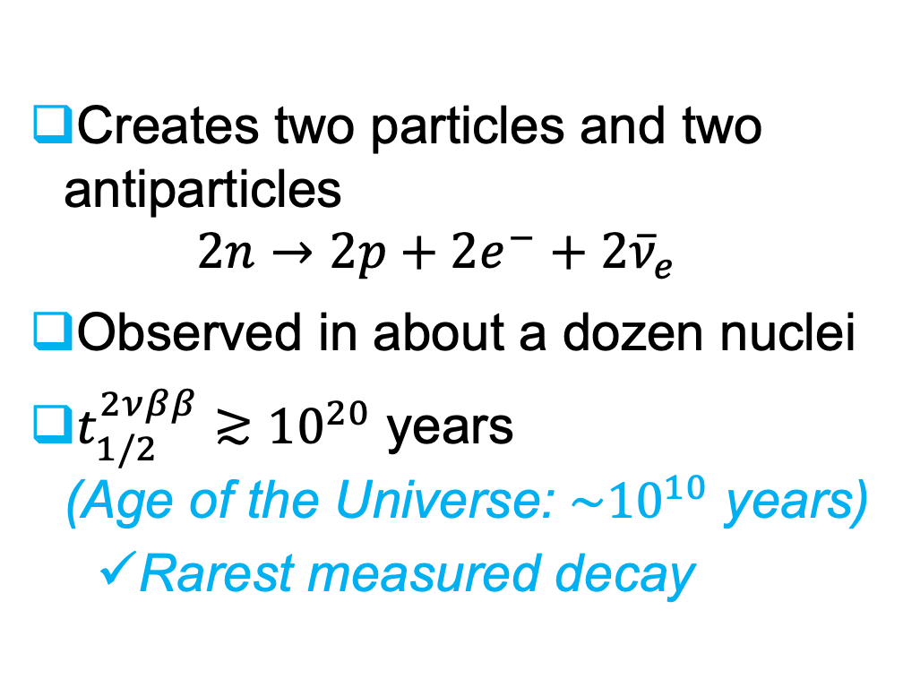
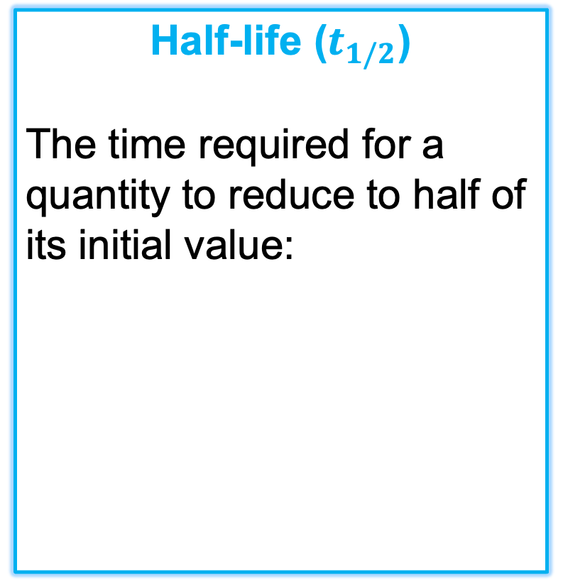
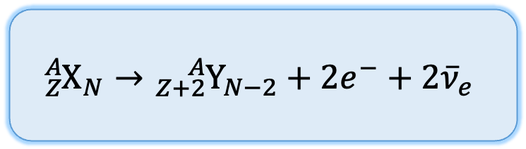
Two-neutrino double-beta ($2νββ$) decay
Creates two particles and two antiparticles $2n→2p+{2e}^{−}+{2\overline{ν}}_{e}$
Observed in about a dozen nuclei
$t_{1/2}^{2νββ}≳{10}^{20}$ years (Age of the Universe: ${\sim 10}^{10}$ years)
Rarest measured decay
Half-life ($t_{1/2}$)
The time required for a quantity to reduce to half of its initial value:
$${{}_{Z}^{A}X}_{N}→{{}_{Z+2}^{A}Y}_{N−2}+2e^{−}+{2\overline{ν}}_{e}$$
M. Goeppert-Mayer 1935

Slide 18
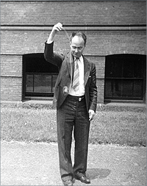
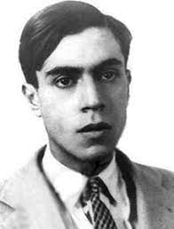
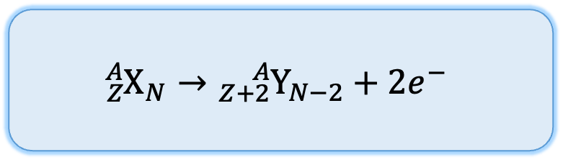
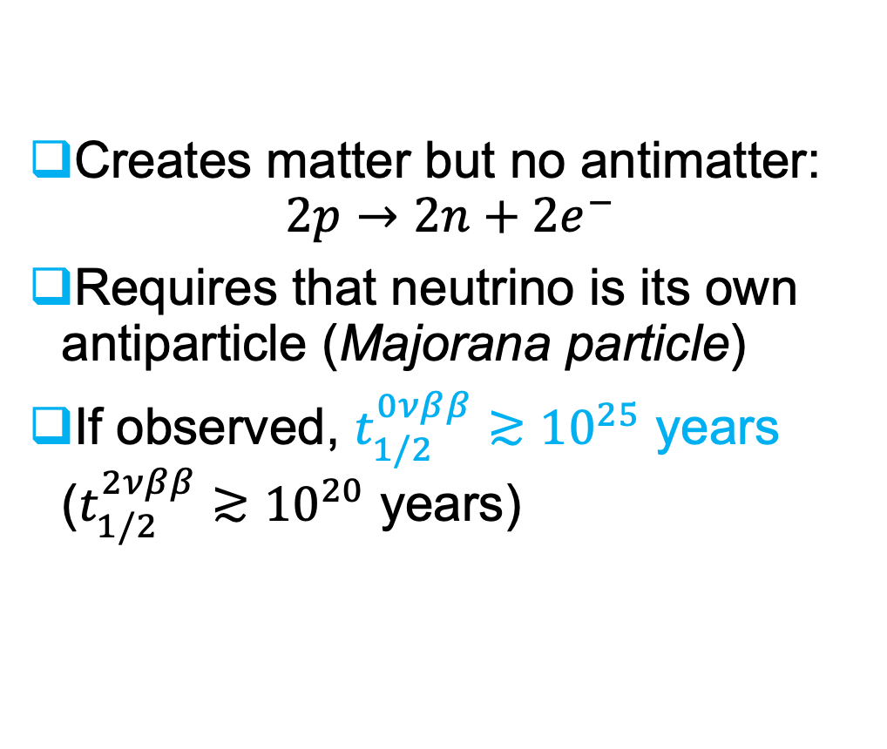
Neutrinoless double-beta ($0νββ$) decay
Creates matter but no antimatter: $2p→2n+{2e}^{−}$
Requires that neutrino is its own antiparticle (Majorana particle)
If observed, $t_{1/2}^{0νββ}≳{10}^{25}$ years ($t_{1/2}^{2νββ}≳{10}^{20}$ years)
$${{}_{Z}^{A}X}_{N}→{{}_{Z+2}^{A}Y}_{N−2}+2e^{−}$$
W. Furry 1939
E. Majorana 1937

Slide 19
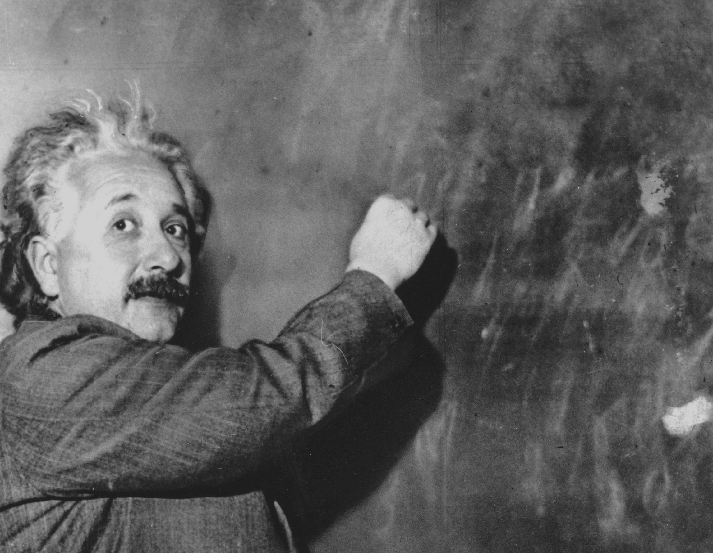
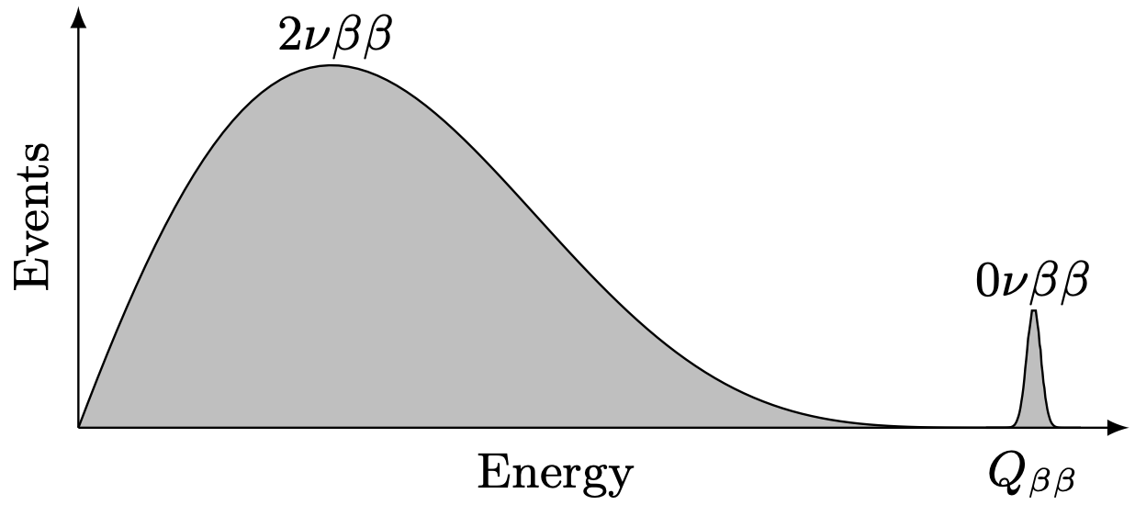
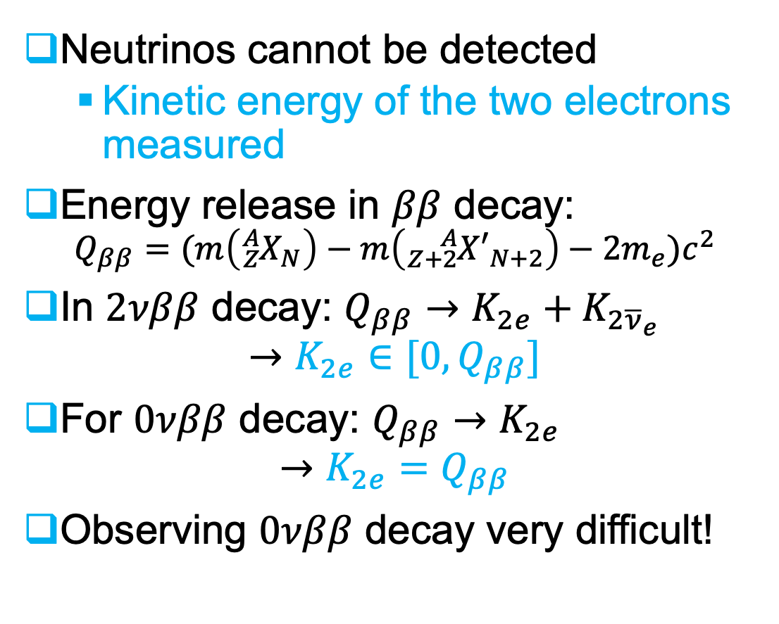
How can double-beta-decay be measured?
Neutrinos cannot be detected
Kinetic energy of the two electrons measured
Energy release in $ββ$ decay: $Q_{ββ}=(m\left({}_{Z}^{A}{X_{N}}\right)−m\left({}_{Z+2}^{A}{{X′}_{N+2}}\right)−2m_{e})c^{2}$
In $2νββ$ decay: $Q_{ββ}→K_{2e}+K_{2{\overline{ν}}_{e}}$ $→K_{2e}∈[0,Q_{ββ}]$
For $0νββ$ decay: $Q_{ββ}→K_{2e}$ $→K_{2e}=Q_{ββ}$
Observing $0νββ$ decay very difficult!
M. Agostini et al., arXiv:2202.01787 [hep-ex]

Slide 20










Double-beta-decay experiments
Kamioka (Japan):
KamLAND-Zen (${}_{}^{136}{Xe}$)
SNOLAB (Canada):
SNO+ (${}_{}^{130}{Te}$)
CNJL(China):
PandaX-III-200 (${}_{}^{136}{Xe}$)
SURF (USA):
MAJORANA (${}_{}^{76}{Ge}$)
LZ-nat (${}_{}^{136}{Xe}$)
LNGS (Italy):
GERDA (${}_{}^{76}{Ge}$)
CUORE (${}_{}^{130}{Te}$)
CUPID-0 (${}_{}^{82}{Se}$)
LEGEND-200 (${}_{}^{76}{Ge}$)
WIPP (USA):
EXO-200 (${}_{}^{136}{Xe}$)
LSC (Spain):
NEXT-100 (${}_{}^{136}{Xe}$)
CROSS (${}_{}^{100}{Mo}$)
LSM (France):
CUPID-Mo (${}_{}^{100}{Mo}$)
NEMO-3 (${}_{}^{100}{Mo}$)
SuperNEMO-D (${}_{}^{82}{Se}$)
Current record: $t_{1/2}^{0νββ}({}_{}^{136}{Xe})>{3.8×10}^{26}$ years

Slide 21



Half-life of neutrinoless double-beta decay
$$\frac{1}{t_{1/2}^{0νββ}}=g_{A}^{4}G^{0νββ}{\left|M^{0νββ}\right|}^{2}{\left(\frac{m_{ββ}}{m_{e}}\right)}^{2}$$
Half-life
Majorana mass
Axial-vector coupling
Phase-space factor
Nuclear matrix element (NME)
Observable to be measured
New physics we want to extract
Known from $β$-decay of neutrons; $g_{A}≈1.27$
Physics of the emitted electrons
$→$ known from atomic physics
From nuclear theory

Slide 22
Nuclear matrix elements currently poorly known
M. Agostini et al., Rev. Mod. Phys. 95, 025002 (2023)

Slide 23




Neutrino masses from $0νββ$ decay
$$m_{3}<m_{1}<m_{2}$$
Effective Majorana mass $m_{ββ}=\sum_{i}{U_{ei}^{2}m_{i}}$ (normal or inverted hierarchy)
From $0νββ$ decay:
$$m_{ββ}=\frac{m_{e}}{g_{A}^{2}\left|M^{0ν}\right|}\frac{1}{\sqrt{G^{0ν}t_{1/2}^{0ν}}}$$
M. Agostini et al., Rev. Mod. Phys. 95, 025002 (2023)
$$m_{1}<m_{2}<m_{3}$$

Slide 24






Next-generation experiments
Kamioka (Japan):
KamLAND2-Zen (${}_{}^{136}{Xe}$)
SNOLAB (Canada):
SNO+II (${}_{}^{130}{Te}$)
Yemilab (Korea):
PandaX-III-200 (${}_{}^{136}{Xe}$)
Goal: $t_{1/2}^{0ν}≳{10}^{28}$ years
LNGS (Italy):
CUPID (${}_{}^{100}{Mo}$)
LSM (France):
SuperNEMO (${}_{}^{82}{Se}$)
+nEXO (${}_{}^{136}{Xe}$), LEGEND-1000 (${}_{}^{76}{Ge}$), NEXT-HD (${}_{}^{136}{Xe}$), Darwin (${}_{}^{136}{Xe}$), …

Slide 25
How Can the Nuclear Theory Predictions Be Improved?
– Corrections to the nuclear matrix elements

Slide 26


Nuclear matrix element
Operator ($2n→2p+2e^{−}$)
$$M^{0ν}=\left\langle Ψ_{f}^{(A)} | 𝒪^{0ν} | Ψ_{i}^{(A)}\right\rangle$$
Final state nuclear wave function
Initial state nuclear wave function
From nuclear many-body method

Slide 27


Nuclear matrix elements of $0νββ$ decay
$$M^{0ν}=\frac{4πR}{g_{A}^{2}}\int{d}x\int{dy}\int{\frac{dk}{{(2π)}^{3}}\frac{e^{ik∙(x−y)}}{|k|}\sum_{n}{\frac{\left\langle f | J_{μ}(x) | n\right\rangle \left\langle n | J^{μ}(y) | i\right\rangle }{\left|k\right|+E_{n}−\frac{1}{2}(E_{i}+E_{f})}}}$$
Hadronic current at the leading order (LO) $𝒥^{0}=τ^{−}\left[g_{V}\left(0\right)\right]$ $J=τ^{−}\text{[}g_{A}(0)σ−g_{P}\left(0\right)q(q∙σ)\text{]}$
Higher order effects absorbed in form factors and induced weak-magnetism terms $𝒥^{0}=τ^{−}\left[g_{V}\left(q^{2}\right)\right]$ $J=τ^{−}\text{[}g_{A}\left(q^{2}\right)σ−g_{P}\left(q^{2}\right)q\left(q∙σ\right)+ig_{M}(q^{2})\frac{σ×q}{2M}\text{]}$
Notes:
Mention axial-vector coupling g_A that can is known from the beta decay of neutron

Slide 28

Effective-field-theory prescription of $0νββ$ decay
$$𝒪^{0ν}=𝒪_{LO}^{0ν}+𝒪_{N^{2}LO}^{0ν}+…$$
Contact term promoted to the LO
What is normally included
Leading order
Next-to-next-to-leading order
V. Cirigliano et al., Phys. Rev. Lett. 120, 202001 (2018), Phys. Rev. C 100, 055504 (2019)

Slide 29




New leading order short-range nuclear matrix element
$$\frac{1}{t_{1/2}^{0νββ}}=g_{A}^{4}G^{0ν}{\left|M_{L}^{0ν}+M_{S}^{0ν}\right|}^{2}{\left(\frac{m_{ββ}}{m_{e}}\right)}^{2}$$
$$\frac{1}{t_{1/2}^{0νββ}}=g_{A}^{4}G^{0ν}{\left|M_{L}^{0ν}\right|}^{2}{\left(\frac{m_{ββ}}{m_{e}}\right)}^{2}$$
The contact term was missing from all calculations V. Cirigliano et al., Phys. Rev. Lett. 120, 202001 (2018), Phys. Rev. C 100, 055504 (2019)
The operator connects directly initial and final nuclei $h_{S}\left(q^{2}\right)=2g_{ν}^{NN}e^{−q^{2}/(2Λ^{2})}$
$$M_{S}^{0ν}=\frac{2R}{πg_{A}^{2}}\left\langle 0_{f}^{+} | \sum_{a,b}{τ_{a}^{−}τ_{b}^{−}\int{dq}}q^{2}j_{0}\left(qr\right)h_{S}(q^{2}) | 0_{i}^{+}\right\rangle$$
Unknown

Slide 30


Nuclear many-body methods
Nuclear shell model (NSM) Caurier et al., Rev. Mod. Phys. 77, 427 (2005)
Solve the nuclear many-body problem in valence space
Use interactions fitted to nuclear data
Proton-neutron quasiparticle random-phase approximation (pnQRPA)
J. Suhonen, From Nucleons to Nucleus: Concepts of Microscopic Nuclear Theory (Springer-Verlag, 2007)
Describe nuclei as two-quasiparticle excitations (quasiparticle$≡$linear combination of particle and hole)
Adjust parameters to nuclear data

Slide 31




Contact term in pnQRPA and nuclear shell model (NSM)
$$\int{C_{L/S}\left(r\right)dr=M_{L/S}^{0ν}}$$
$\frac{M_{S}^{0ν}}{M_{L}^{0ν}}≈30\%−80\%$ (pnQRPA)
$\frac{M_{S}^{0ν}}{M_{L}^{0ν}}≈15\%−50\%$ (NSM)
LJ, P. Soriano, J. Menéndez, Phys. Lett. B 823, 136720 (2021)

Slide 32

Impact of the contact term in the Majorana mass
New theory predictions for $m_{ββ}$ based on experimental limits and nuclear matrix elements for ${}_{}^{76}{Ge}, {}_{}^{130}{Te}$ and ${}_{}^{136}{Xe}$
$M_{L}^{0ν}$
$M_{L}^{0ν}+$ $M_{S}^{0ν}$
LJ, P. Soriano, J. Menéndez, Phys. Lett. B 823, 136720 (2021)
Notes:
Explain that this combines different isotopes

Slide 33
Effective-field theory corrections to the operator
$$𝒪^{0ν}=𝒪_{LO}^{0ν}+𝒪_{N^{2}LO}^{0ν}+…$$
What is normally included
What needs to be included
Leading order
Next-to-next-to-leading order
How about these?
V. Cirigliano et al., Phys. Rev. Lett. 120, 202001 (2018), Phys. Rev. C 100, 055504 (2019)

Slide 34


The ultrasoft-neutrino term
$$M_{usoft}^{0ν}=−\frac{2π}{R}\sum_{n}{\left\langle f | \sum_{a}{{τ_{a}^{−}σ}_{a}} | n\right\rangle \left\langle n | \sum_{b}{{τ_{b}^{−}σ}_{b}} | i\right\rangle } \\ ×(E_{e}+E_{n}−E_{i})(ln\frac{μ_{us}}{2(E_{e}+E_{n}−E_{i})}+1)$$
Contribution from “ultrasoft” neutrinos ($\left|k\right|≪k_{F}\sim 100 MeV$)
$\left|\frac{M_{usoft}^{0ν}}{M_{LO}^{0ν}}\right|≲5\%−10\%$
Can be seen as a correction to the “closure approximation”
D. Castillo, LJ, P. Soriano, J. Menéndez, Phys. Lett. B 860, 139181 (2025)

Slide 35




The $N^{2}LO$ loop corrections
$$M_{loop}^{0ν}=\frac{4R}{πg_{A}^{2}}\left\langle f | \sum_{a,b}{τ_{a}^{−}τ_{b}^{−}\int{dqq^{2}e_{}^{{{−q}^{2}}/{2Λ^{2}}}j_{u}(qr)V_{ν,2}^{(a,b)}}} | i\right\rangle$$
With $V_{ν,2}^{(a,b)}=V_{VV}^{(a,b)}+V_{AA}^{(a,b)}+ln\frac{m_{π}^{2}}{μ_{us}^{2}}V_{usoft}^{(a,b)}+V_{CT}^{(a,b)}$
$\frac{M_{loop}^{0ν}}{M_{LO}^{0ν}}≤10\%$ (pnQRPA)
$\frac{M_{loop}^{0ν}}{M_{LO}^{0ν}}≤5\%$ (NSM)
$$M_{loop}^{0ν}=\int{drC_{loop}^{0ν}}(r)$$
D. Castillo, LJ, J. Menéndez, Phys. Lett. B 860, 139181 (2025)

Slide 36





Towards complete nuclear matrix elements at $N^{2}LO$
$\frac{1}{t_{1/2}^{0νββ}}=g_{A}^{4}G^{0ν}|M_{L}^{0ν}{+M}_{S}^{0ν}+M_{usoft}^{0ν}+M_{loop}^{0ν}$ $|^{2} {\left(\frac{m_{ββ}}{m_{e}}\right)}^{2}$
$$\sim 15\%−80\%$$
NOTE:
Operators evaluated with $χ$EFT Hamiltonians and nuclear wave functions with phenomenological Hamiltonians $→$ inconsistency
$$\sim 5\%−10\%$$
$$\sim 5\%−10\%$$
D. Castillo, LJ, J. Menéndez, Phys. Lett. B 860, 139181 (2025)

Slide 37
Could We Learn from Other Nuclear Processes?

Slide 38



Probing $0νββ$ decay by $2νββ$ decay
Similarities:
Same initial and final nuclei
Weak-interaction processes
Differences:
Different momentum exchange
$2νββ$ decay measured, $0νββ$ not
$q_{2νββ}≈2$ MeV
$q_{0νββ}≈100$ MeV

Slide 39

Probing $0νββ$ decay by $2νββ$ decay
Nuclear matrix elements of $0νββ$ and $2νββ$ decays found to be correlated
We can derive $M^{0ν}$ from the correlations and measured $2νββ$-decay half-lives
Theoretical uncertainties based on systematics
LJ, B. Romeo, P. Soriano, J. Menéndez, Phys. Rev. C 107, 044305 (2023)

Slide 40


Muon capture on nuclei
A muon can replace an electron in an atomic orbit, forming a muonic atom
Eventually in the lowest, ${1s}_{1/2}$, orbit
The muon can then be captured by the nucleus:
$$μ^{−}+{}_{Z}^{A}{X(J_{i}^{π_{i}})}→ν_{μ}+{}_{Z−1}^{A}Y(J_{f}^{π_{f}})$$

Slide 41



$0νββ$ decay vs. muon capture
$q≈\frac{1}{\left|r_{1}−r_{2}\right|}≈100−200$ MeV
Yet hypothetical
$q≈m_{μ}+E_{i}−E_{f}≈100$ MeV
Has been measured!
Both involve hadronic current:
$$𝒥^{0}=τ^{−}\left[g_{V}\left(q^{2}\right)\right] \\ J=τ^{−}\text{[}g_{A}\left(q^{2}\right)σ−g_{P}\left(q^{2}\right)q\left(q∙σ\right)+ig_{M}(q^{2})\frac{σ×q}{2M}\text{]}$$

Slide 42


Ab initio no-core shell model
Solve nuclear many-body problem $H^{(A)}Ψ_{n}^{(A)}=E_{n}Ψ_{n}^{(A)}$
Two- (NN) and three-nucleon (3N) forces from $χ$EFT $H^{(A)}=\sum_{i=1}^{A}{\frac{p_{i}^{2}}{2m}+\sum_{i<j=1}^{A}{V_{ij}^{2N}}+\sum_{i<j<k=1}^{A}{V_{ijk}^{3N}}}$
Expansion in harmonic oscillator (HO) basis $Ψ^{(A)}=\sum_{N=0}^{N_{max}}{\sum_{j}{c_{Nj}φ_{Nj}^{HO}}(r_{1},r_{2},…,r_{A})}$
Courtesy of Petr Navrátil

Slide 43
Muon capture on ${}_{}^{16}O$
LJ, P. Navrátil, J. Kotila, K. Kravvaris, Phys. Rev. C 109, 065501 (2024)

Slide 44

Total muon-capture rates
Rates obtained by summing over ~100 final states
We capture ~85% of the total capture rate in ${}_{}^{12}C$ and ${}_{}^{16}N$
Better estimation with the Lanczos strength function method underway D. Araujo Najera, M. Gennari, LJ, M. Drissi, P. Navrátil, in preparation
LJ, P. Navrátil, J. Kotila, K. Kravvaris, Phys. Rev. C 109, 065501 (2024)

Slide 45


Summary
Neutrinoless double-beta-decay would be a clear signal of physics beyond the Standard Model
Reliable nuclear-theory input is crucial
Correlation with $2νββ$ decay can help constrain the nuclear matrix elements
Muon capture can probe the relevant nuclear-weak currents

Slide 46
Thank you Merci
ljokiniemi@triumf.ca

