Slide 1
Probing New Physics via Nuclear-Weak Processes
Lotta Jokiniemi (she/her/hers)
Postdoctoral Fellow, Theory Department, TRIUMF
University of Tennessee, Knoxville
01/24/2025

Slide 2
Possible funding opportunities
Natural Science Foundation (NSF)
  The Faculty Early Career Development (CAREER)
Department of Energy (DoE)
  Early Career Research Program
ACCESS by NSF
Frontier at ORNL
Computing time

Slide 3
Motivation

Slide 4
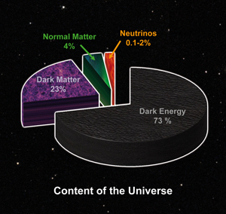
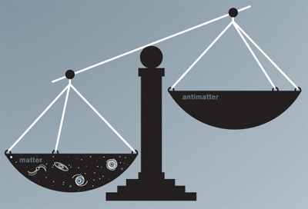
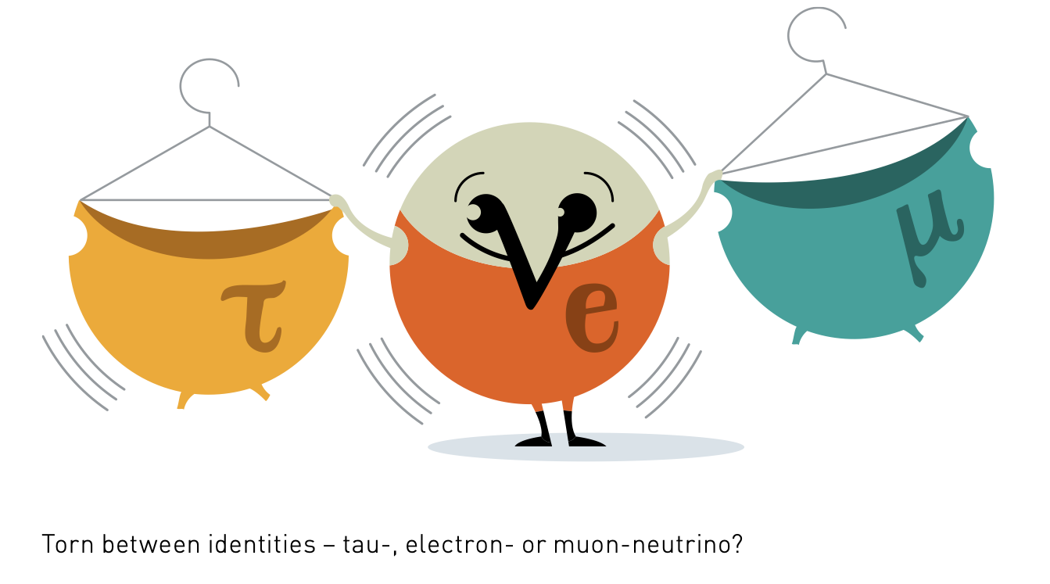
The Big Picture – Physics Beyond the Standard Model
Source: The Royal Swedish Academy of Science
Source: Quantum Diaries
Source: Helmholtz Association – Alliance for Astroparticle Physics
Neutrino masses
Matter-antimatter asymmetry
Dark matter and dark energy

Slide 5
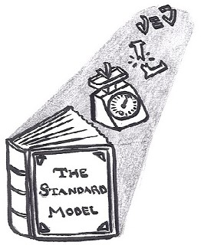
What Can We Learn from Nuclear Physics?
Vision of LJ ca. 2016

Slide 6
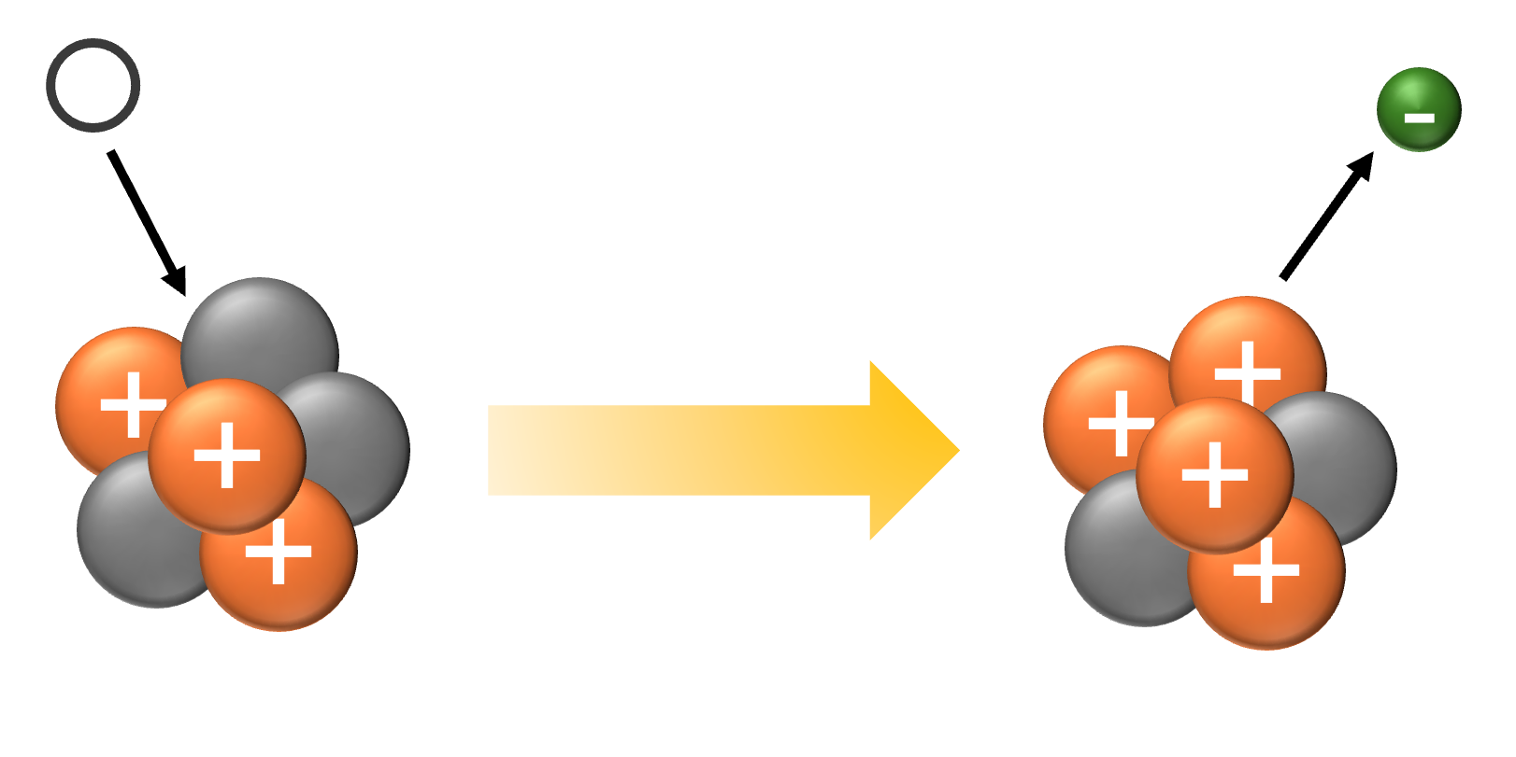
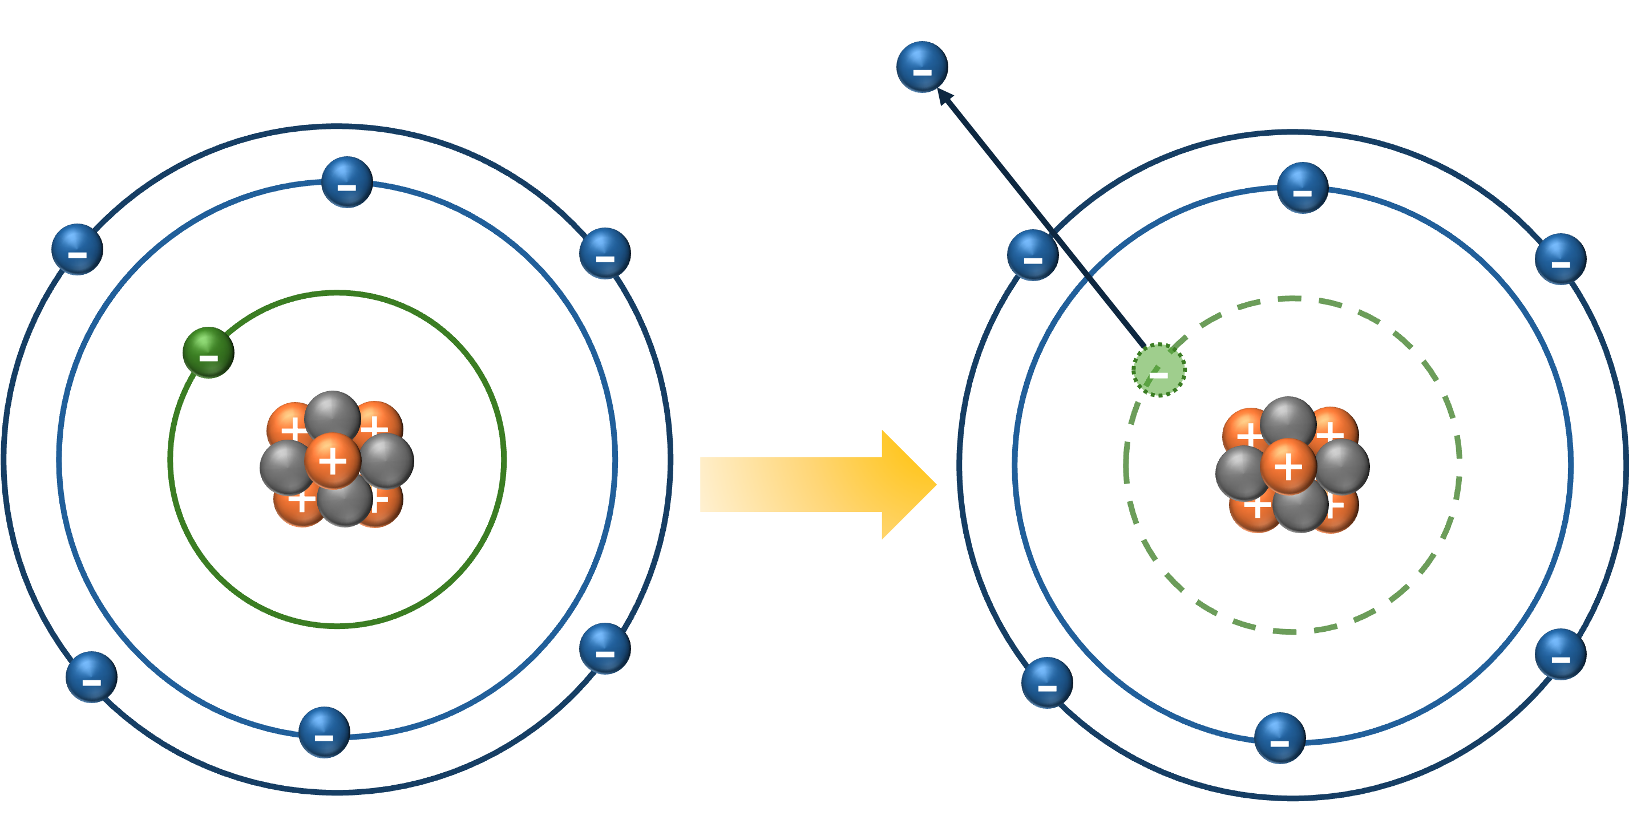
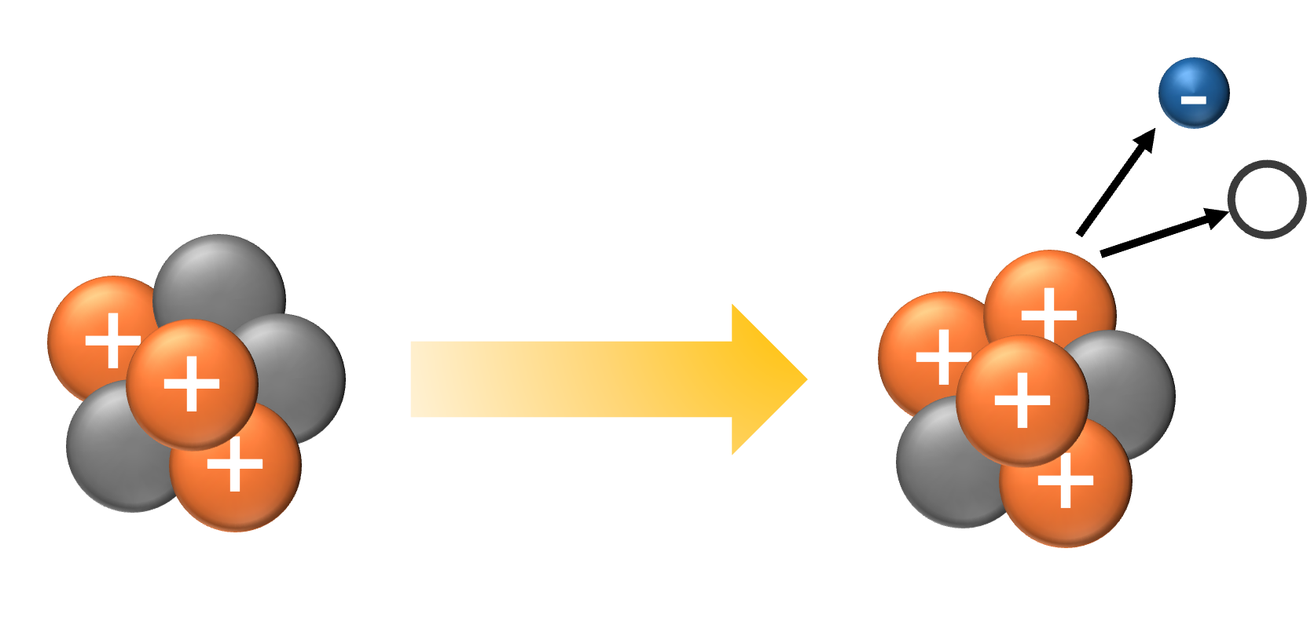
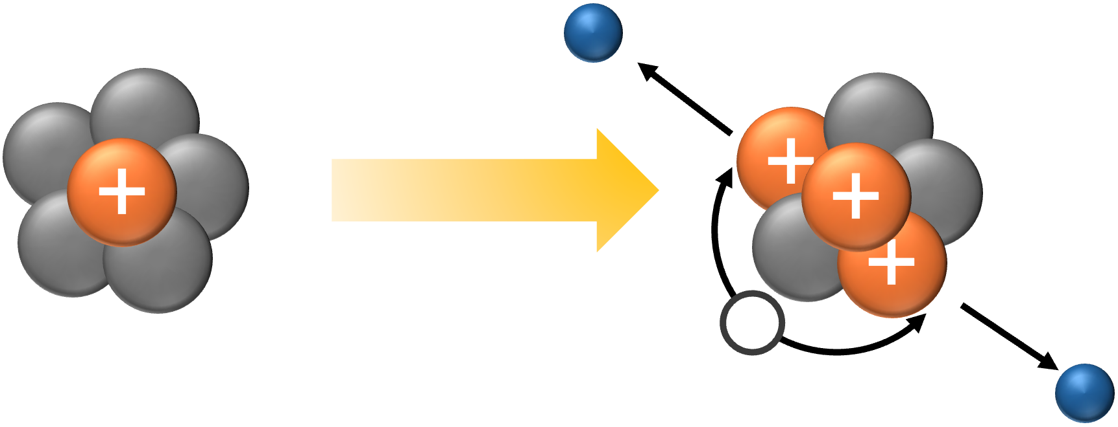

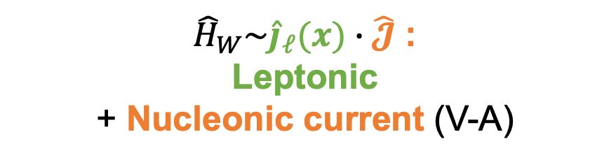
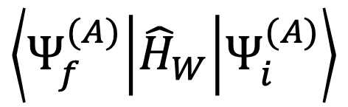

Where to Find New Physics in Nuclei?
Processes forbidden by the SM
Possible BSM contributions
Muon to electron conversion
Initial and final nuclear states
Neutrino-nucleus scattering
$$\left\langle Ψ_{f}^{(A)} | {\hat{H}}_{W} | Ψ_{i}^{(A)}\right\rangle$$
${\hat{H}}_{W}\sim {\hat{j}}_{ℓ}(x)∙\hat{𝓙}$ :
Leptonic
+ Nucleonic current (V-A)
$0νββ$ Decay
Forbidden $β$ decays

Slide 7


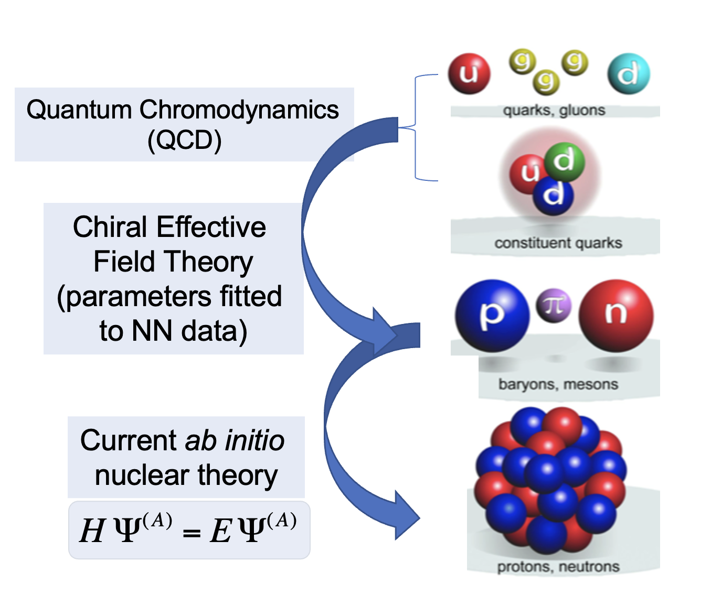

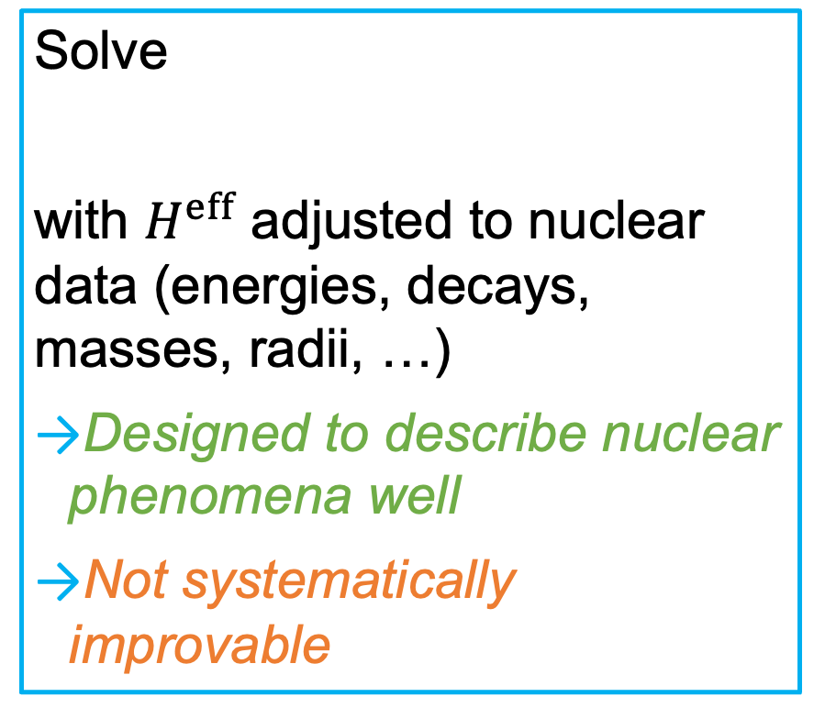
Nuclear many-body methods
Ab initio
Phenomenological
Solve
with $H^{eff}$ adjusted to nuclear data (energies, decays, masses, radii, …)
Designed to describe nuclear phenomena well
Not systematically improvable
$$H^{eff}Ψ^{(A)}=EΨ^{\left(A\right)}$$
Notes:
Highlight that ab initio methods are systematically improvable

Slide 8
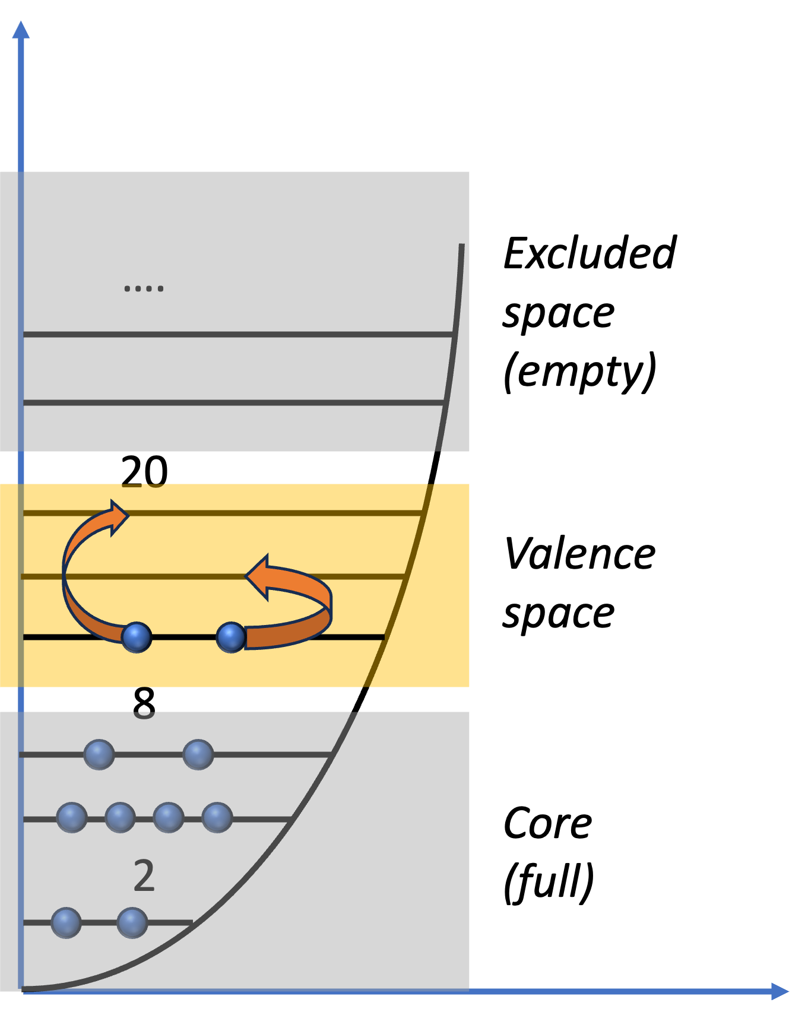
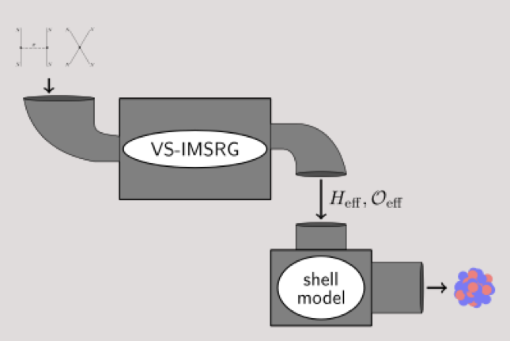
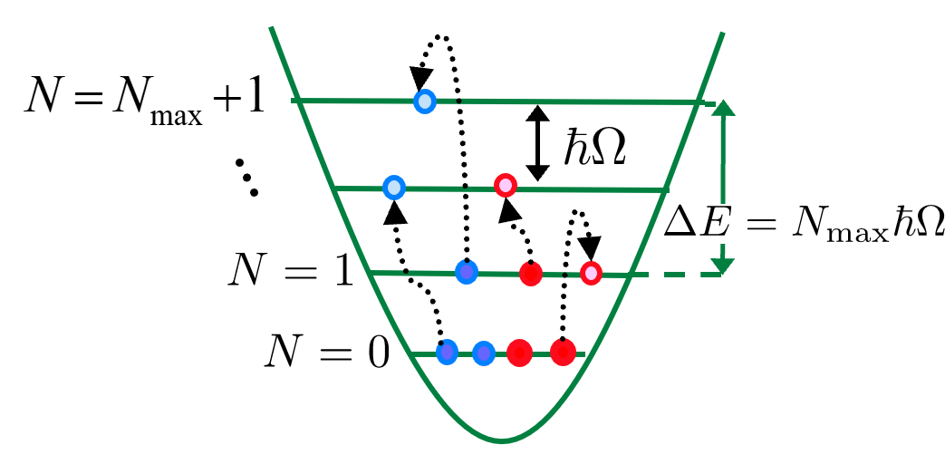
Examples of Nuclear Many-Body Methods
Phenomenological
  Nuclear Shell Model (NSM)
  Quasiparticle Random-Phase Approximation (QRPA)
Ab initio
  Valence-Space In-Medium Similarity Renormalization Group (VS-IMSRG)
  No-Core Shell Model (NCSM)
Figure courtesy of: P. Navrátil
Figure courtesy of: S. R. Stroberg

Slide 9
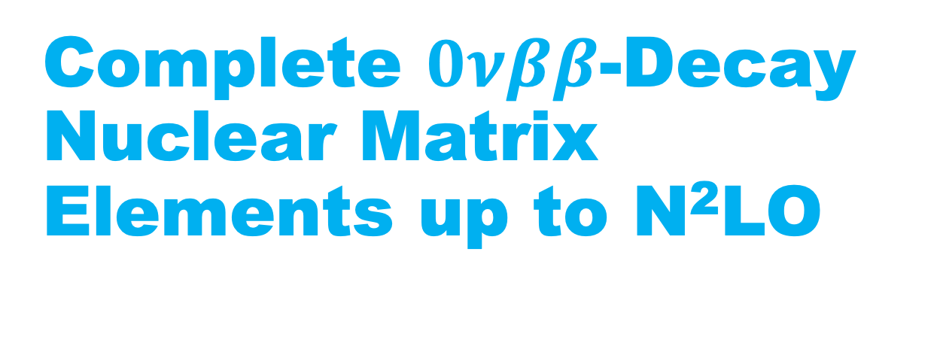
Complete $0νββ$-Decay Nuclear Matrix Elements up to N²LO

Slide 10
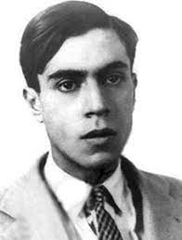
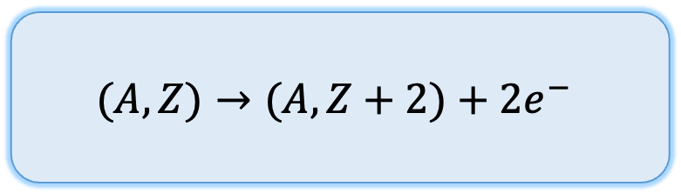
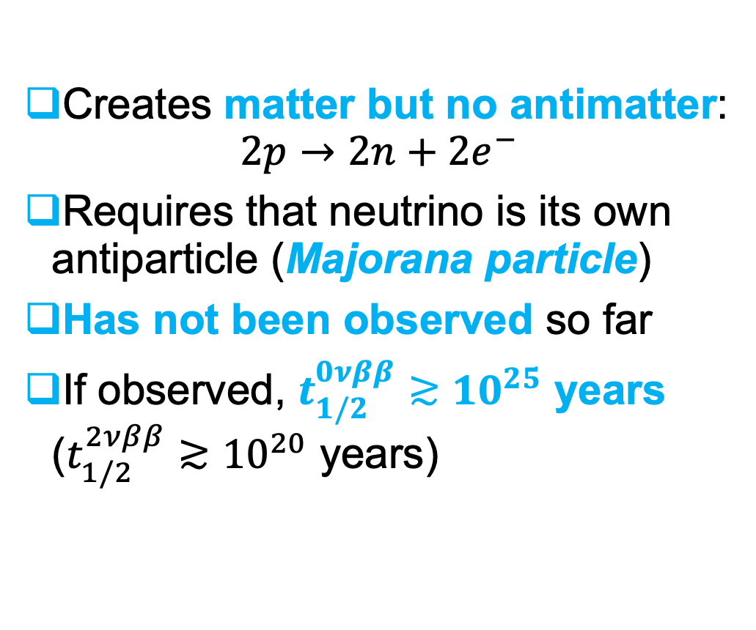
Neutrinoless Double-Beta ($0νββ$) Decay
E. Majorana 1937
Creates matter but no antimatter:
$2p→2n+{2e}^{−}$
Requires that neutrino is its own antiparticle (Majorana particle)
Has not been observed so far
If observed, $t_{1/2}^{0νββ}≳{10}^{25}$ years
($t_{1/2}^{2νββ}≳{10}^{20}$ years)
$$(A,Z)→(A,Z+2)+2e^{−}$$

Slide 11

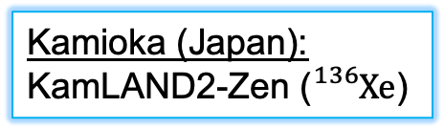
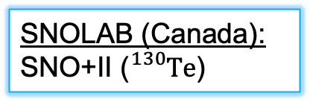
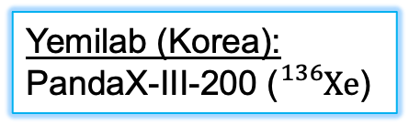
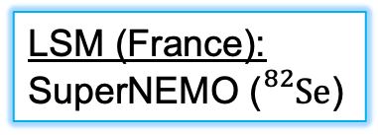

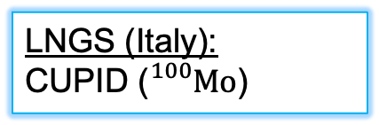
Next-generation experiments
Kamioka (Japan):
KamLAND2-Zen (${}_{}^{136}{Xe}$)
SNOLAB (Canada):
SNO+II (${}_{}^{130}{Te}$)
Yemilab (Korea):
PandaX-III-200 (${}_{}^{136}{Xe}$)
Goal: $t_{1/2}^{0ν}≳{10}^{28}$ years
LNGS (Italy):
CUPID (${}_{}^{100}{Mo}$)
LSM (France):
SuperNEMO (${}_{}^{82}{Se}$)
+nEXO (${}_{}^{136}{Xe}$), LEGEND-1000 (${}_{}^{76}{Ge}$), NEXT-HD (${}_{}^{136}{Xe}$), Darwin (${}_{}^{136}{Xe}$), …

Slide 12
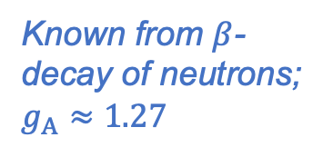
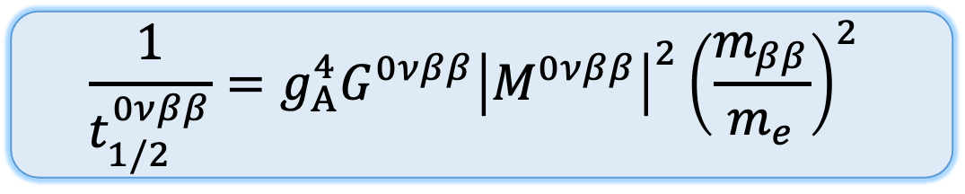
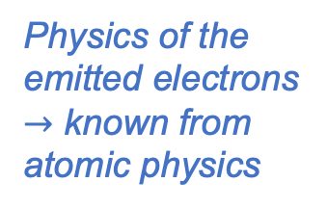
Half-life of neutrinoless double-beta decay
$$\frac{1}{t_{1/2}^{0νββ}}=g_{A}^{4}G^{0νββ}{\left|M^{0νββ}\right|}^{2}{\left(\frac{m_{ββ}}{m_{e}}\right)}^{2}$$
Half-life
Effective Majorana mass
Axial-vector coupling
Phase-space factor
Nuclear matrix element (NME)
Observable to be measured
New physics we want to extract
Known from $β$-decay of neutrons; $g_{A}≈1.27$
Physics of the emitted electrons
$→$ known from atomic physics
From nuclear theory

Slide 13
Main Goal: Quantified Uncertainties for the Nuclear Matrix Elements
M. Agostini et al., Rev. Mod. Phys. 95, 025002 (2023)

Slide 14
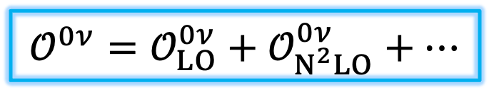
Effective-Field-Theory Approach to $0νββ$ Decay
$$𝒪^{0ν}=𝒪_{LO}^{0ν}+𝒪_{N^{2}LO}^{0ν}+…$$
Needs to be promoted to the LO
What is normally included
Leading order
Next-to-next-to-leading order
V. Cirigliano et al., Phys. Rev. Lett. 120, 202001 (2018), Phys. Rev. C 100, 055504 (2019)

Slide 15

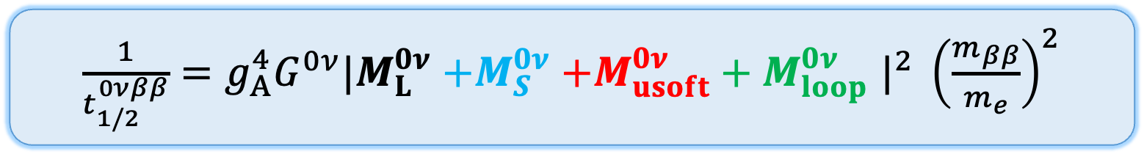
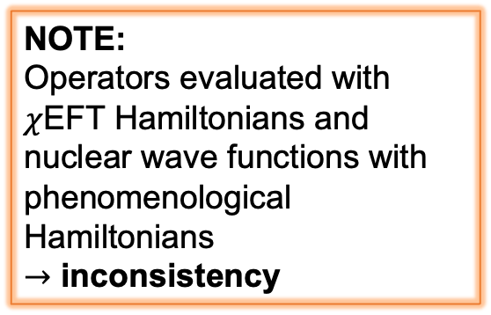


Towards complete nuclear matrix elements at $N^{2}LO$
$\frac{1}{t_{1/2}^{0νββ}}=g_{A}^{4}G^{0ν}|M_{L}^{0ν}{+M}_{S}^{0ν}+M_{usoft}^{0ν}+M_{loop}^{0ν}$ $|^{2} {\left(\frac{m_{ββ}}{m_{e}}\right)}^{2}$
$$\sim 15\%−80\%$$
NOTE:
Operators evaluated with $χ$EFT Hamiltonians and nuclear wave functions with phenomenological Hamiltonians
$→$ inconsistency
$$\sim 5\%−10\%$$
$$\sim 5\%−10\%$$
D. Castillo, LJ, J. Menéndez, Phys. Lett. B 860, 139181 (2025)

Slide 16
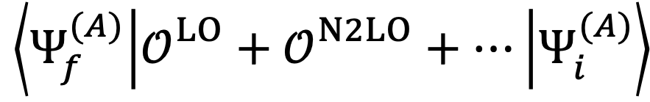


Consistent $χ$EFT Analysis of $0νββ$ Decay
$$\left\langle Ψ_{f}^{(A)} | 𝒪_{}^{LO}+𝒪_{}^{N2LO}+… | Ψ_{i}^{(A)}\right\rangle$$
Currently
Ideally
$$H^{eff}$$
$$H_{χEFT}$$
Benchmarks in light nuclei with NCSM
Extend to heavier nuclei with VS-IMSRG (and CC)
D. Castillo, LJ, J. Menéndez,
Phys. Lett. B 860, 139181 (2025)

Slide 17
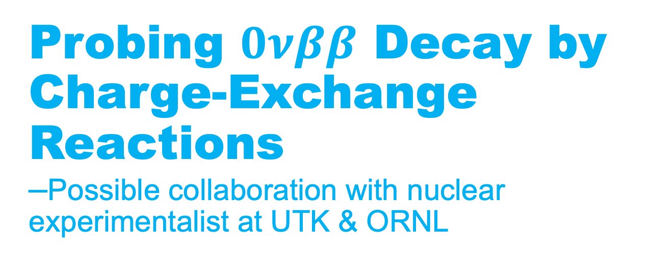
Probing $0νββ$ Decay by Charge-Exchange Reactions
–Possible collaboration with nuclear experimentalist at UTK & ORNL

Slide 18
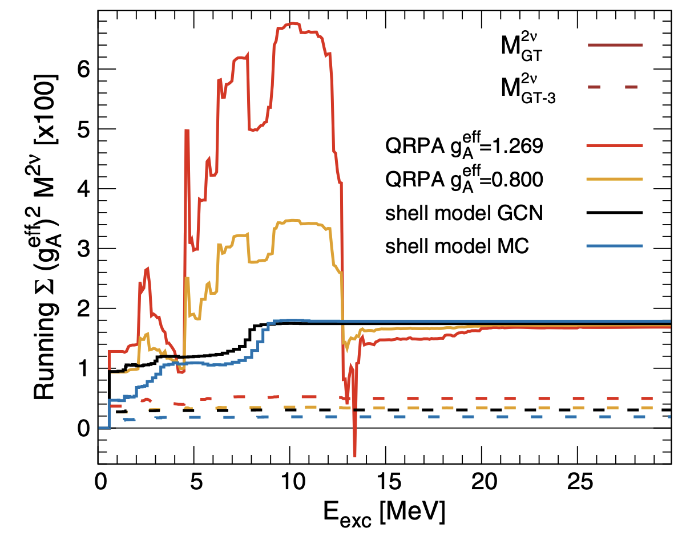
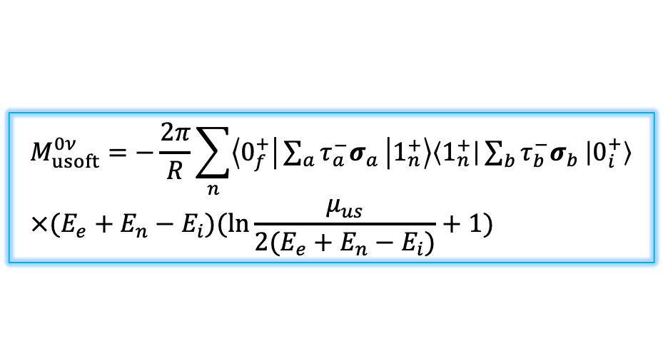
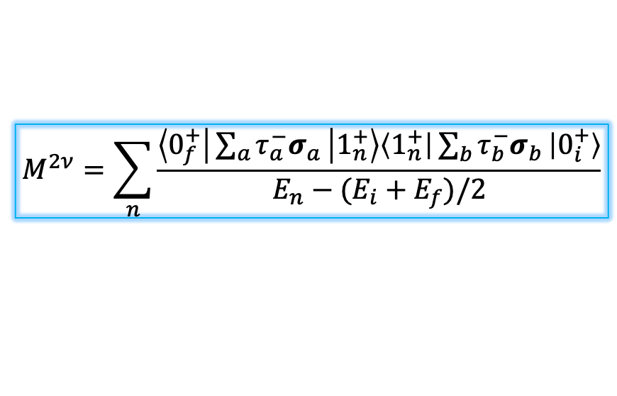
Many-Body Methods Disagree on Running Sums
$$M_{usoft}^{0ν}=−\frac{2π}{R}\sum_{n}{\left\langle 0_{f}^{+} | \sum_{a}{{τ_{a}^{−}σ}_{a}} | 1_{n}^{+}\right\rangle \left\langle 1_{n}^{+} | \sum_{b}{{τ_{b}^{−}σ}_{b}} | 0_{i}^{+}\right\rangle } \\ ×(E_{e}+E_{n}−E_{i})(ln\frac{μ_{us}}{2(E_{e}+E_{n}−E_{i})}+1)$$
$$M^{2ν}=\sum_{n}{\frac{\left\langle 0_{f}^{+} | \sum_{a}{τ_{a}^{−}σ_{a}} | 1_{n}^{+}\right\rangle \left\langle 1_{n}^{+} | \sum_{b}{τ_{b}^{−}σ_{b}} | 0_{i}^{+}\right\rangle }{E_{n}−(E_{i}+E_{f})/2}}$$
D. Castillo, LJ, J. Menéndez,
Phys. Lett. B 860, 139181 (2025)
KamLAND-Zen Collaboration, Phys. Rev. Lett. 122, 192501 (2019)

Slide 19
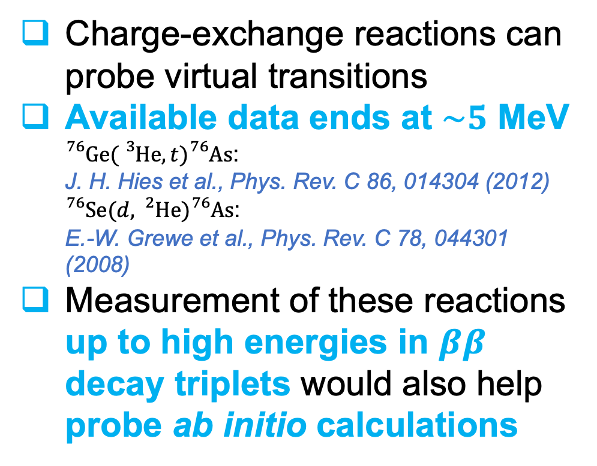
Probing $ββ$Decays by Charge-Exchange Reactions
Charge-exchange reactions can probe virtual transitions
Available data ends at $\sim 5$ MeV
${}_{}^{76}{Ge({}_{}^{3}{He},t)}{}_{}^{76}{As}$:
J. H. Hies et al., Phys. Rev. C 86, 014304 (2012)
${}_{}^{76}{Se(d,{}_{}^{2}{He})}{}_{}^{76}{As}$:
E.-W. Grewe et al., Phys. Rev. C 78, 044301 (2008)
Measurement of these reactions up to high energies in $ββ$ decay triplets would also help probe ab initio calculations
Modified from D. Castillo, LJ, J. Menéndez,
Phys. Lett. B 860, 139181 (2025)

Slide 20
Precision Physics with Muonic Atoms

Slide 21
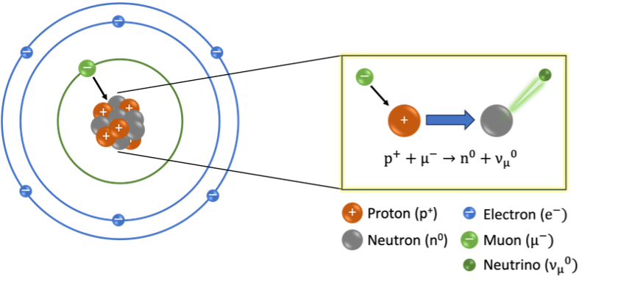
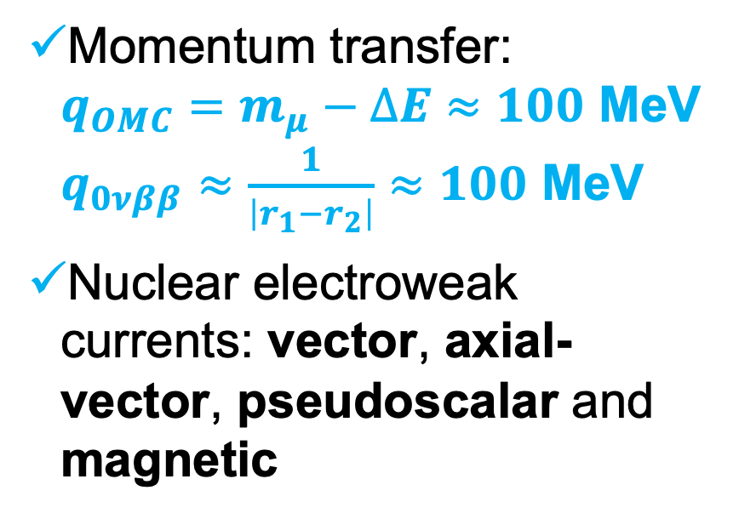
Probing $0νββ D$ecay by Ordinary Muon Capture (OMC)
Similarities:
Momentum transfer:
$q_{OMC}=m_{μ}−∆E≈100$ MeV
$q_{0νββ}≈\frac{1}{\left|r_{1}−r_{2}\right|}≈100$ MeV
Nuclear electroweak currents: vector, axial-vector, pseudoscalar and magnetic

Slide 22
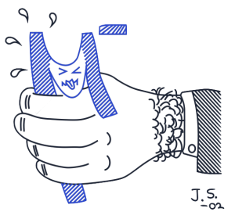
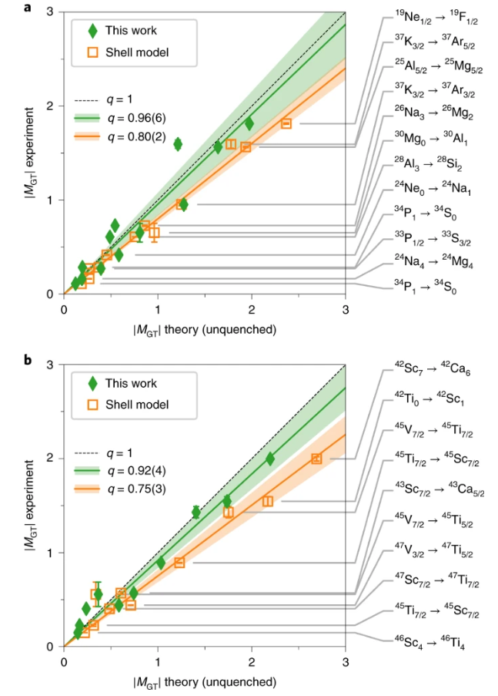
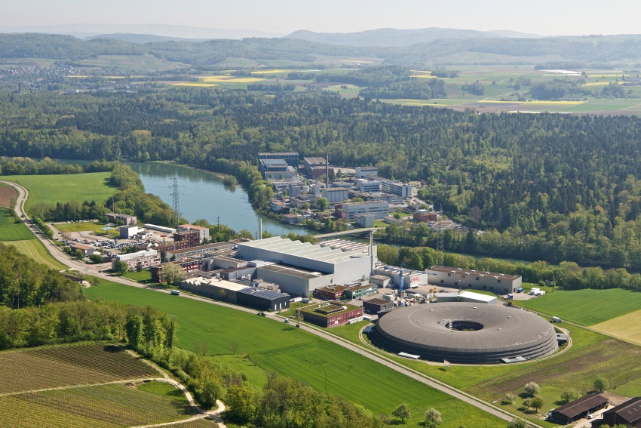
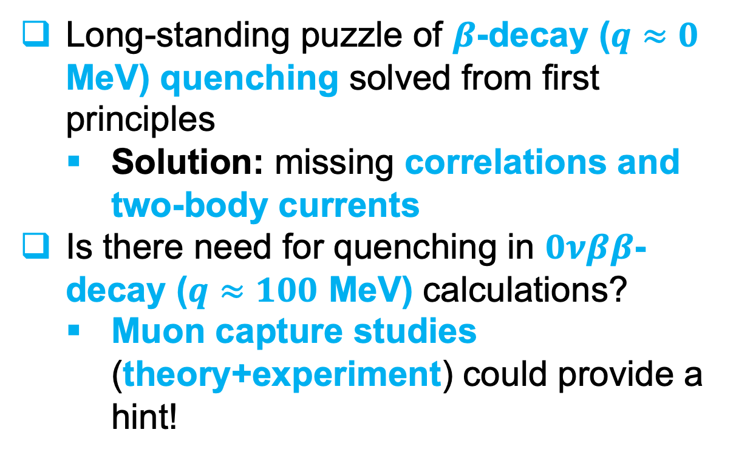
Muon capture and two-body currents
Long-standing puzzle of $β$-decay ($q≈0$ MeV) quenching solved from first principles
  Solution: missing correlations and two-body currents
Is there need for quenching in $0νββ$-decay ($q≈100$ MeV) calculations?
  Muon capture studies (theory+experiment) could provide a hint!
MONUMENT Experiment @ PSI
Eur. Phys. J. C 84, 1188 (2024)
P. Gysbers, G. Hagen, J.D. Holt et al., Nature Phys. 15, 428 (2019)

Slide 23
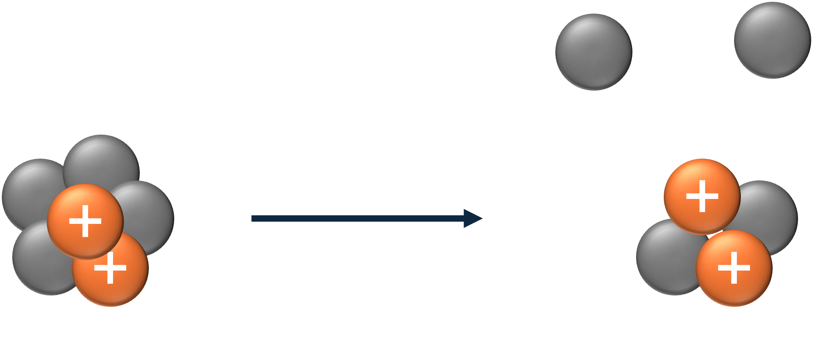
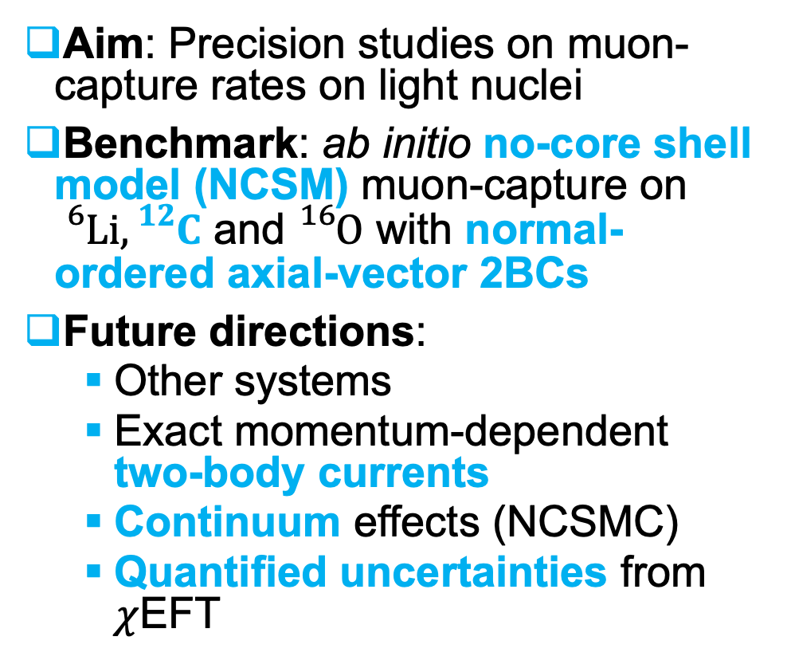
Ab Initio Studies on Muon Capture in Light Nuclei
Aim: Precision studies on muon-capture rates on light nuclei
Benchmark: ab initio no-core shell model (NCSM) muon-capture on ${}_{}^{6}{Li}, {}_{}^{12}C$ and ${}_{}^{16}O$ with normal-ordered axial-vector 2BCs
Future directions:
  Other systems
  Exact momentum-dependent two-body currents
  Continuum effects (NCSMC)
  Quantified uncertainties from $χ$EFT
LJ, P. Navrátil, J. Kotila, K. Kravvaris, Phys. Rev. C 109, 065501 (2024)

Slide 24
Momentum-Dependent Two-Body Currents
Next steps:
  The inclusion of normal-ordered vector 2BC
  The inclusion of exact momentum-dependent axial and vector 2BCs
  Application to other processes

Slide 25
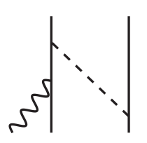
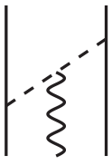
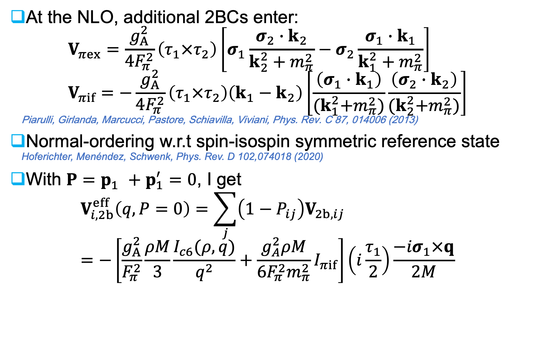
Normal-Ordered Vector Two-Body Currents (2BCs)
At the NLO, additional 2BCs enter:
$V_{πex}=\frac{g_{A}^{2}}{4F_{π}^{2}}\left(τ_{1}×τ_{2}\right)\left[σ_{1}\frac{σ_{2}∙k_{2}}{k_{2}^{2}+m_{π}^{2}}−σ_{2}\frac{σ_{1}∙k_{1}}{k_{1}^{2}+m_{π}^{2}}\right]$
$V_{πif}=−\frac{g_{A}^{2}}{4F_{π}^{2}}\left(τ_{1}×τ_{2}\right)\left(k_{1}−k_{2}\right)\left[\frac{\left(σ_{1}∙k_{1}\right)}{{(k}_{1}^{2}+m_{π}^{2})}\frac{\left(σ_{2}∙k_{2}\right)}{{(k}_{2}^{2}+m_{π}^{2})}\right]$
Piarulli, Girlanda, Marcucci, Pastore, Schiavilla, Viviani, Phys. Rev. C 87, 014006 (2013)
Normal-ordering w.r.t spin-isospin symmetric reference state
Hoferichter, Menéndez, Schwenk, Phys. Rev. D 102,074018 (2020)
With $P=p_{1}^{}+p_{1}^{′}=0$, I get
$V_{i,2b}^{eff}\left(q,P=0\right)=\sum_{j}{\left(1−P_{ij}\right)V_{2b,ij}}=−\left[\frac{g_{A}^{2}}{F_{π}^{2}}\frac{ρM}{3}\frac{I_{c6}(ρ,q)}{q^{2}}+\frac{g_{A}^{2}ρM}{6F_{π}^{2}m_{π}^{2}}I_{πif}\right]\left(i\frac{τ_{1}}{2}\right)\frac{−{iσ}_{1}×q}{2M}$
One-body operator

Slide 26
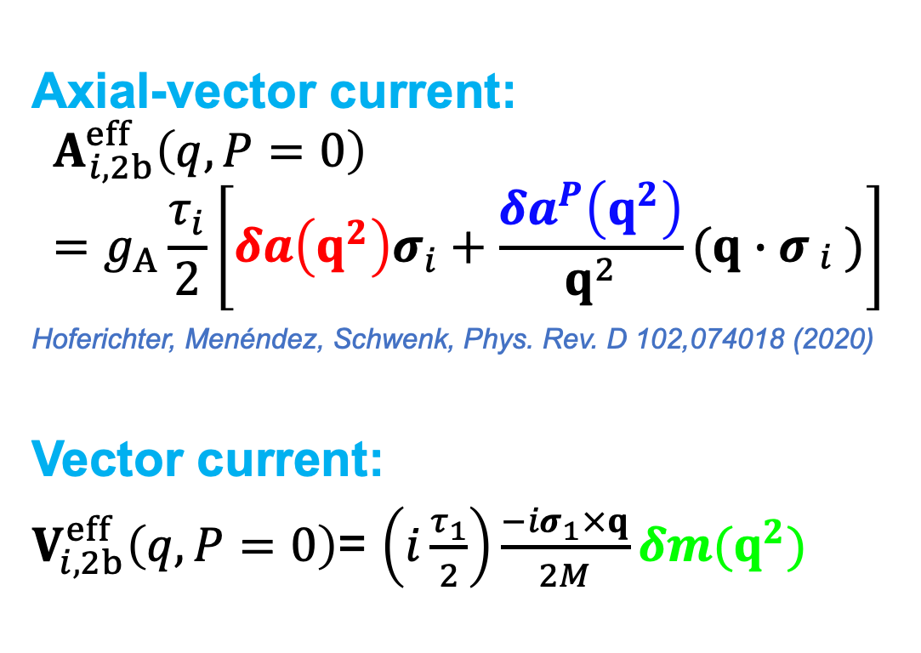
Normal-Ordered Two-Body Currents
Axial-vector current:
$$A_{i,2b}^{eff}\left(q,P=0\right)=g_{A}\frac{τ_{i}}{2}\left[δa\left(q^{2}\right)σ_{i}+\frac{δa^{P}\left(q^{2}\right)}{q^{2}}(q∙σ_{\begin{aligned}i \\ \end{aligned}})\right]$$
Hoferichter, Menéndez, Schwenk, Phys. Rev. D 102,074018 (2020)
Vector current:
$V_{i,2b}^{eff}\left(q,P=0\right)$= $\left(i\frac{τ_{1}}{2}\right)\frac{−{iσ}_{1}×q}{2M}δm(q^{2})$

Slide 27



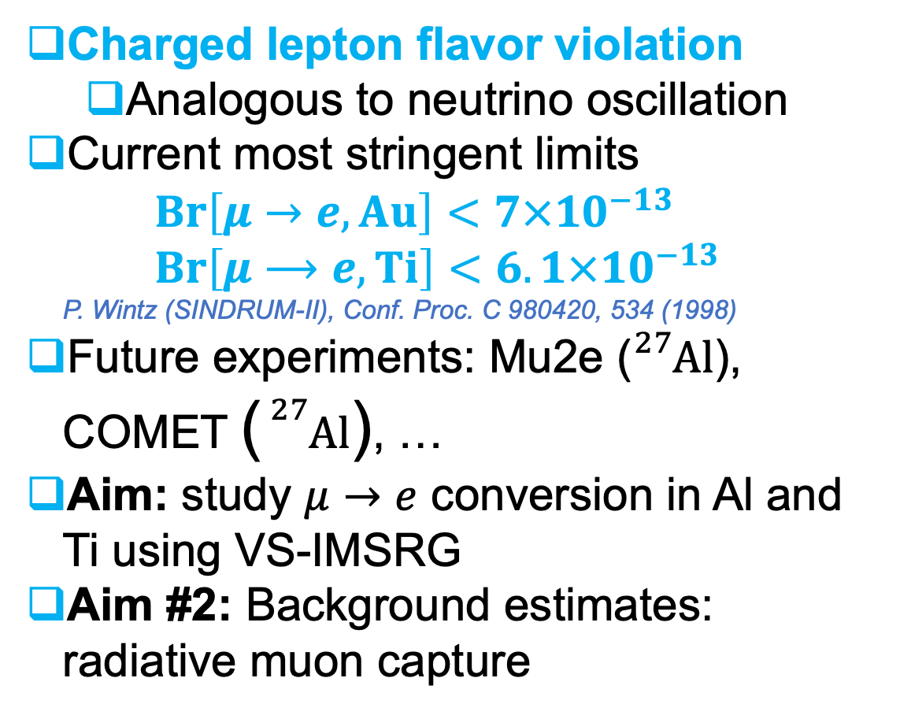

Muon-to-Electron Conversion
Charged lepton flavor violation
  Analogous to neutrino oscillation
Current most stringent limits
$Br\left[μ→e, Au\right]<7×{10}^{−13}$
$Br\left[μ⟶e,Ti\right]<6.1×{10}^{−13}$
P. Wintz (SINDRUM-II), Conf. Proc. C 980420, 534 (1998)
Future experiments: Mu2e (${}_{}^{27}{Al}$), COMET (${}_{}^{27}{Al}$), …
Aim: study $μ→e$ conversion in Al and Ti using VS-IMSRG
Aim #2: Background estimates: radiative muon capture
$E≈105$ MeV
$$\left(A,Z\right)+μ^{−}⟶\left(A,Z\right)+e^{−}$$

Slide 28
Forbidden Beta Decays

Slide 29
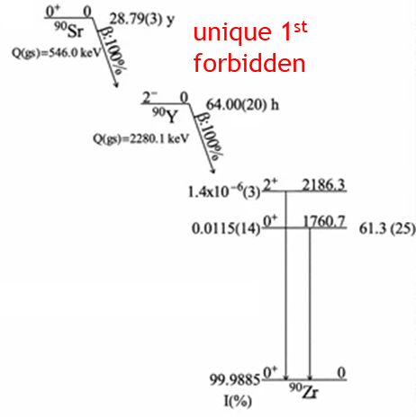


Forbidden Beta Decays
$$ΔJ=2, π_{i}≠π_{f}$$
1st forbidden $β$ decay rates sensitive to angular correlation and Fierz term (observables)
$dω∝{\left|(ψ_{f}||{\hat{H}}_{W}||ψ_{i})\right|}^{2}∝1+α_{βν}\left[1−{\left(\hat{β}∙\hat{ν}\right)}^{2}\right]+b_{F}\frac{m_{e}}{ε}$
A. Glick-Magid et al., Phys. Lett. B 767, 285 (2017)
$α_{βν}$ and $b_{F}$ involve possible BSM corrections
Ongoing experiments at SARAF and ORNL aiming at ${10}^{−3}$ accuracy
Aim: ab initio calculations for ¹⁶N (NCSM) and ⁹⁰Sr, ${}_{}^{90}Y$ (VS-IMSRG)
Morozov et al., J. Rad. Nucl. Chem. 284, 221 (2010)

Slide 30





Forbidden Beta Decay of ${}_{}^{16}N$
$${}_{}^{16}{N(2_{g.s.}^{−})}\underset{→}{β}{}_{}^{16}O(0_{g.s.}^{+})$$
$∆J=2, π_{i}≠π_{f}$ (first forbidden unique)
$$dω∝1+a_{βν}\left[1−{\left(\hat{β}∙\hat{ν}\right)}^{2}\right]+b_{F}\frac{m_{e}}{ε}$$
$b_{F}=0+δb+\frac{C_{T}^{+}}{C_{A}}\sim {10}^{−3}$
$a_{βν}=−\frac{1}{5}(1+\tilde{δ}a+\frac{{\left|C_{T}^{+}\right|}^{2}+{\left|C_{T}^{−}\right|}^{2}}{4{\left|C_{A}\right|}^{2}})$
SM
SM corr.
BSM
A. Glick-Magid, C. Forssén, D. Gazda, D. Gazit, LJ, P. Navrátil, in preparation
J. Suhonen, “From Nucleons to Nucleus: Concepts of Microscopic Nuclear Theory”
SM
SM corr.
BSM

Slide 31


Forbidden Beta Decay of ${}_{}^{90}{Sr}$ and ${}_{}^{90}Y$
Ongoing measurements for ${}_{}^{90}{Sr(0_{g.s.}^{+})}\underset{→}{β}{}_{}^{90}{Y(2_{g.s.}^{−})}$ and ${}_{}^{90}{Y(2_{g.s.}^{−})}\underset{→}{β}{}_{}^{90}{Zr(0_{g.s.}^{+})}$
(Hebrew University of Jerusalem)
Planned measurement for ${}_{}^{90}{Y(2_{g.s.}^{−})}\underset{→}{β}{}_{}^{90}{Zr(0_{g.s.}^{+})}$(ORNL)
NCSM not applicable ($A≫20$)
VS-IMSRG
Method:

Slide 32



Forbidden $β$ Decays for Astrophysics
–Possible student project
Forbidden $β$ decays shown to be important for r-process
  There are no ab initio predictions for this mass region
  Aim: Extend the VS-IMSRG studies to this region
N=50
N=82
N=126
T. Marketin, L. Huther & G. Martínez-Pinedo, Phys. Rev. C 93, 025805 (2016)

Slide 33
Neutrino-Nucleus Scattering
–Possible student project

Slide 34


Neutrino-Nucleus Scattering
Neutral current:
${ν_{l}}/{{\overline{ν}}_{l}}+\left(A,Z\right)⟶{\left(A,Z\right)}^{∗}+ν_{l}/{\overline{ν}}_{l}$
Charged current:
${ν_{l}}/{{\overline{ν}}_{l}}+\left(A,Z\right)⟶\left(A,Z±1\right)+l^{∓}$
Neutrino-nucleus cross-sections important for neutrino experiments DUNE, MINERvA, NOvA, T2K, …
Aim: cross-sections for ${}_{}^{12}C$ (liquid scintillators) and ${}_{}^{16}O$ (water Cherenkov detectors) in NCSM and ${}_{}^{40}{Ar}$ (Argon detectors) in VS-IMSRG
$$ν_{μ}+\left(A,Z\right)⟶\left(A,Z+1\right)+μ^{−}$$
Very similar to muon capture!

Slide 35



(Very) Rough Timeline
Forbidden $β$ decays for BSM physics
2025
2026
2027
2029
2028
2030
Muon capture with exact two-body currents
Neutrino-nucleus scattering
N2LO corrections to $0νββ$ decay from ab initio
Muon-to-electron conversion
Forbidden $β$ decays for astrophysics

Slide 36
Thank you
Merci
ljokiniemi@triumf.ca

